Slide 1
User-To-Device Access Control Models for Cloud-Enabled IoT With Smart Home Case Study
Ph.D. Dissertation Defense
Safwa Ameer
Institute for Cyber Security,
Department of Computer Science
The University of Texas at San Antonio
Committee:
Dr. Ravi Sandhu (Advisor and Chair)
Dr. Jianwei Niu
Dr. Ram Krishnan
Dr. Weining Zhang
Dr. Xiaoyin Wang
July 2021

Slide 2
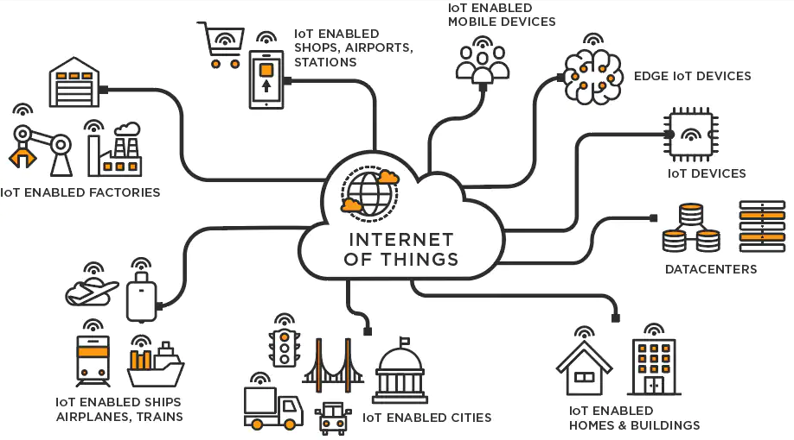
Internet of Things
The Internet of Things (IoT) is a new technology paradigm envisioned as a global network of physical objects (things) that are embedded with sensors, software, and other technologies for the purpose of connecting and exchanging data with other devices and systems over the Internet.

Slide 3
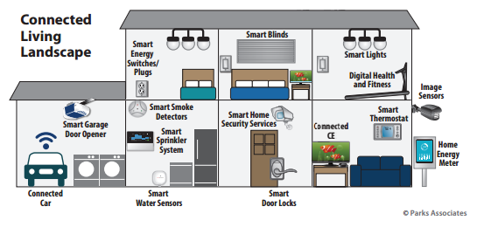
Smart Home IoT
Surprisingly, little attention has been paid to access control in home IoT.
AC issues have been explored extensively for many different domains.
The characteristics that make IoT distinct from prior computing domains necessitate a rethinking of access control and authentication.
The need arises for a dynamic and ﬁne-grained access control mechanism, where users and resources are constrained.

Slide 4
Problem Statement
In the literature, several access control models have been proposed for IoT in general.
Most of them are built on ABAC or RBAC.
Some researchers argue that RBAC is more suitable for IoT since it is simpler in management and review, while ABAC is complex.
Others argue that ABAC models are more scalable and dynamic, since they can capture different devices and environment contextual information.
Hence, when it comes to smart homes, at this point it is not fully clear what is the benefit of ABAC over RBAC, and vice versa.
Our intuitive insight is that a hybrid model will better capture smart home IoT access control requirements.

Slide 5
Thesis Statement
The established paradigms of role-based and attribute-based access control can be utilized, adapted, and extended to provide fine grained and dynamic authorization approaches for user to device access in smart home IoT. A detailed analysis of these approaches, their formal models, and implementation can ultimately be utilized to develop hybrid access control models that combine role-based and attribute-base access control features to meet smart home IoT challenges.

Slide 6
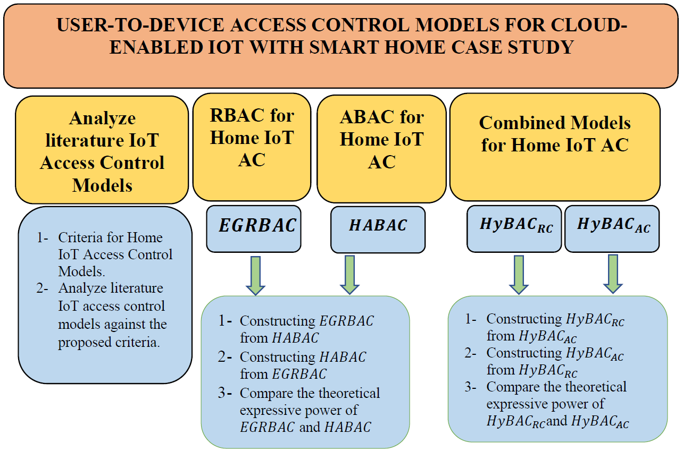
Summary of Contributions

Slide 7
Summary of Contributions
Notes:
Our first contribution is

Slide 8
Criteria for Smart Home IoT Access Control Models

Slide 9
Our Criteria for Smart Home IoT Access
Control Models
Based on the literature review that we have done, we believe that a smart home IoT access control model (whether it is device to device (D-D), user to device (U-D) or both) should exhibit, at least, the following characteristics:
  Dynamic, to capture environment and object contextual information.
  Fine-grained, so that a subset of the functionality of a device can be authorized rather than all-or-nothing access to the device.
  Suitable for constrained smart home devices. Smart things in homes are usually limited in term of computational power, and storage. Furthermore, a generic interoperability standard among IoT devices is still missing.

Slide 10
Our Criteria for Smart Home IoT Access
Control Models
  Constructed speciﬁcally for smart home IoT or otherwise be interpreted for the smart home domain such as by appropriate use cases. To ensure that the model is suitable for smart home different specifications such as, social relationships between house members, cost effectiveness, usability, and so on
  The model should be demonstrated in a proof-of-concept, to be credible using commercially available technology with necessary enhancements.
  The model should have a formal deﬁnition, so that there is a precise and rigorous speciﬁcation of the intended behavior.
We investigated literature’s IoT access control models that govern user to device access against our criteria, and notably no model satisfies all desired specifications.

Slide 11
Summary of Contributions

Slide 12
Role-Based Access Control Model for Smart Home IoT (EGRBAC)

Slide 13
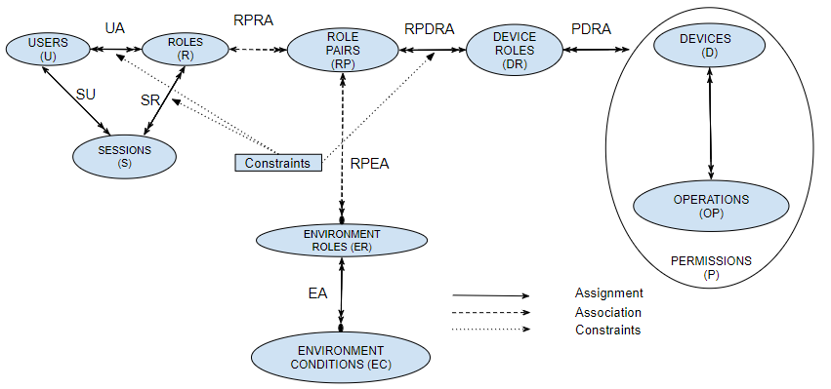
The EGRBAC Model

Slide 14

The EGRBAC Model
The main idea in EGRBAC as a whole is that a user is assigned to a set of roles and according to the current active sessions, and current active environment roles some role pairs will be active, the user will get access to the permissions assigned to the device roles which are assigned to the current active role pairs.

Slide 15

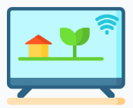








Use Case
( Kids, {Entertainment Time} )
$$OFF$$
$$ON$$
$$PG$$

Slide 16
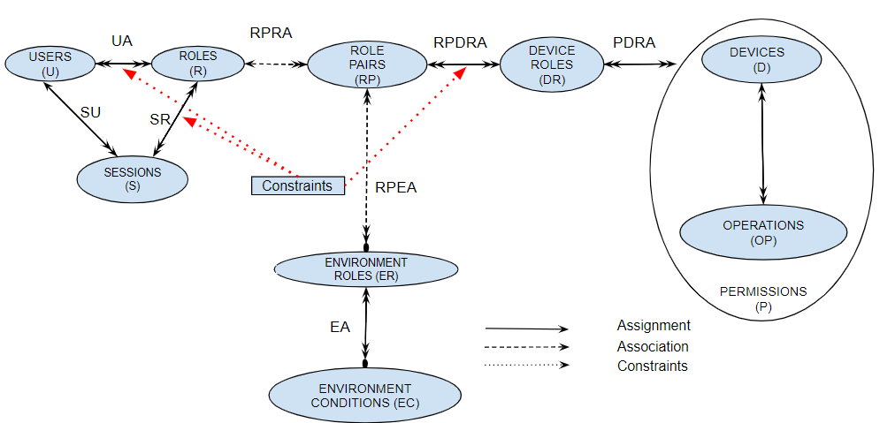
Constraints
A constraint is an invariant that must always be maintained.

Slide 17


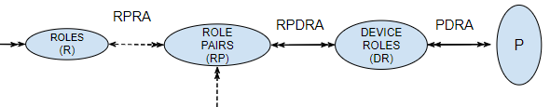



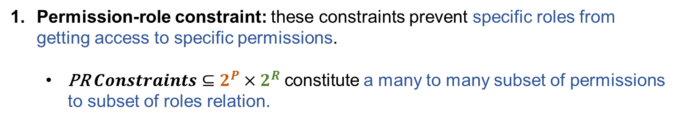

Constraints
Permission-role constraint: these constraints prevent specific roles from getting access to specific permissions.
  PR$Constraints⊆2^{P}×2^{R}$constitute a many to many subset of permissions to subset of roles relation.
$$Lock$$
$$ON$$
$$Unlock$$
$$OFF$$
$$\left(\left\{ \left(DoorLock, Lock\right), \left(DoorLock, Unlock\right), \left(Oven, On\right), \left(Oven, OFF\right) \right\} , \left\{ Kids \right\}\right)$$

Slide 18

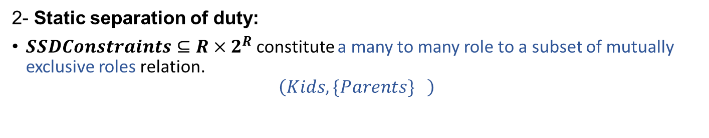
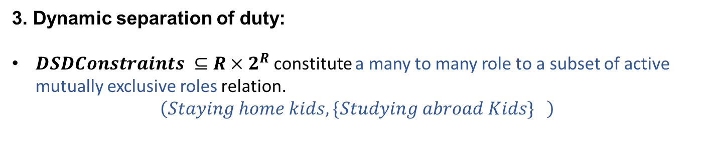
Constraints
2- Static separation of duty:
$SSDConstraints⊆R×2^{R}$constitute a many to many role to a subset of mutually exclusive roles relation.
$$\left(Kids, \{Parents\} \right)$$
Kids
Parents
3. Dynamic separation of duty:
$DSDConstraints ⊆R×2^{R}$constitute a many to many role to a subset of active mutually exclusive roles relation.
$$\left(Staying home kids, \{Studying abroad Kids\} \right)$$
Staying home kids
Studying abroad kids

Slide 19
Summary of Contributions

Slide 20
Attribute-Based Access Control Model for Smart Home IoT (HABAC)

Slide 21
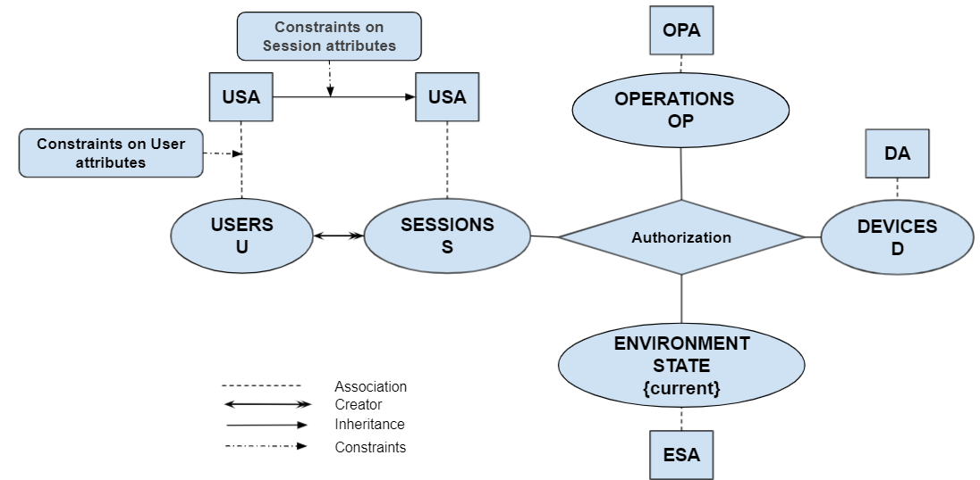
The HABAC Model

Slide 22
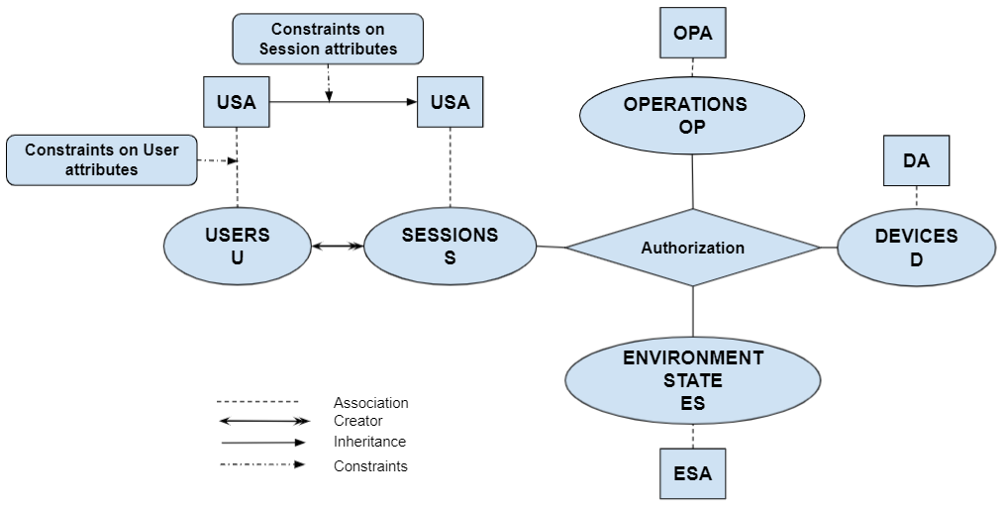


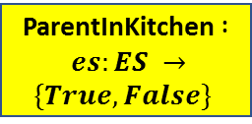


Use Case
$FamilRole\left(s\right)=teenager∧\text{DangerousKitchen} \text{Devices}\text{ (}\text{d}\text{) = }\text{True}$ ∧ ParentInKitchen (Current) = True
$FamilRole$($S_{X}$) = teenager
$FamilRole$(Anne) = teenager
DangerousKitchenDevices (Oven) = True
$${ S}_{x}$$
TRUE
ParentInKitchen (Current) = True
Current
ParentInKitchen $: es:ES →\{True, False\}$

Slide 23
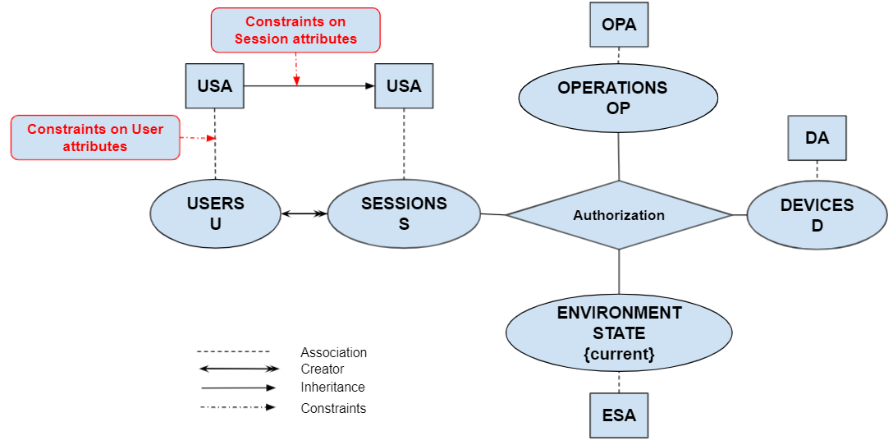
The HABAC Model

Slide 24

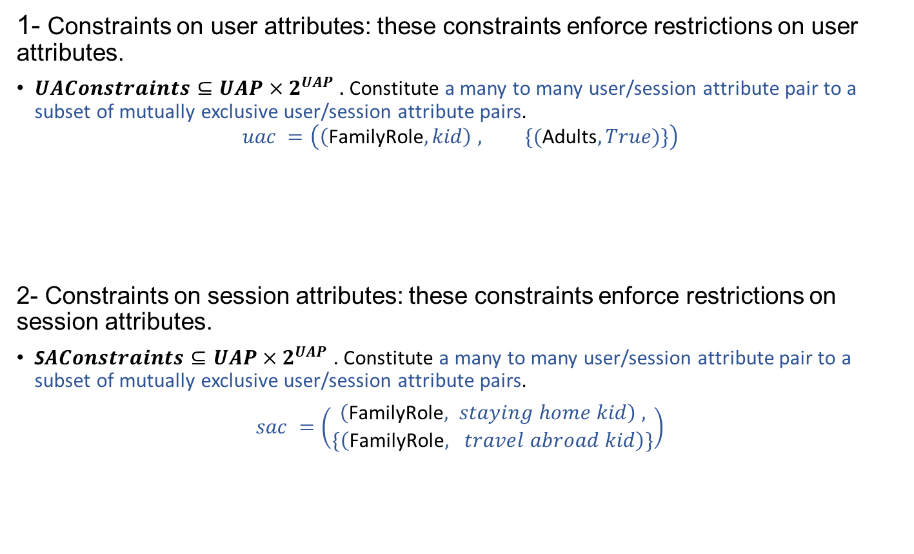
The HABAC Model
Constraints
1- Constraints on user attributes: these constraints enforce restrictions on user attributes.
$UAConstraints⊆UAP×2^{UAP} .$ Constitute a many to many user/session attribute pair to a subset of mutually exclusive user/session attribute pairs.
$$uac =\left(\left(\text{FamilyRole}, kid\right) , \{(\text{Adults}, True)\}\right)$$
2- Constraints on session attributes: these constraints enforce restrictions on session attributes.
S$AConstraints⊆UAP×2^{UAP} .$ Constitute a many to many user/session attribute pair to a subset of mutually exclusive user/session attribute pairs.
$sac =\left(\begin{aligned}\left(\text{FamilyRole}, staying home kid\right) , \\ \{\left(\text{FamilyRole}, travel abroad kid\right)\}\end{aligned}\right)$
(FamilyRole, kid)
(Adults, True)
(FamilyRole, staying home kid)
(FamilyRole, travel abroad kid)

Slide 25
Summary of Contributions

Slide 26
From HABAC to EGRBAC and Vice Versa

Slide 27
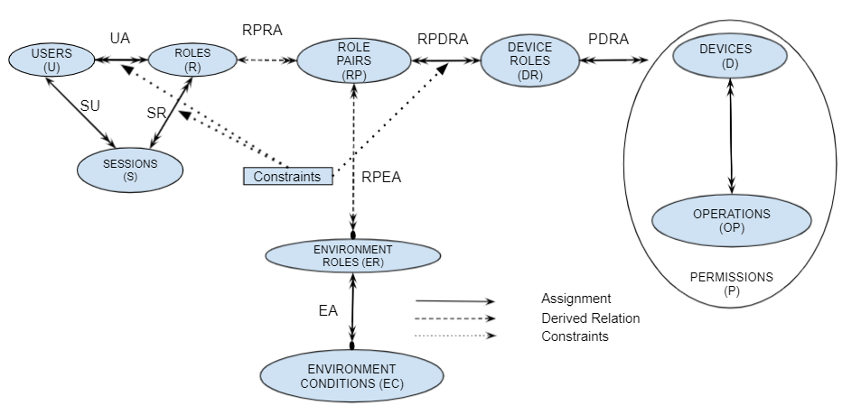
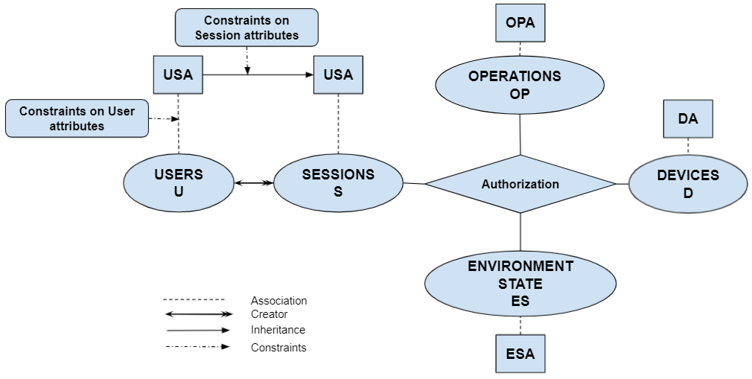


Constructing HABAC From EGRBAC
  The goal is to construct HABAC elements (U, UA, SA, ES, ESA, D, DA, OP, OPA) and the authorization policy function from EGRBAC policy in such a way that the authorizations are the same as those under EGRBAC.

Slide 28
Constructing EGRBAC From HABAC
  The goal is to construct EGRBAC elements (U, R, EC, ER, RP, D, OP, P, DR), assignments (UA, EA, PDRA, RPDRA), and associations (RPRA, RPEA) from HABAC policies in such a way that the authorizations are the same as those under HABAC.

Slide 29
HABAC Vs EGRBAC
1- In HABAC we can not create something equivalent to EGRBAC PRConstraints.

Slide 30
HABAC Vs EGRBAC
2- In EGRBAC it is easy to define who has what permissions, and who is not allowed to have a future access
to specific permissions.
1- In HABAC we can not create something equivalent to EGRBAC PRConstraints.

Slide 31
HABAC Vs EGRBAC
2- In EGRBAC it is easy to define who has what permissions, and who is not allowed to have a future access
to specific permissions.
3- in EGRBAC, we can’t handle HABAC policies that involve
users, devices and operations dynamic attributes. Such handling may lead to role explosion
in EGRBAC.
1- In HABAC we can not create something equivalent to EGRBAC PRConstraints.

Slide 32
Summary of Contributions

Slide 33
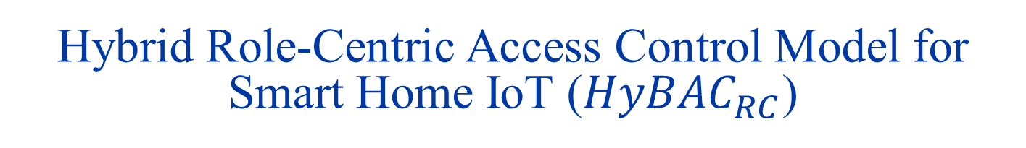
Hybrid Role-Centric Access Control Model for Smart Home IoT ($HyBAC_{RC}$)

Slide 34

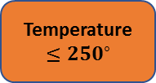
$$Motivation$$
(Teenagers, {Teenager Kitchen Time
} )
Dangerous Kitchen Devices
Temperature $≤250^{∘}$
Teenagers
Teenager Kitchen Time
ON
OFF
Parent is in the kitchen

Slide 35
$$Motivation$$
Low Temp. Oven
(Teenagers, {Teenager Kitchen Time
} )
High Temp. Oven
Temperature $≤250^{∘}$
Teenagers
In case of many devices this will lead to a role explosion
Teenager Kitchen Time
ON
OFF
Parent is in the kitchen

Slide 36
$$Motivation$$
Low Temp. Dangerous Kitchen Devices
High Temp. Dangerous Kitchen Devices
Temperature $≤250^{∘}$
Teenagers
We would still need to add mechanism to dynamically activate or deactivate devices membership in different device roles according to their temperatures
Teenager Kitchen Time
ON
OFF
Parent is in the kitchen

Slide 37
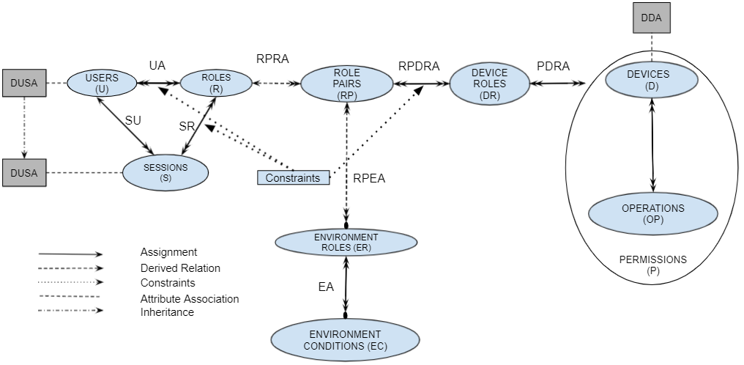
$$HyBAC_{RC}$$

Slide 38
$$HyBAC_{RC}$$
The check access predicate will evaluate to True if and only if:
The requirements of role membership and role activation specified by EGRBAC are true.
The authorization function evaluates to True.

Slide 39
Summary of Contributions

Slide 40
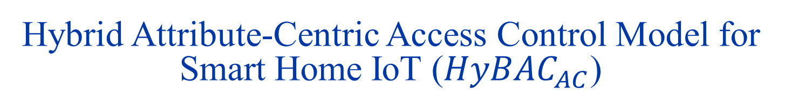
Hybrid Attribute-Centric Access Control Model for Smart Home IoT ($HyBAC_{AC}$)

Slide 41
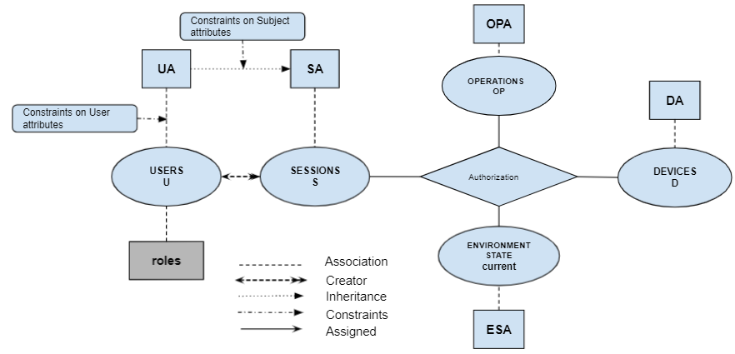
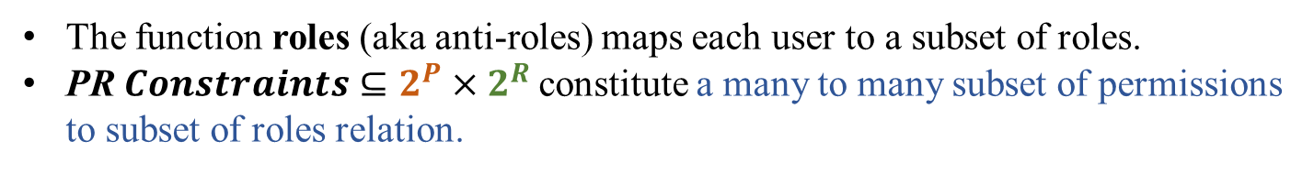
$$HyBAC_{AC}$$
The function roles (aka anti-roles) maps each user to a subset of roles.
PR$Constraints⊆2^{P}×2^{R}$constitute a many to many subset of permissions to subset of roles relation.

Slide 42
$$HyBAC_{AC}$$
The check access predicate will evaluate to True if and only if:
The requested operation is assigned to the requested device by the device manufacturer.
The authorization function evaluates to True.
There is no permission role constraint in the set of permission role constraints that prevent this access.

Slide 43
Summary of Contributions

Slide 44
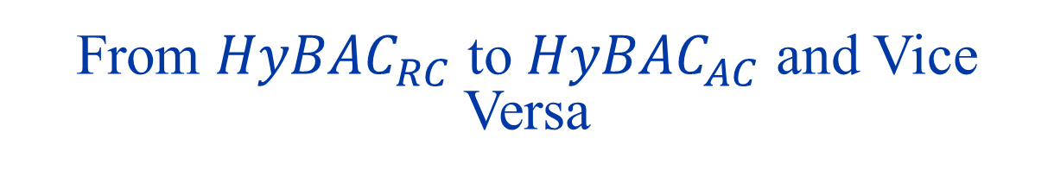
From $HyBAC_{RC}$ to $HyBAC_{AC}$ and Vice Versa

Slide 45
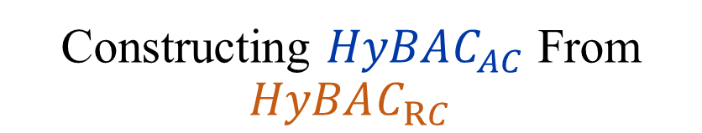
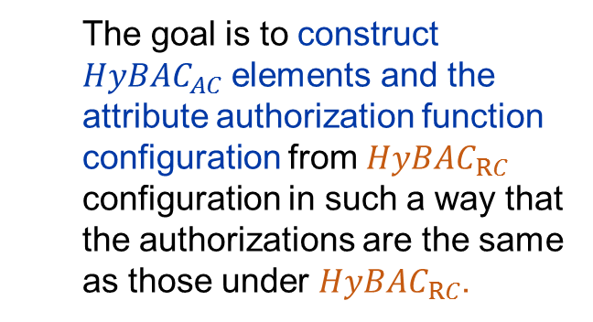
Constructing $HyBAC_{AC}$ From $HyBAC_{RC}$
  The goal is to construct $HyBAC_{AC}$ elements and the attribute authorization function configuration from $HyBAC_{RC}$ configuration in such a way that the authorizations are the same as those under $HyBAC_{RC}$.

Slide 46
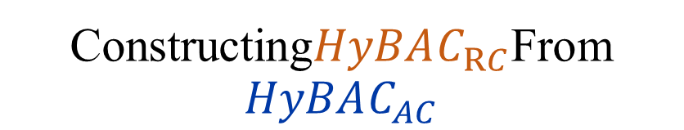
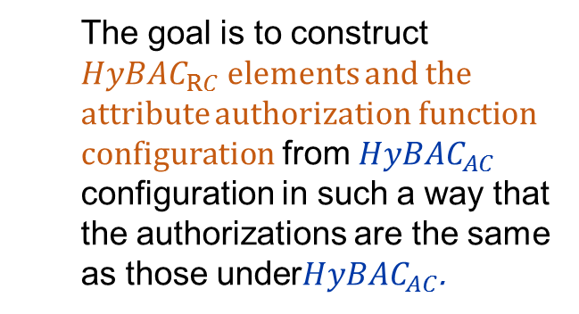
Constructing$HyBAC_{RC}$From $HyBAC_{AC}$
  The goal is to construct $HyBAC_{RC}$elements and the attribute authorization function configuration from $HyBAC_{AC}$ configuration in such a way that the authorizations are the same as those under$HyBAC_{AC}$.

Slide 47
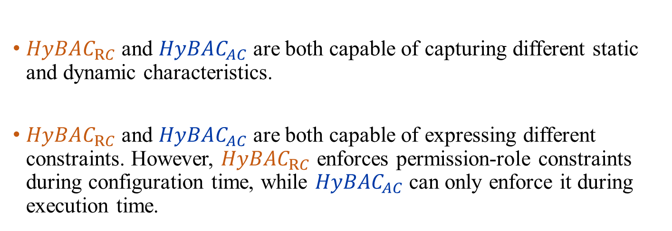

$HyBAC_{RC}$ Vs $HyBAC_{AC}$
$HyBAC_{RC}$ and $HyBAC_{AC}$ are both capable of capturing different static and dynamic characteristics.
$HyBAC_{RC}$ and $HyBAC_{AC}$ are both capable of expressing different constraints. However, $HyBAC_{RC}$ enforces permission-role constraints during configuration time, while $HyBAC_{AC}$ can only enforce it during execution time.

Slide 48
Implementation

Slide 49
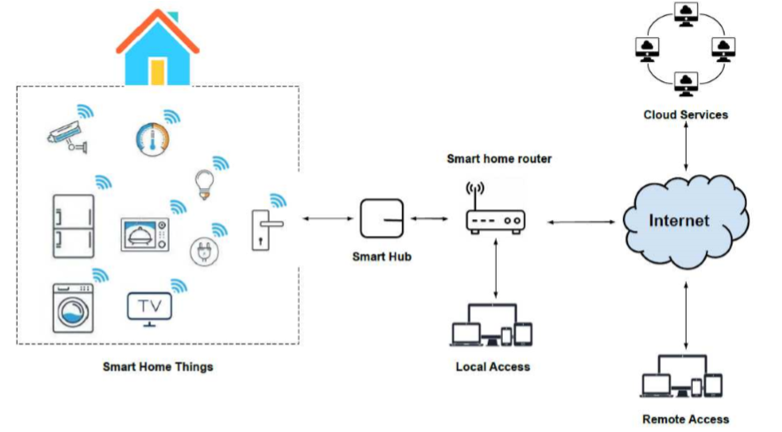
Enforcement Architecture
Adapted from [1]
There are two types of requests: A- Local requests. B- Remote requests.
We implemented our model using AWS IoT service.

Slide 50




EGRBAC Enforcement
$$Policy$$
User Assignments
AWS IoT Greengrass

Slide 51
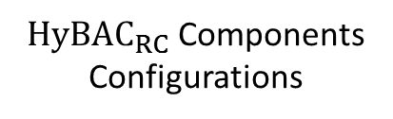
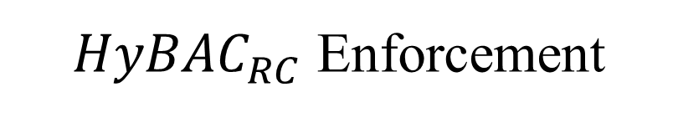
$HyBAC_{RC}$ Enforcement
$HyBAC_{RC}$ Components Configurations
User Assignments
Dynamic Attributes
AWS IoT Greengrass

Slide 52
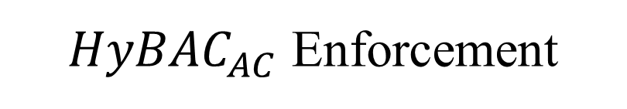
$HyBAC_{AC}$ Enforcement
Devices Attributes
User Attributes
Operations Attributes
Environment Attributes
AWS IoT Greengrass

Slide 53
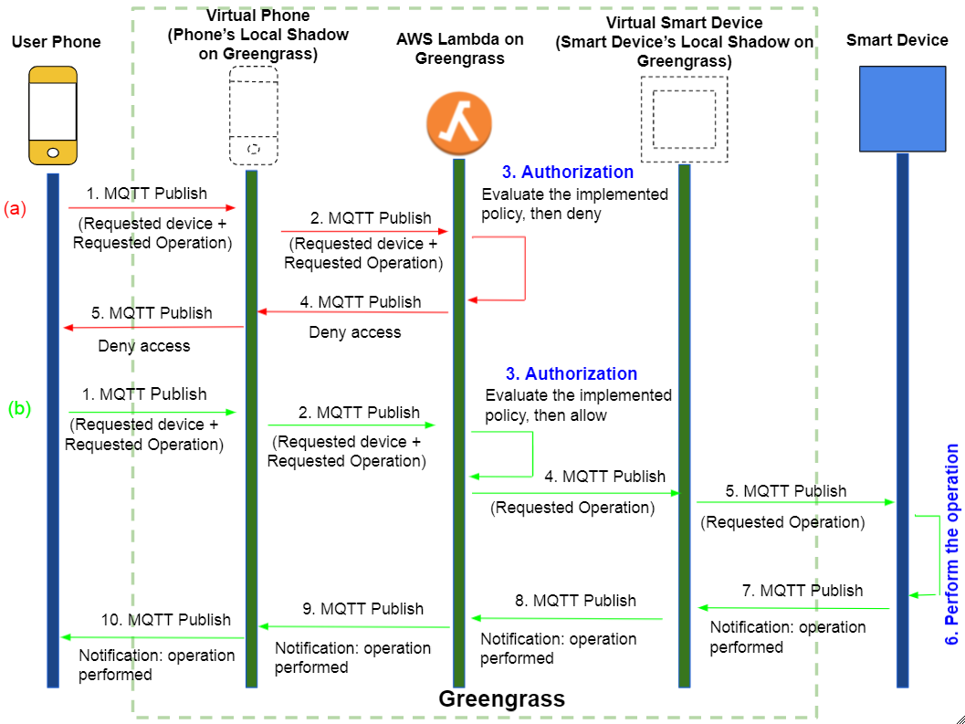
Sequence Diagram

Slide 54
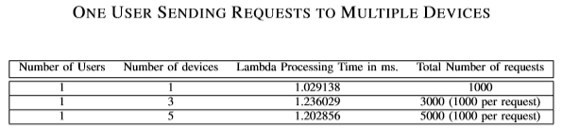
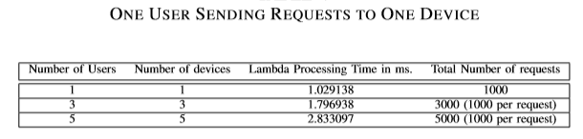
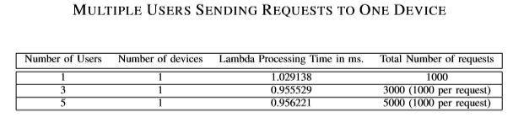
EGRBAC Performance Analysis
We conducted a performance test to depict how our system responds in different scenarios with different loads.
The results show that our model is functional, and applicable.

Slide 55
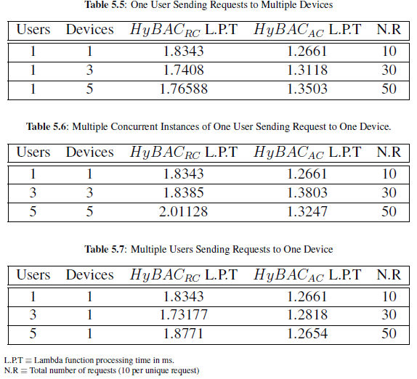
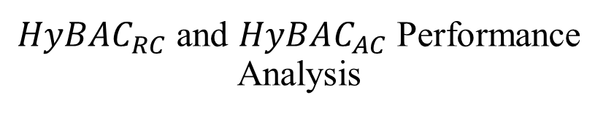
$HyBAC_{RC}$ and $HyBAC_{AC}$ Performance Analysis

Slide 56
Theoretical Comparison

Slide 57
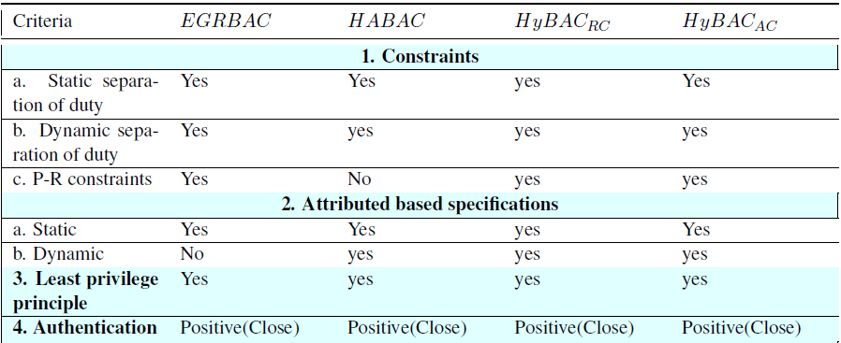
A Comprehensive Comparison
1- Basic and Main Criteria
This Criteria is adapted from [2]

Slide 58
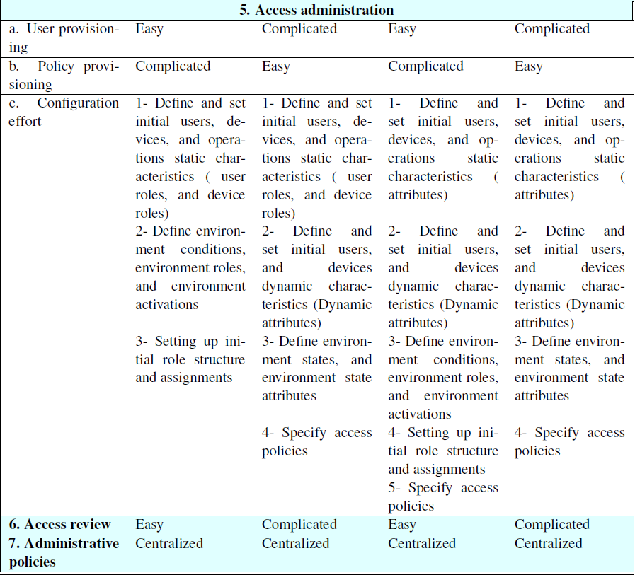
A Comprehensive Comparison
1- Basic and Main Criteria

Slide 59
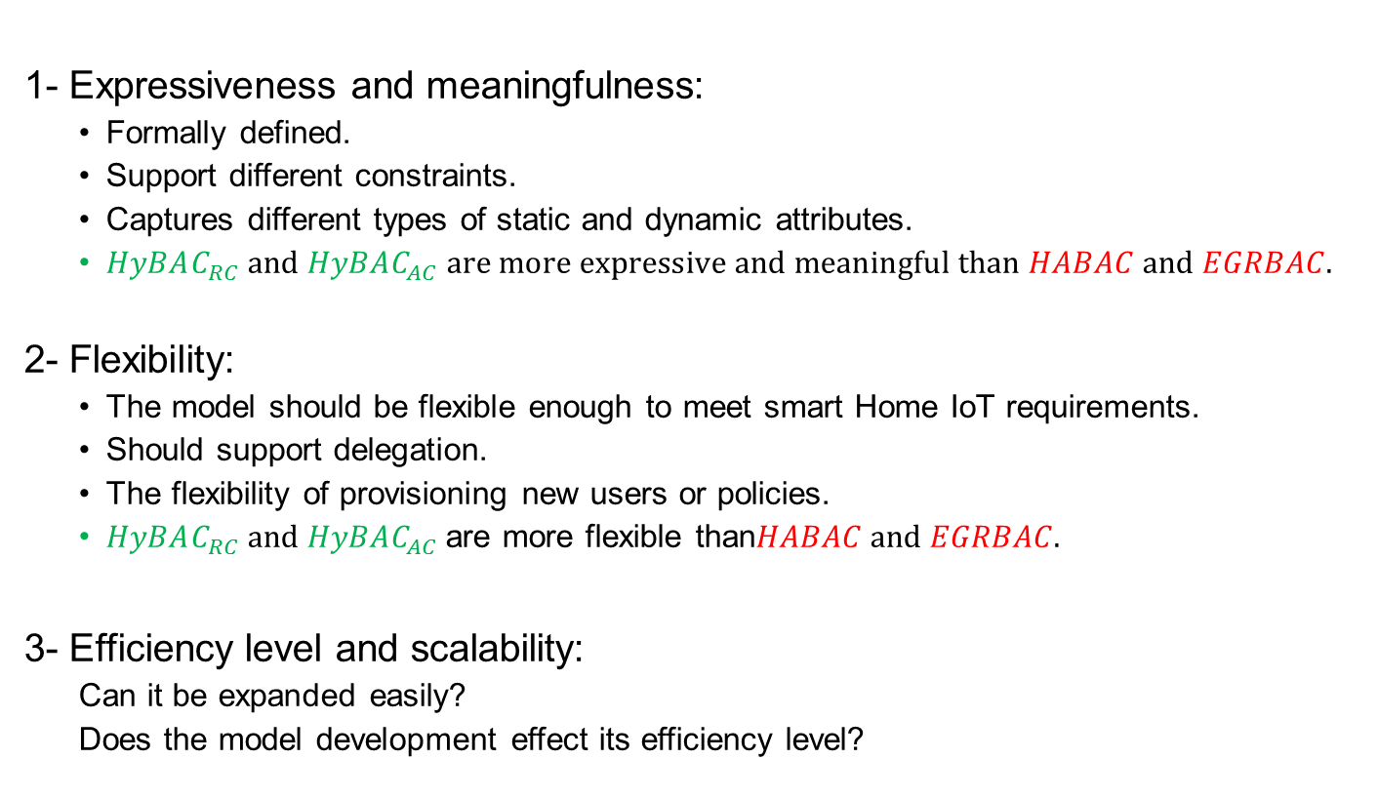
A Comprehensive Comparison
2- Quality Criteria
1- Expressiveness and meaningfulness:
  Formally defined.
  Support different constraints.
  Captures different types of static and dynamic attributes.
  $HyBAC_{RC} and HyBAC_{AC} are more expressive and meaningful than HABAC and EGRBAC.$
2- Flexibility:
  The model should be flexible enough to meet smart Home IoT requirements.
  Should support delegation.
  The flexibility of provisioning new users or policies.
  $HyBAC_{RC} and HyBAC_{AC}$are more flexible than$HABAC and EGRBAC.$
3- Efficiency level and scalability:
  Can it be expanded easily?
  Does the model development effect its efficiency level?

Slide 60
Conclusion

Slide 61
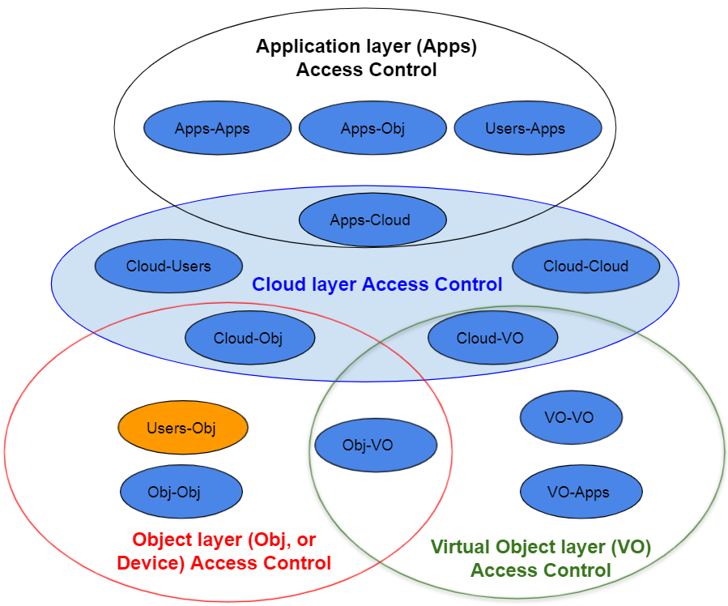
Some Future Directions

Slide 62
Dissertation Publications
Conference papers:
Ameer, Safwa, James Benson, and Ravi Sandhu. "The EGRBAC Model for Smart Home IoT." In 2020 IEEE 21st International Conference on Information Reuse and Integration for Data Science (IRI), pp. 457-462. IEEE, 2020. (Published)
Ameer, Safwa, and Ravi Sandhu. “The HABAC Model for Smart Home IoT and Comparison to EGRBAC”. In the Proceedings of the ACM Workshop on Secure and Trustworthy Cyber-Physical Systems (SaT-CPS 2021). (Published)
Journal papers:
Ameer, Safwa, James Benson, and Ravi Sandhu. “Hybrid Approaches (ABAC and RBAC) Toward Secure Access Control in Smart Home IoT”. To be submitted to IEEE Trans. on Dependable and Secure Computing.
Ameer, Safwa, and Ravi Sandhu. “ An ABAC Approach toward secure Access Control in Smart Home IoT”. Got invitation to be submitted to Special Issue "Secure and Trustworthy Cyber–Physical Systems“ in Information.

Slide 63
Refrences
[1] Dimitris Geneiatakis, Ioannis Kounelis, Ricardo Neisse, Igor Nai-Fovino, Gary Steri, and Gianmarco Baldini. Security and privacy issues for an IoT based smart home. In 2017 40th MIPRO. IEEE, 2017.
[2] Shabnam Mohammad Hasani and Nasser Modiri. Criteria specifications for the comparison and evaluation of access control models. International Journal of Computer Network and Information Security, 2013.

Slide 64
Thank you!
Questions?

