Slide 1
Attribute-Based Access and Communication Control Models for Cloud and Cloud-Enabled Internet of Things
Ph.D. Dissertation Defense:
Smriti Bhatt
Institute for Cyber Security (ICS)
Department of Computer Science
University of Texas at San Antonio
Ph.D. Dissertation Committee:
Dr. Ravi Sandhu, Chair
Dr. Murtuza Jadliwala
Dr. Palden Lama
Dr. Gregory White
Dr. Rohit Valecha

Slide 2


Introduction
Cloud-Enabled IoT (CE-IoT)
Security and Privacy
Internet of Things (IoT) [*]
*Source: https://en.wikipedia.org/wiki/Internet_of_things#/media/File:Internet_of_Things.jpg

Slide 3
Introduction
Access Control
Secure data, information, and resources from unauthorized entities
Communication Control
Secure communication and data flow from one component to other
Traditional Access Control Models:
Discretionary Access Control (DAC) – Ownership,
Mandatory Access Control (MAC) – Security Levels,
Role-Based Access Control (RBAC) – Roles,
Attribute-Based Access Control (ABAC) – Attributes, …
Communication Control Examples: Firewall, Routing Tables, Guards, …
Formal models ???

Slide 4
Introduction
Cloud & CE-IoT
Access Control
Secure data, information, and resources from unauthorized entities
Communication Control
Secure communication and data flow from one component to other
Attribute-Based Approach
Attribute-Based Access Control
(ABAC)
Attribute-Based Communication Control
(ABCC)

Slide 5
Problem Statement
Significant gap between theoretical ABAC models and their application in real-world Cloud and CE-IoT platforms
Fundamental lack of knowledge and academic literature on Attribute-Based Communication Control (ABCC), a novel concept
Lack of ABCC models focused on CE-IoT context
Thesis Statement:
A flexible attribute-based approach can be utilized to address security and privacy issues in the dynamic and rapidly progressive Cloud Computing and CE-IoT architectures. A detailed exploration of ABAC and ABCC, their formal models, and implementation in different contexts concerning Cloud Computing and CE-IoT can ultimately strengthen the access, authorization, and communication framework in these domains.

Slide 6
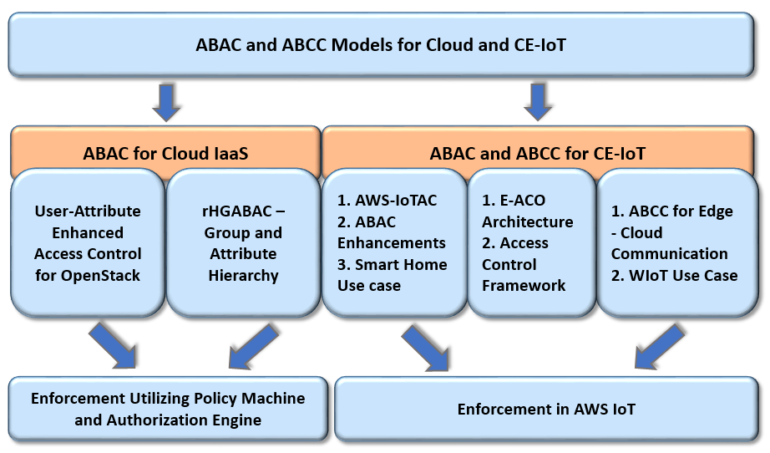
Summary of Contributions

Slide 7




Attribute-Based Approach
Entities
Attributes
Policies
Operations
read, write, send, …
name,
title,
type,
created_by,
owner,
…
Rule 1,
Rule 2,
…
Decision Function
User
IoT Devices
File
Example: Attribute-Based Authorization
User (u)
Object (o)
Auth_{read} ≡ title(u) = Manager ʌ type(o) = Sensitive
Auth_{write} ≡ name(u) = created_by(o)
Auth_{read} (u, o)
name: Alice
title: Manager
type: Sensitive
created_by: Alice

Slide 8
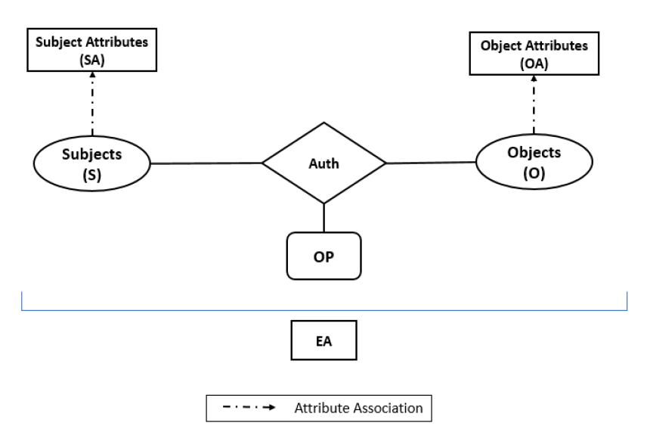
Attribute-Based Access Control
Background
name, title, …
type, created_by, …
users, processes, …
files, databases, …
read, write, …
Environment/Context Attribute: time, location, trust_level, …
Next-Generation Access Control (NGAC) – By NIST
Gartner predicts 2014 – “By 2020, 70 percent of enterprises will use ABAC as the dominant mechanism to protect critical assets” [source: https://www.tripwire.com/state-of-security/security-data-protection/security-controls/rbac-is-dead-now-what/]

Slide 9
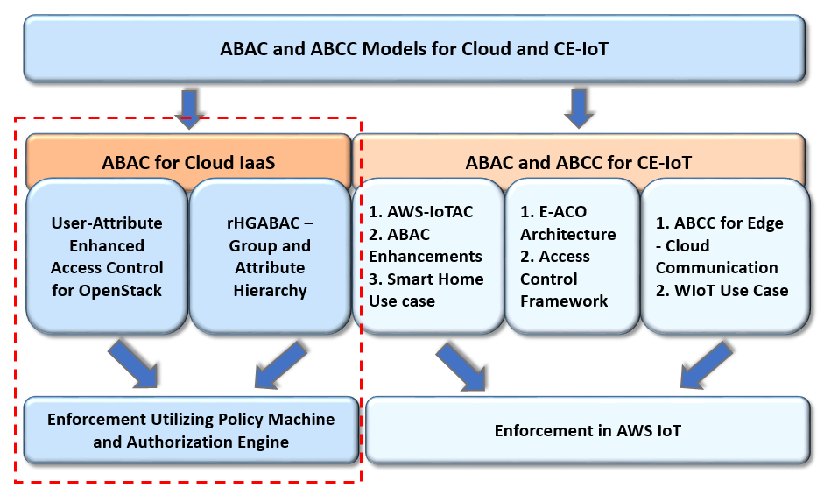
Summary of Contributions

Slide 10
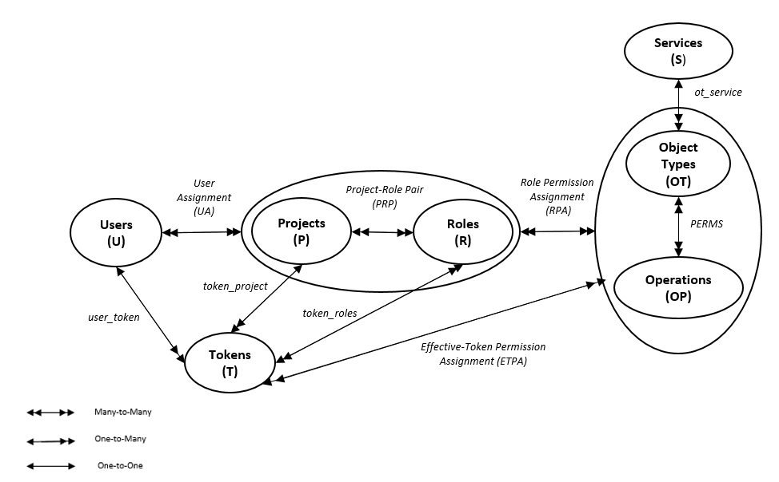
OpenStack Access Control (OSAC) Model
Users ←→ Roles ←→ Permissions on Objects
Union of role permissions
Union of role permissions based on the token of a user
Fig. 1: Simplified OSAC Model (Adapted from Tang et al., 2014)

Slide 11
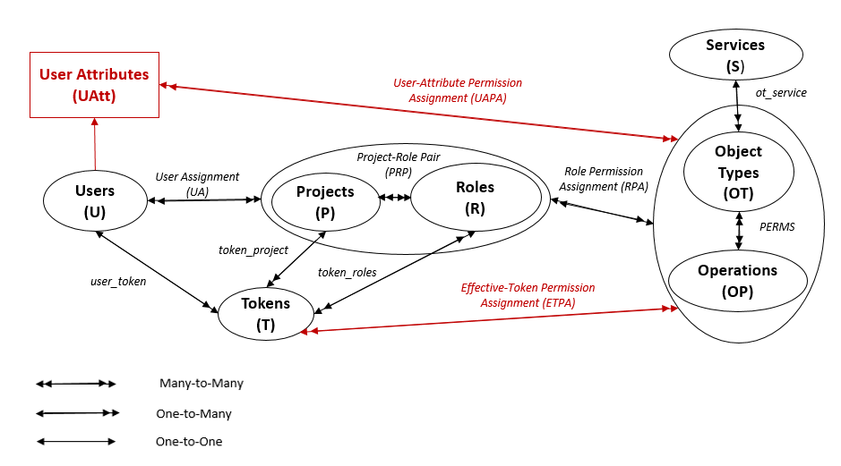

User-Attribute Enhanced OSAC Model
Role-Centric ABAC (Roles + Attributes)
Union of attribute-value permissions

Slide 12
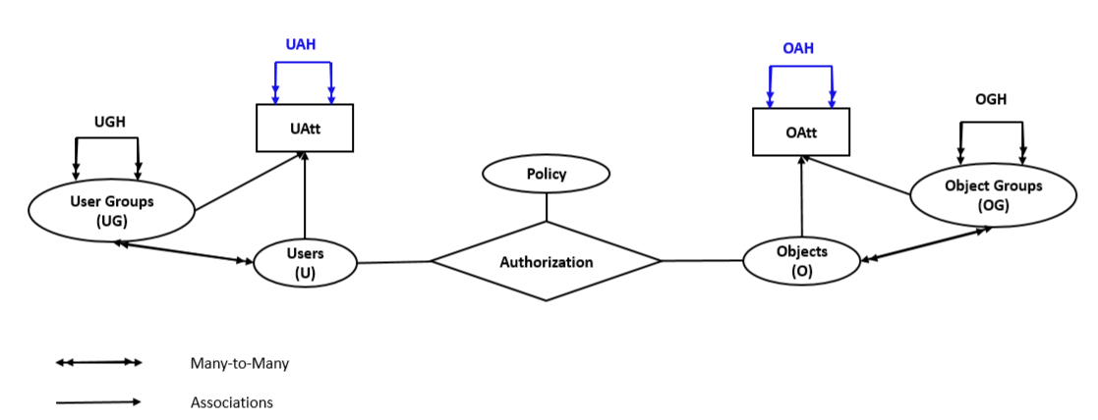
rHGABAC Model
Facilitate attribute assignment through Group and Attribute Hierarchy
Attribute Hierarchy
→ Formalized as Single-Value Enumerated Authorization Policy
e.g., Policy_{read} = (Manager, Private)
uav
oav
Fig. 2: Restricted Hierarchical Group and Attribute-Based Access Control (rHGABAC) Model Extended from HGABAC [Servos and Osborn, 2015]

Slide 13
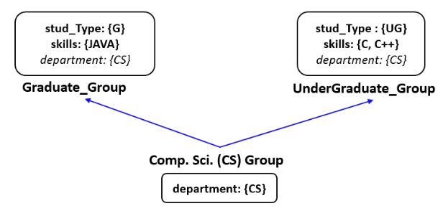
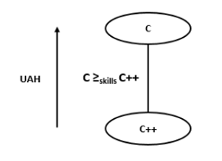
Group and Attribute Hierarchy
Group Attribute Inheritance
skills = {C, C++, Java}
a) An Example of User Group Hierarchy
(Adapted from [Gupta and Sandhu, 2016])
b) User Attribute-value Hierarchy

Slide 14
Enforcement
A novel enforcement architecture utilizing Policy Machine (by NIST) and Authorization Engine (our custom implementation component)
Policy Machine (PM):
  an open-source ABAC framework to express and enforce access control policies
Authorization Engine (AE):
  a RESTful service as an interface between PM and applications
  provide authorization decisions (Allow/Deny)
PM Core Elements
Users
Objects
User Attributes
Object Attributes
Operations
Policy Classes, …
assignment— relationships between policies, users and user attributes, objects and object attributes
association – authorization policies based on attributes
PM Relations
Assignment
Association
Prohibition
Obligation

Slide 15
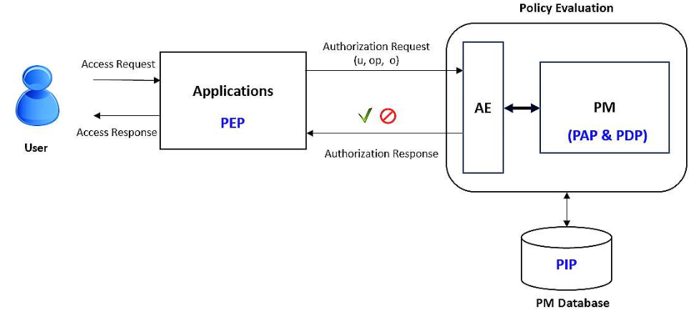
Enforcement Architecture
e.g., OpenStack
PAP - Policy Administration Point
PDP - Policy Decision Point
PEP – Policy Enforcement Point
PIP – Policy Information Point
Fig. 3: Authorization Architecture Utilizing PM and AE

Slide 16
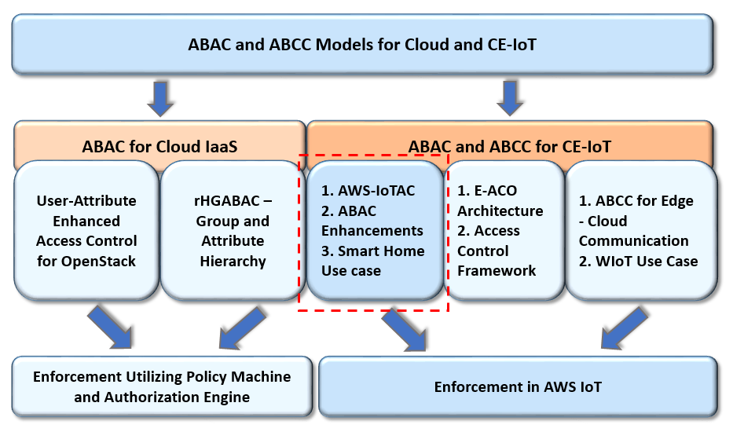
Summary of Contributions

Slide 17
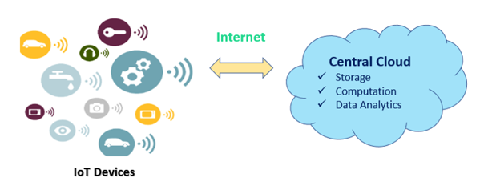
ABAC for Cloud-Enabled IoT
Cloud-Enabled IoT (CE-IoT)
  Seamless communication (devices-to-cloud, cloud-to-devices)
  Unlimited resources → compute, storage, etc.
  Meaningful insights → Data Analytics and Visualizations
  Virtual things/devices management, access control management, …
Security and Privacy
Edge Computing (Cloudlets)

Slide 18
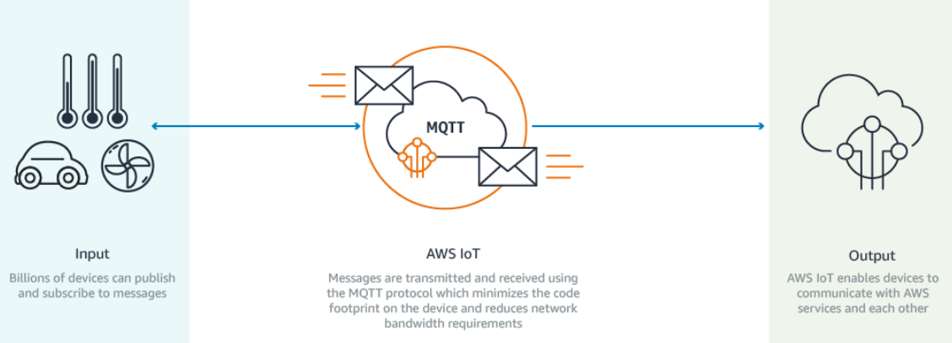
AWS IoT Access Control Model
Amazon Web Services (AWS) IoT – a CE-IoT platform
Currently utilize customized policy-based access control
Lack a formal access control model for controlling access and authorization in cloud-enabled IoT
[Source: AWS Website]

Slide 19
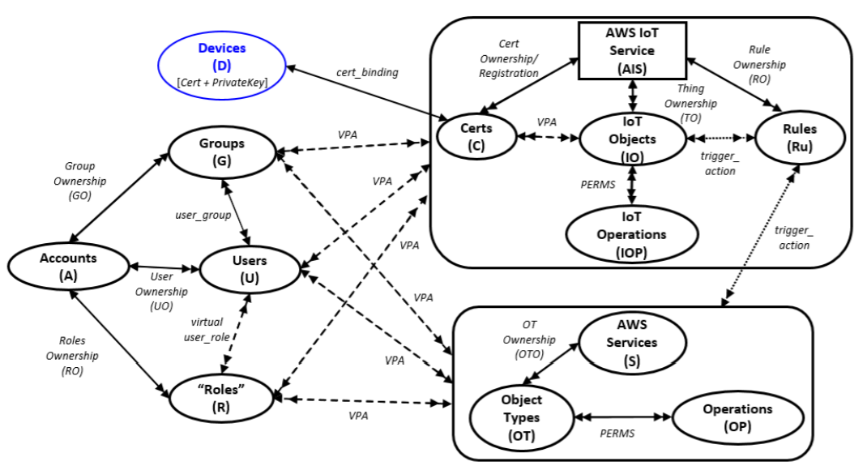
AWS-IoTAC Model
Fig. 4: AWS IoT Access Control (AWS-IoTAC) Model within a Single Account
Extended from Zhang et al., 2015

Slide 20
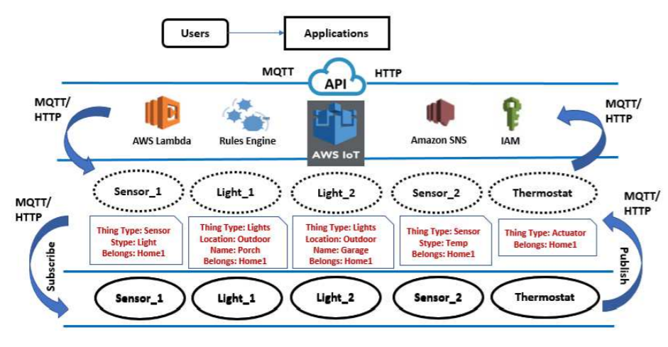
Smart Home Use Case in AWS IoT
Fig. 5: Smart-Home Use Case Utilizing AWS IoT and Cloud Services

Slide 21
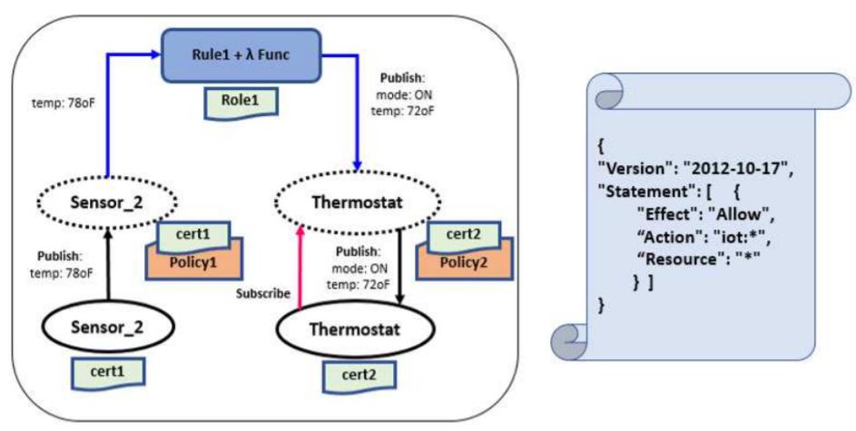
Use Case – Scenario 1
Existing AWS Policy Structure: Allows all the IoT operations on any resource in AWS IoT
A temperature sensor and thermostat use case

Slide 22
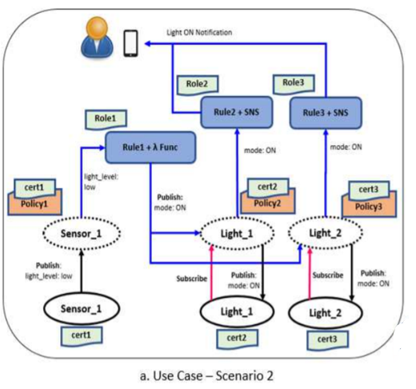
Use Case – Scenario 2
Sensor Attribute:
Belongs = Home1
Light Attributes:
Location = Outdoor
Belongs = Home1

Slide 23
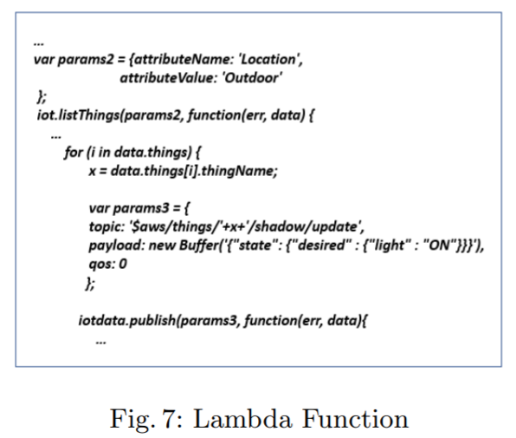
ABAC Policy – Scenario 2
Utilizing target things attributes through AWS Lambda function
Search and list things with attribute name = Location & attribute value = Outdoor
Publish update on all thing shadows (outdoor lights here) that has attribute “Location = Outdoor” to turn on outdoor lights
AWS Lambda Function

Slide 24
ABAC Enhancements for AWS-IoTAC
ABAC Including Attributes of Target Resources
  Attributes of source and target things
ABAC Including User and Group Attributes
  Attributes besides thing attributes in access control policies
Policy Management Utilizing the Policy Machine
  Policy-Explosion
  Customized policy management for enterprises

Slide 25
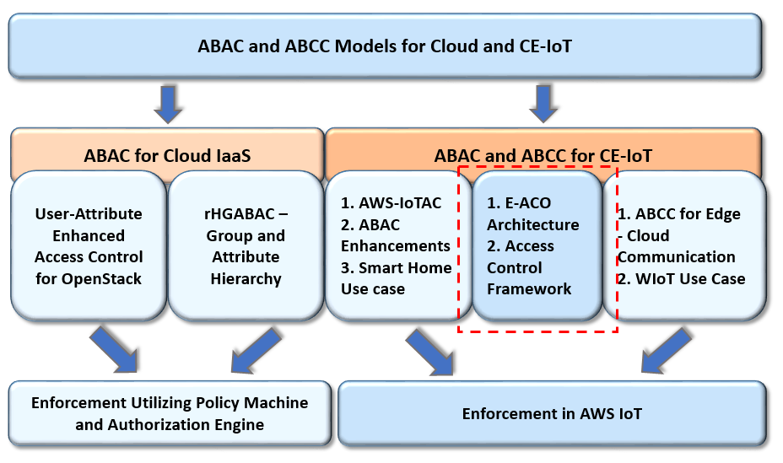
Summary of Contributions

Slide 26
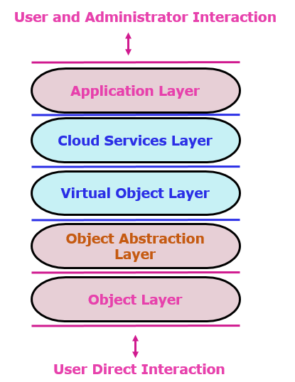
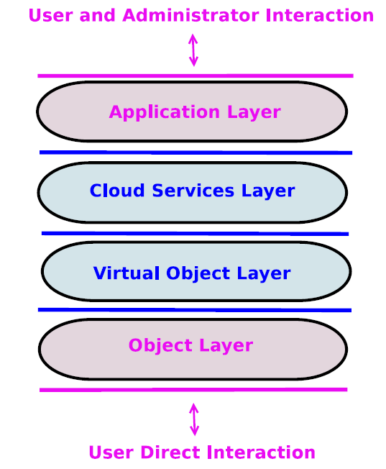
Enhanced ACO Architecture for CE-IOT
a) Access Control Oriented (ACO) Architecture [Alshehri and Sandhu, 2016]
b) Enhanced ACO (E-ACO) Architecture

Slide 27
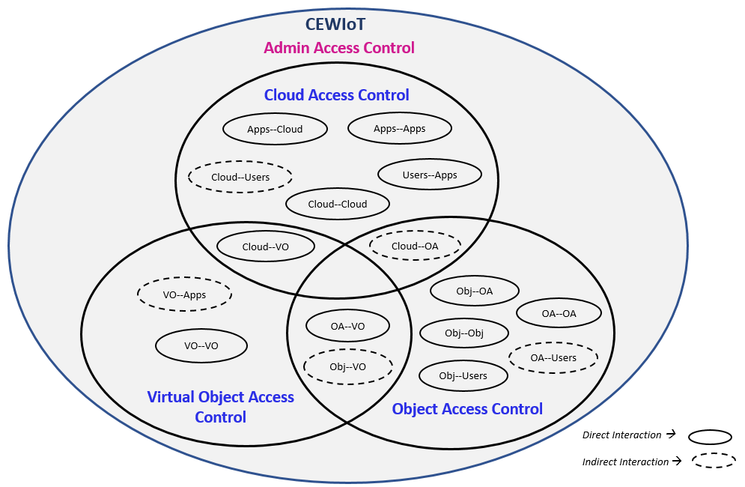
Access Control Framework
AWS-IoTAC Model
Policy-based access control
ABAC in limited form
- Client Attributes
- Target Attributes
CE-IoT
Alshehri and Sandhu, 2017
VO-VO communications
Operational and Administrative Access Control Models
- ACLs, CapBAC, RBAC, ABAC

Slide 28
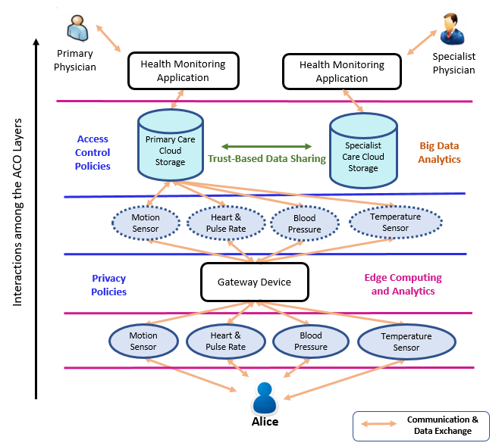
Wearable IoT Use Case
Fig. 6: Remote Health and Fitness Monitoring (RHFM) Example

Slide 29
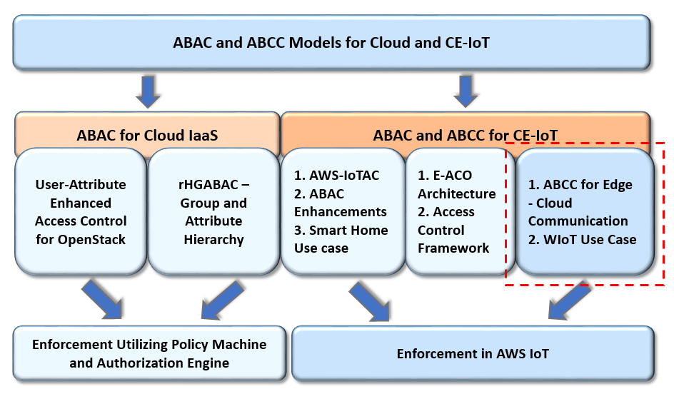
Summary of Contributions

Slide 30
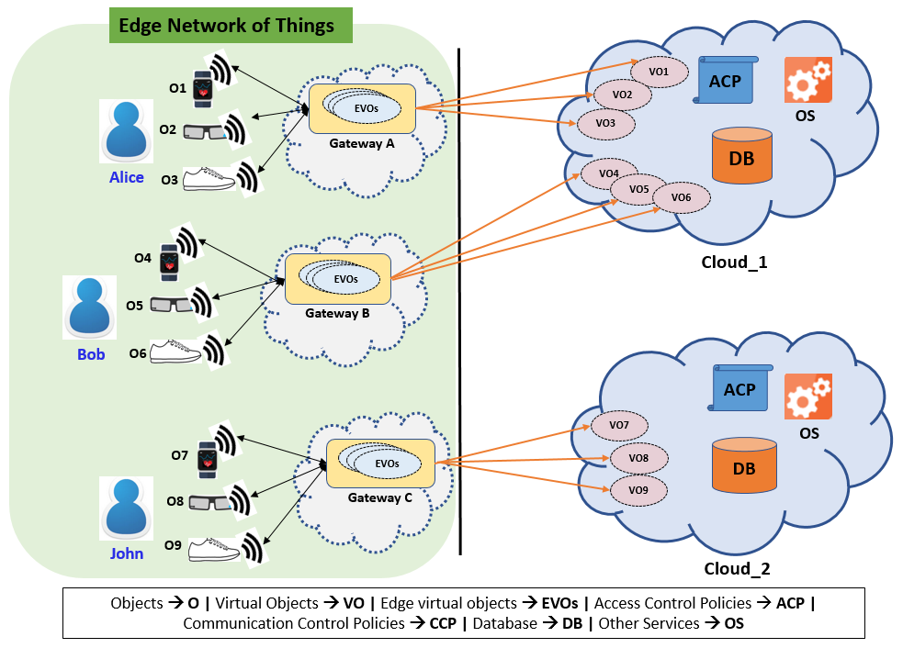
Communication Control in CE-IoT
Certificate and Crypto Based Communication control
Attribute-Based Communication Control
CCP
Bandwidth and Latency
User-Centric Privacy
CCP
CCP

Slide 31
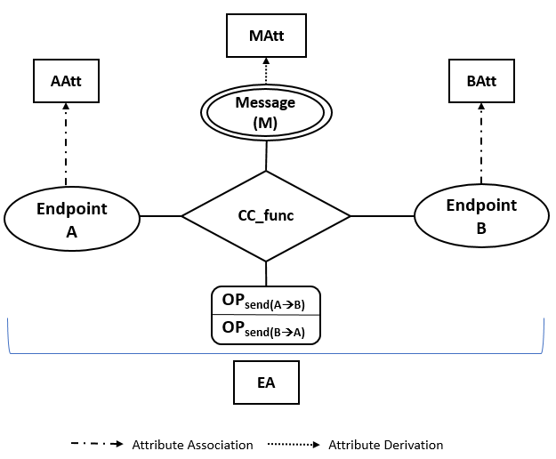
A Conceptual ABCC Model
Fig. 7: A General Conceptual Attribute-Based Communication Control (ABCC) Model

Slide 32
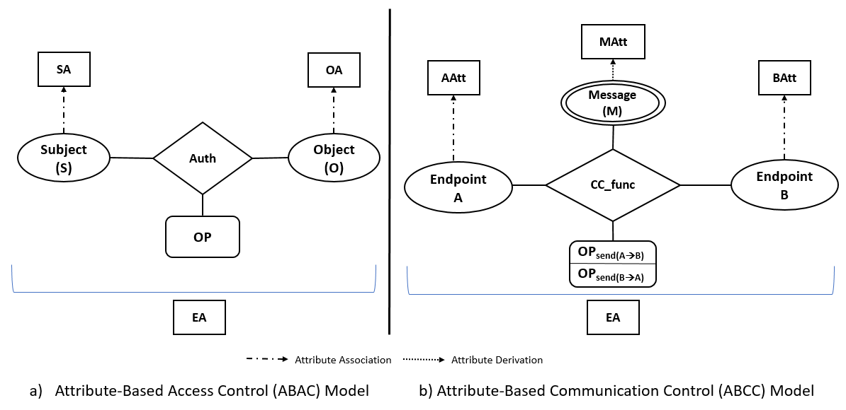
ABAC vs. ABCC

Slide 33
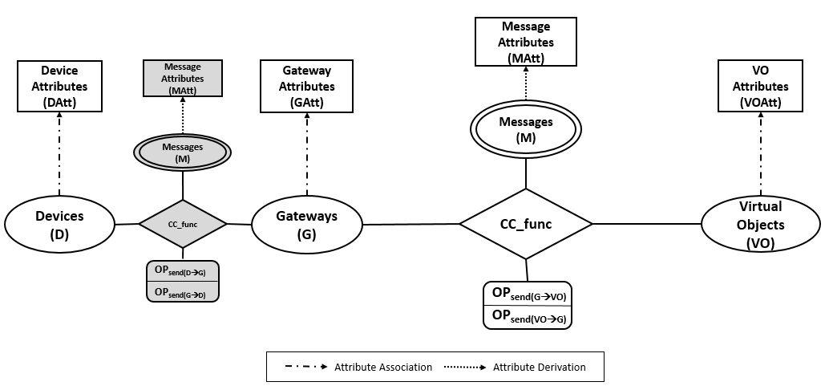
ABCC for Edge and Cloud Communication
Secure Communication through certificates and crypto keys
Fig. 8: ABCC for Edge and Cloud Communication Model

Slide 34
ABCC Components
Basic Entities and Functions:
  Two endpoints – gateway and virtual object
  Message – the control unit (device data messages)
  Attributes of entities (gateways, virtual objects, messages, contextual)
  Message attributes within the message (key, value(s))
  Operation – send
  Communication Control Function
    Communication Control Policies based on attributes
Send Allow
send (m) → m
Communication Control Decision
Send Filtered
send (m) → m’
Send Deny
send (m) → Ø

Slide 35

Use Case
Notification
Message
heartrate
temp
location
ABCC Policies
Access Control Policy
AWS Services
Alice
Heartrate_Temp Sensor
Gateway
Heartrate_Temp Sensor
Database
owner,
type,
…
Certificates
gowner,
type,
…
Attributes
Notification
Physician
ABCC Policies
  Send Allow→ gowner(g) = owner(vo) ^ heartrate(m) >= 150 ^ temp(m) > 104
  Send Filtered → gowner(g) = owner(vo) ^ heartrate(m) <= 75 (filter location)
  Send Deny → If policy evaluation failed (e.g., gowner(g) ≠ owner(vo))
Non-ABCC Data Flow
ABCC Data Flow

Slide 36
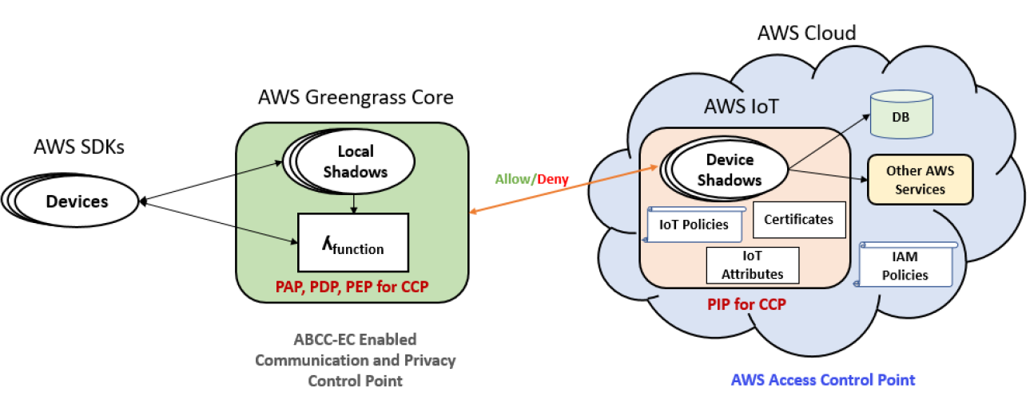
Enforcement in AWS IoT
AWS IoT and AWS Greengrass (Edge Computing Service)
Allow/Deny/Filter
PAP – Policy Administration Point
PDP – Policy Decision Point
PEP – Policy Enforcement Point
PIP – Policy Information Point

Slide 37
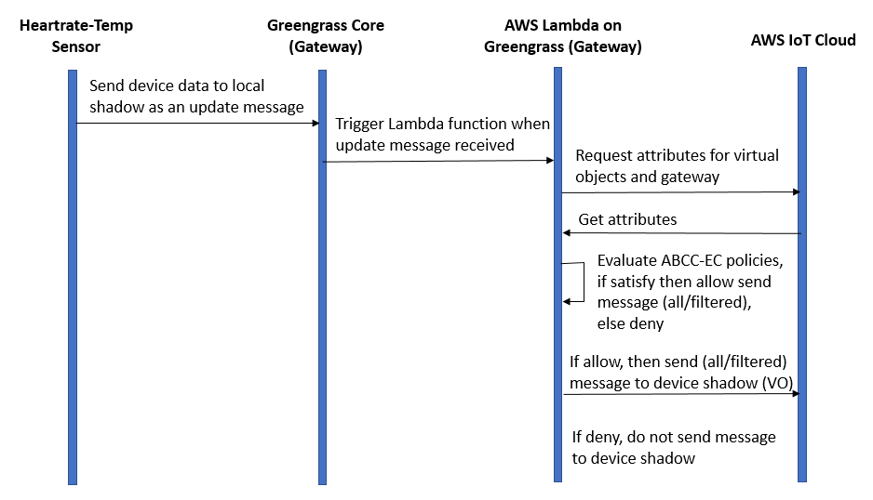
Sequence Diagram

Slide 38
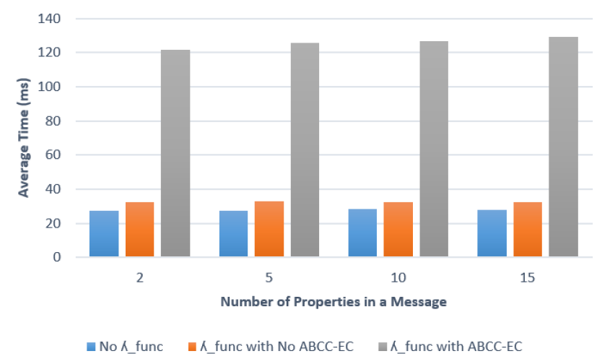
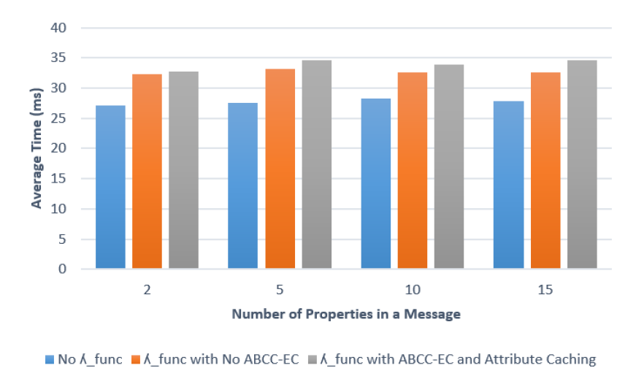
Evaluation
Device Shadow Update Time
Attribute Caching

Slide 39
Conclusion
Developed and implemented ABAC and ABCC models in different context of Cloud and CE-IoT
Presented novel enforcement frameworks to implement our models in real-world platforms
Main goal of this research:
  To depict the applicability and benefits of the attribute-based approach for access and communication control in Cloud and CE-IoT
  To stimulate implementation and adoption of ABAC and ABCC models in real-world scenarios

Slide 40
Future Work
  ABAC and ABCC in context of Multi-Cloud architectures
  ABAC and ABCC in other application domains with additional capabilities (e.g., Trust mechanisms)
  Applicability of ABCC in critical domains: Battlefield IoT, Medical/Healthcare IoT, and Vehicular IoT

Slide 41
Dissertation Publications
Published:
Smriti Bhatt, Farhan Patwa and Ravi Sandhu, An Access Control Framework for Cloud-Enabled Wearable Internet of Things. In Proceedings of the 3rd IEEE International Conference on Collaboration and Internet Computing (CIC), San Jose, CA, October 15-17, 2017, 11 pages.
Smriti Bhatt, Farhan Patwa and Ravi Sandhu, Access Control Model for AWS Internet of Things. In Proceedings of the 11th International Conference on Network and System Security (NSS), Helsinki, Finland, August 21-23, 2017, 15 pages.
Smriti Bhatt, Farhan Patwa and Ravi Sandhu, ABAC with Group Attributes and Attribute Hierarchies Utilizing the Policy Machine. In Proceedings of the 2nd ACM Workshop on Attribute-Based Access Control (ABAC), March 24, 2017, Scottsdale, Arizona, 12 pages.
Smriti Bhatt, Farhan Patwa and Ravi Sandhu, An Attribute-Based Access Control Extension for OpenStack and its Enforcement Utilizing the Policy Machine. In Proceedings of the 2nd IEEE International Conference on Collaboration and Internet Computing (CIC), Pittsburgh, PA, November 1-3, 2016, 9 pages.
In preparation:
Smriti Bhatt, Farhan Patwa and Ravi Sandhu, Attribute-Based Communication Control in Cloud-Enabled Internet of Things. Venue TBD.

Slide 42
Thank you!
Questions?

