Slide 1
Cyber Incident Response Models and Platforms for Information and Resource Sharing
Secure Information Sharing for Cyber Response Teams
UTSA Team
Ram Krishnan, Assistant Professor (ECE)
Ravi Sandhu, Professor (CS) and Executive Director (ICS)
Amy Zhang, PhD Candidate, UTSA
October 06, 2014

Slide 2
THANKS!

Slide 3
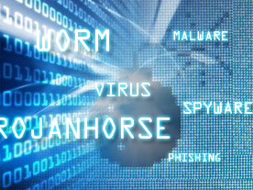
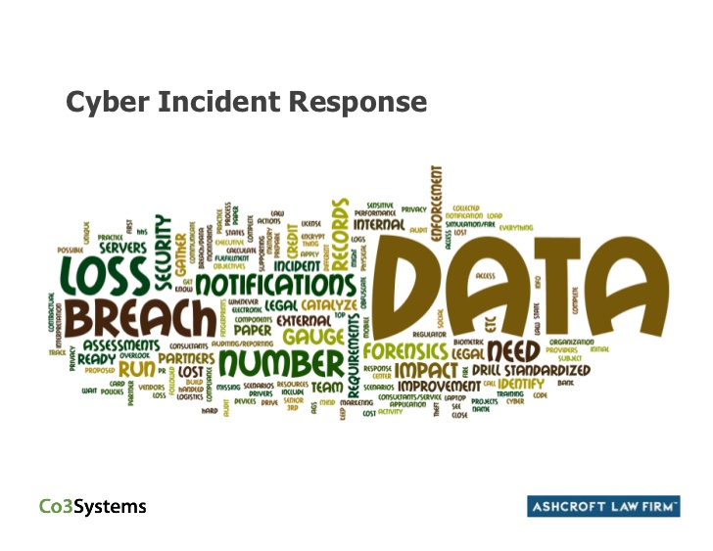

Cyber Incidents
Recent incidents
JPMorgan Chase and 9 other financial institutions
>76M households compromised
Target, Home Depot, Michaels, Nieman Marcus

Slide 4
Cyber Incident Response
Information sharing
Two major challenges
Policy
Technology

Slide 5
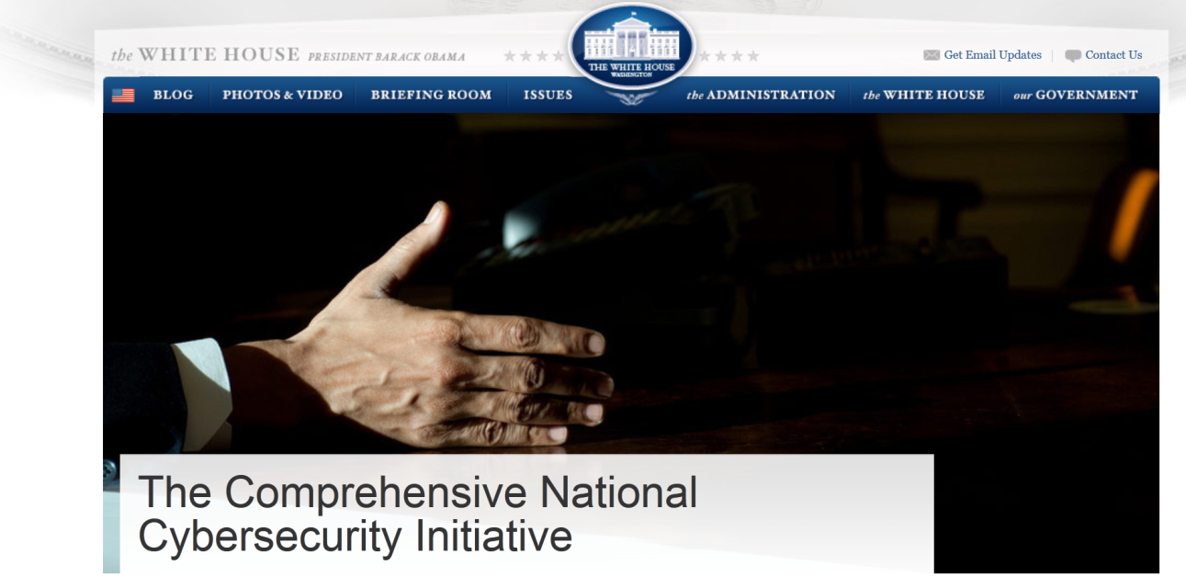
National Information Sharing and Coordination Initiatives
Inter-agency collaboration and coordination to enhance situational awareness
Share malicious activities on federal systems
Technologies, tools, procedures, analytics
Ref: http://www.whitehouse.gov/issues/foreign-policy/cybersecurity/national-initiative

Slide 6
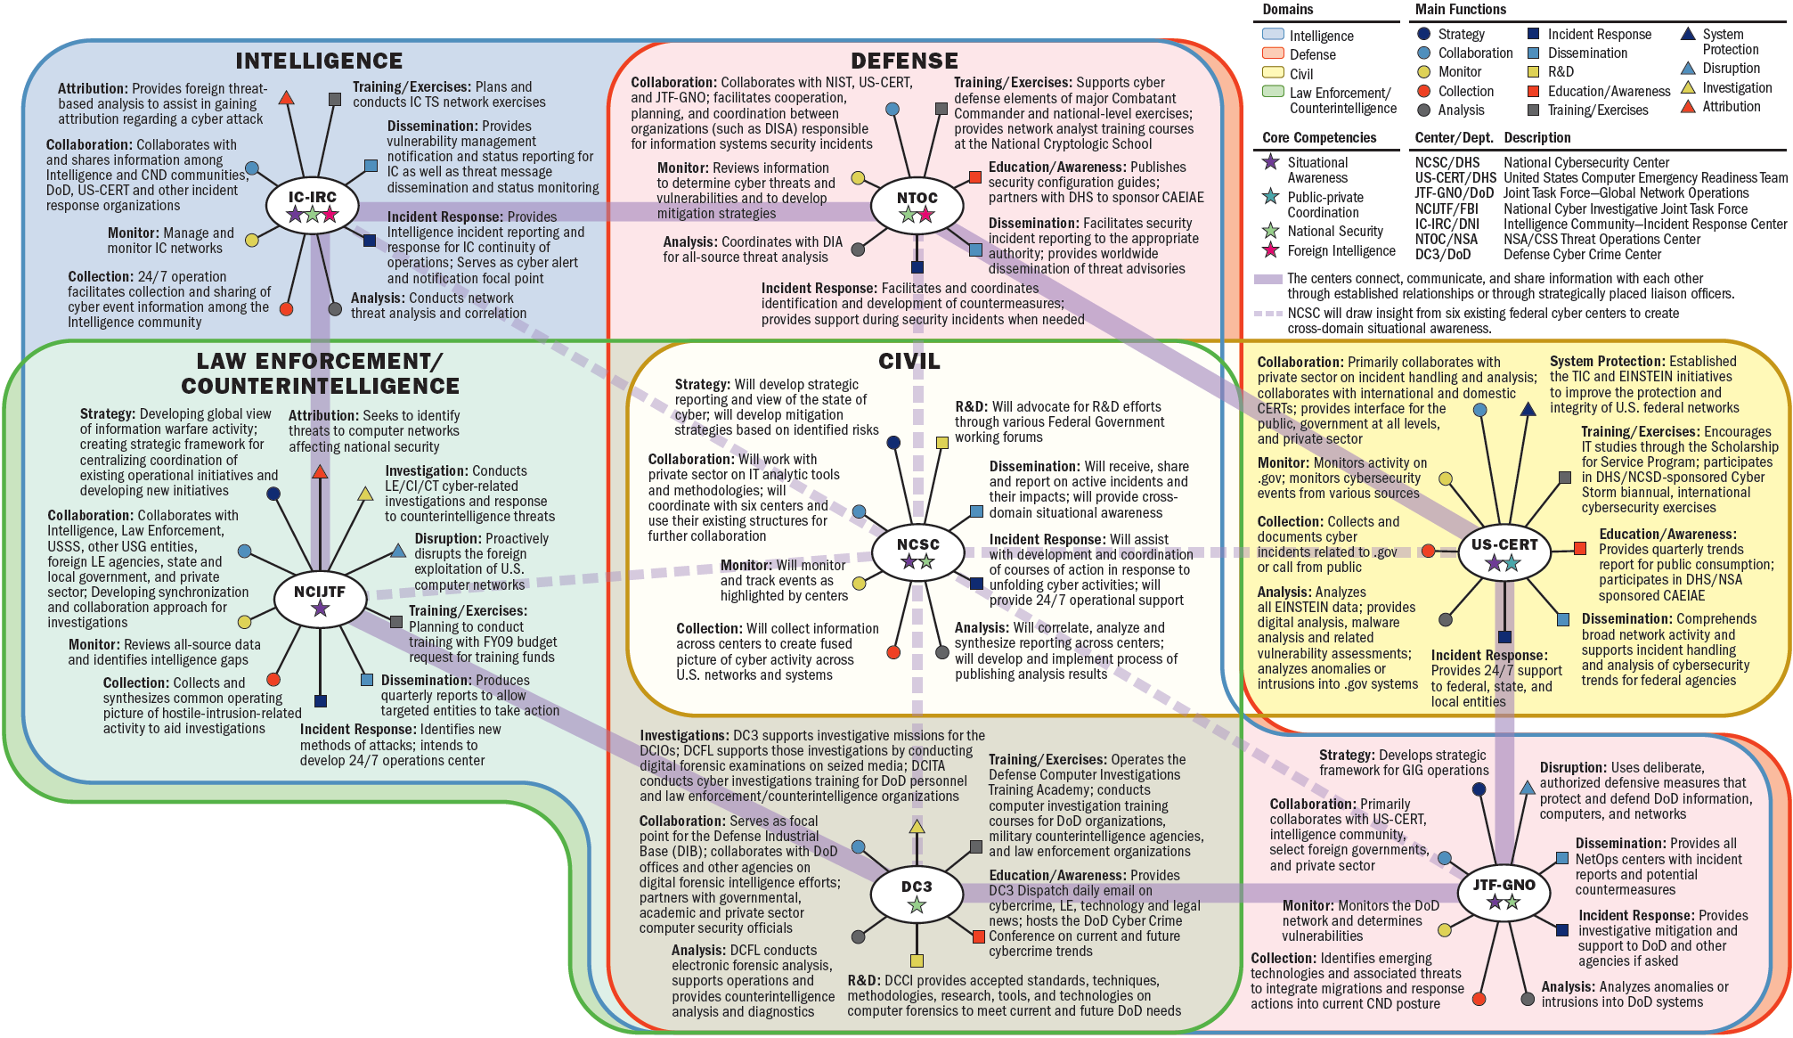
National Cybersecurity Center
Ref: http://www.whitehouse.gov/files/documents/cyber/CybersecurityCentersGraphic.pdf

Slide 7
Project Scope
Focus on technical challenges
Sharing amongst a set of organizations
Information, infrastructure, tools, analytics, etc.
May want to share malicious or infected code/systems (e.g. virus, worms, etc.)
Sensitive
Often ad hoc
What are the effective ways to facilitate sharing in such circumstances?
Information sharing models
Infrastructure, technologies, platforms

Slide 8
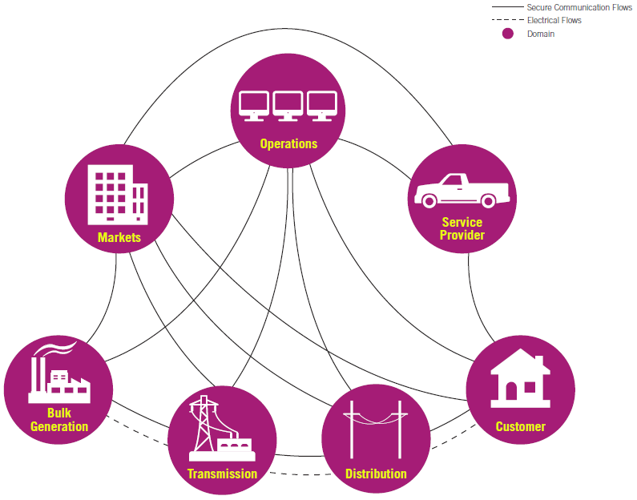
Electric Grid Scenario
Cyber incidents in electricity providers
Local utilities, regional, state, national operators
Need a standing platform that facilitates sharing
Controlled access
Notes:
DHS has identified 16 critical infrastructure sectors. E.g.: Comm, Financial, IT, Transportation, etc.
Information Sharing and Analysis Center (ISACs) exist for several of these sectors

Slide 9
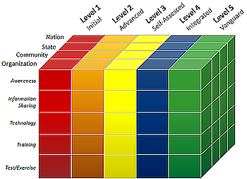
Community Scenario
Cyber incidents across critical infrastructure providers in a community
Emergency response, healthcare, banks, utility
Need a community information sharing platform
Controlled access
Community Cyber Security Maturity Model
“Yardstick” to determine current cyber security posture

Slide 10
Data Exfiltration Scenario
Unusual file transfers from IP addresses within an org to an external IP address
Similar activities observed in partner orgs
Need to find if these events are connected
Any correlation between those files?
Share resources for analysis+collaboration

Slide 11
Key Requirements for Information Sharing
Cyber infrastructure
Light-weight and agile
Rapid deployment and configuration
Secure isolated environment

Slide 12
Cyber Infrastructure for Sharing
Traditional platforms
Shared storage
SharePoint, Dropbox, Google Drive, etc.
Shared infrastructure
Grid computing
Modern platform
Cloud

Slide 13


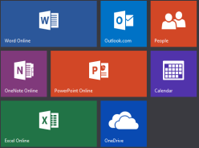







Cloud Service Models
Software as a Service (SaaS)
Network accessible software
Platform as a Service (PaaS)
App dev environment with cloud characteristics
Infrastructure as a Service (IaaS)
Virtualized hardware infrastructure

Slide 14
IaaS Cloud
Physical Datacenter
VM
VM
VM
VM
VM
VM
VM
VM
VM
VM
VM
VM
Hypervisor
Hypervisor
Hypervisor
Hypervisor
Physical Machine
Physical Machine
Physical Machine
Physical Machine
Tenant 1: Need 3 VMs
Tenant 2: Need 3 VMs
Each tenant sees a virtual private datacenter
Tenant 3: Need 2 VMs
Tenant 2: Need 3 VMs
Tenant 4: Need 1 VM

Slide 15
Cloud IaaS Advantages for Cyber Incident Sharing
Virtualized resources
Theoretically, one can take a snapshot and mobilize
Operational efficiency
Light-weight and agile
Rapid deployment and configuration
Dynamic scaling
Self-service

Slide 16
Cloud IaaS Challenges for Cyber Incident Sharing
Tenants are strongly isolated
IaaS clouds lack secure sharing models
Storage
Compute
Networks
Need ability to snapshot tenant infrastructure, share, and control who can access
Share by copy

Slide 17

Sharing Model in Cloud IaaS
Add/Remove Data
Add/Remove Data
Secure Isolated Domain (SID)
View #1: Org C
View #1: Org A
Participant C
View #2: SID
View #2: SID
Participant A
Join/Leave Users
Join/Leave Users
Add/Remove Data
Join/Leave Users
Participant B
Can create multiple secure isolated projects (SIPs) within SID with different controls
View #1: Org B
View #2: SID

Slide 18
Conceptual Model
Administrative Model
Collaboration Group
Operational Model
Establish/Disband
ORG A
ORG B
Join User
Join User
Create RO/RW Subject
Kill Subject
Create Object
Read/Update Version
Suspend/Resume
Version
Leave User
Create RO/RW Subject
Kill Subject
Create Object
Read/Update Version
Suspend/Resume
Version
Leave User
Add Version
Add Version
Remove Version
Remove Version
Merge Version
Merge Version
Substitute User
Substitute User
Import Version

Slide 19
Read-only Vs Read-Write Subjects
Org A
Collaboration Group
Org B
Export
Read
Write
Malicious Group Subject
Read Only subjects can read from multiple groups/entities
Read-Write subjects restricted to one group
Object

Slide 20
Merge Vs Export of Objects
Org A
Collaboration Group
Org B
Merge
Merge
Copy?
Add
Add
Copy?
Export
Export
Add?
Newly created group object
Add
Org C

Slide 21
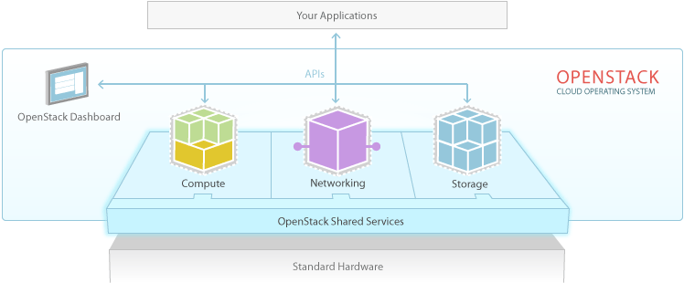
OpenStack
> 200 companies
~14000 developers
>130 countries
OpenStack
Dominant open-source cloud IaaS software
Ref: http://www.openstack.org

Slide 22
OpenStack Access Control (OSAC)

Slide 23
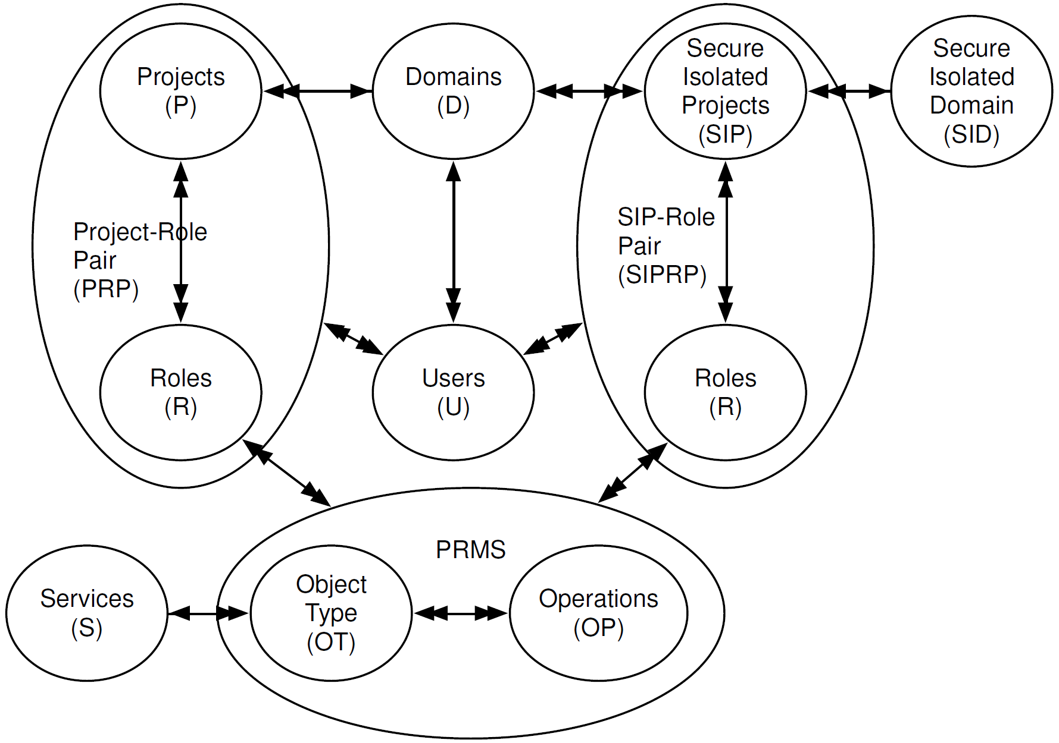
OSAC-SID

Slide 24
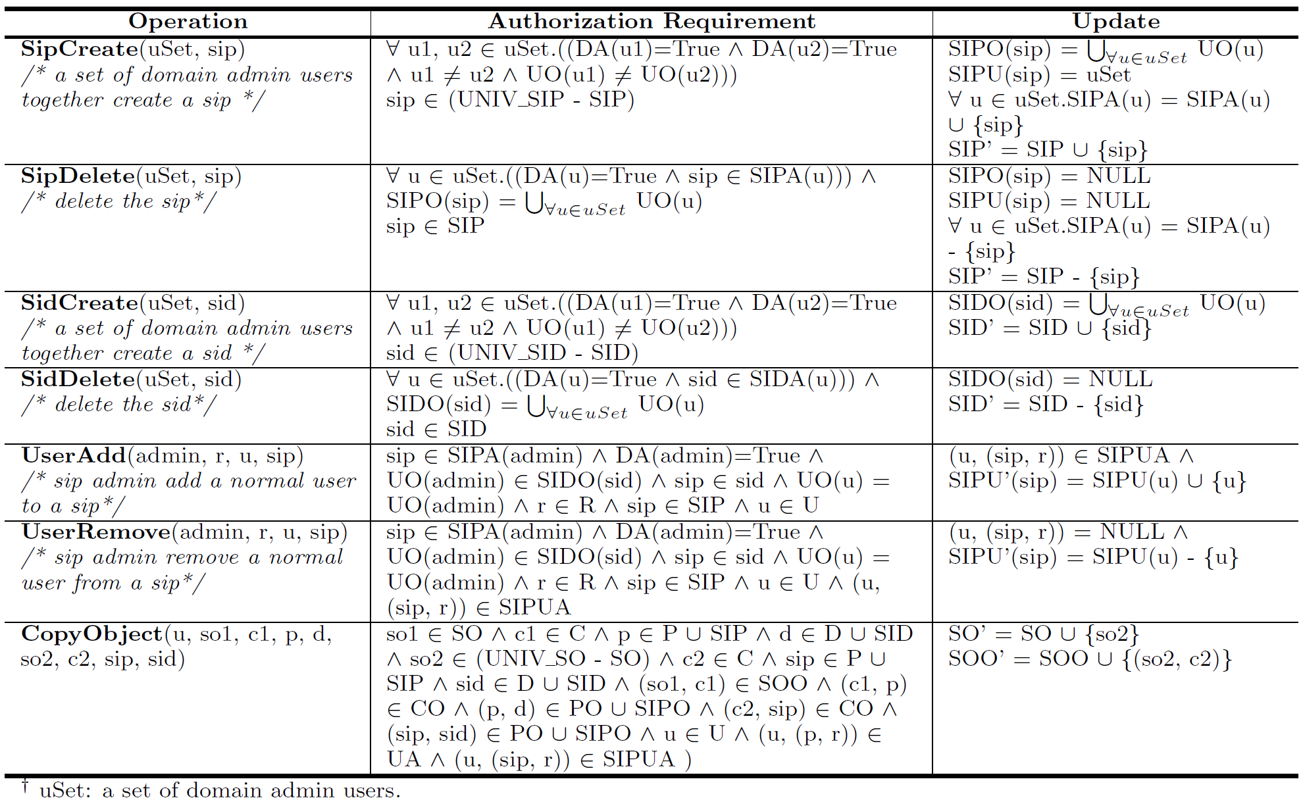
OSAC-SID Administrative Model

Slide 25
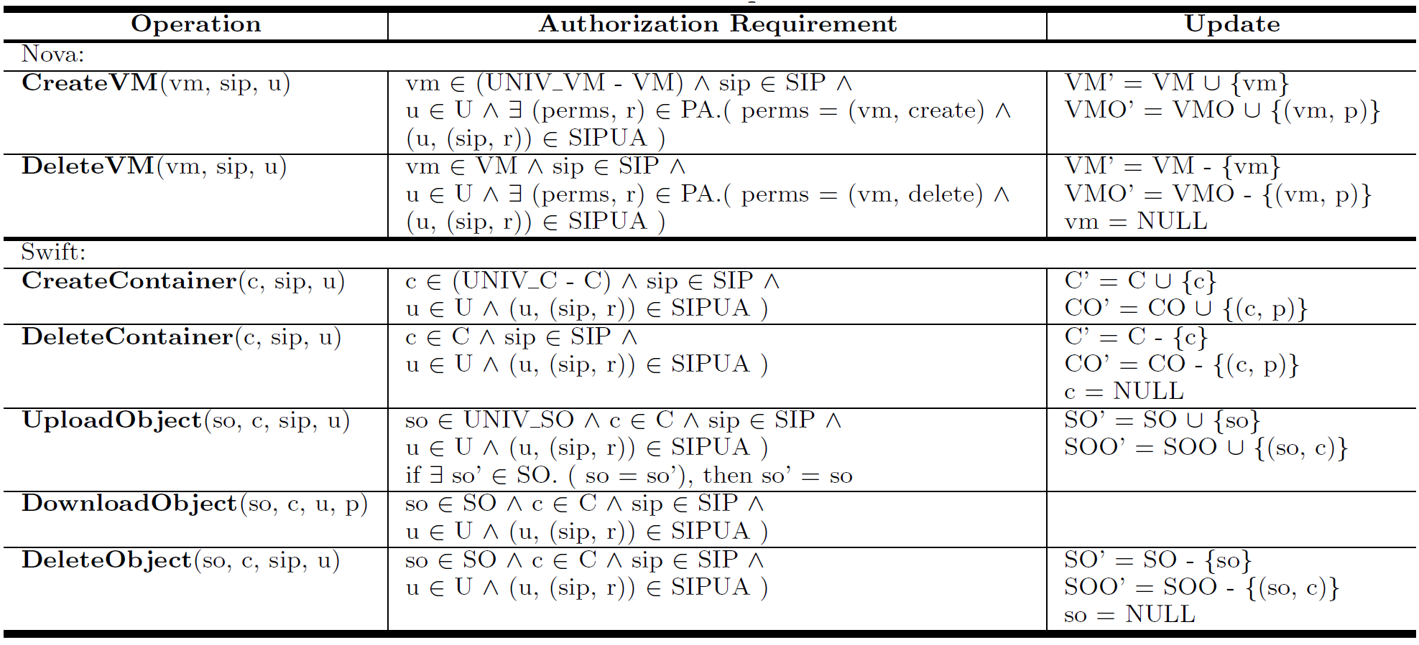
OSAC-SID Operational Model

Slide 26
SID and SIP in OpenStack
CPS
SID-Critical-Infrastructure
SAWS
Admin: CPSadmin
Admins:
CPSadmin, SAWSadmin
Admin: SAWSadmin
Users: Alice@CPS, Bob@CPS
Create
Join
Users: Harry@SAWS
Users: Alice@CPS, Harry@SAWS
member
member
SIP-PortScanning
IT-CPS
member
IT-SAWS
member
SIP-DOS
Share objects, VMs, etc.
Admin: SAPDadmin
Users: Martin@SAPD
member
IT-SAPD
SAPD

Slide 27
Key Accomplishments (1)
Developed sharing models
Formal specification
Cloud-based instantiation
Enhanced OpenStack with SID/SIP capabilities
Cyber incident response capabilities out of the box
Self-service
SID/SIP specific security
Share data, tools, etc. in an isolated environment
Ability to execute and analyze malicious code in an isolated environment
Practitioners can deploy a “cyber incident response” cloud
Potential blueprint for official OpenStack adoption

Slide 28
Key Accomplishments (2)
Initial work published in Association for Computing Machinery (ACM) Workshop on Information Sharing and Collaborative Security (WISCS ‘14)
To be presented on November 3, 2014 in Scottsdale, AZ
Potential dissertation topic for Amy Zhang, PhD Candidate

Slide 29
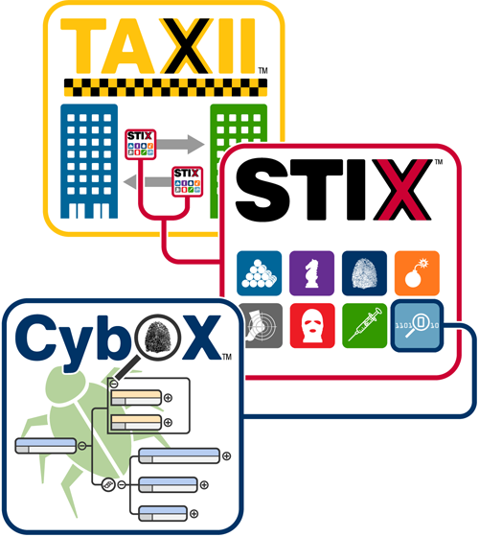
Next Steps (1)
Integrate STIX-TAXII in SID
Information Sharing Specifications for Cybersecurity
Trusted Automated eXchange of Indicator Information (TAXII)
Structured Threat Information eXpression (STIX)
Cyber Observable eXpression (CybOX)

Slide 30
Next Steps (2)
Fine-grained and expressive access control
Hardened SID/SIP
User-friendly interface for management
Develop cyber incident response lifecycle management in cloud
Prepare, share, detect & analyze, contain/eradicate, post-incident activity, etc.

Slide 31
Thanks
Comments, Q&A

