Slide 1
Big Data and Privacy
Panel
Prof. Ravi Sandhu
Executive Director and Endowed Chair
IEEE International Conference on Big Data
December 6, 2016, Washington DC
ravi.sandhu@utsa.edu
www.profsandhu.com
www.ics.utsa.edu
© Ravi Sandhu
World-Leading Research with Real-World Impact!

Slide 2
Security Objectives
INTEGRITY
modification
AVAILABILITY
access
CONFIDENTIALITY
disclosure
© Ravi Sandhu
World-Leading Research with Real-World Impact!
2

Slide 3
Security Objectives
USAGE
purpose
INTEGRITY
modification
AVAILABILITY
access
CONFIDENTIALITY
disclosure
© Ravi Sandhu
World-Leading Research with Real-World Impact!
3

Slide 4
Security Objectives
USAGE
purpose
USAGE
INTEGRITY
modification
AVAILABILITY
access
CONFIDENTIALITY
disclosure
© Ravi Sandhu
World-Leading Research with Real-World Impact!
4

Slide 5
Trade-Offs
Benefit
Privacy
Security
© Ravi Sandhu
World-Leading Research with Real-World Impact!
5

Slide 6
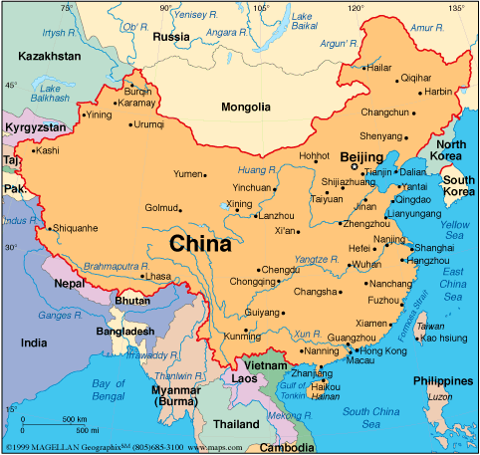
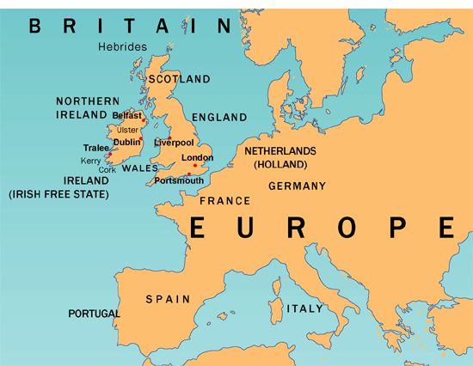
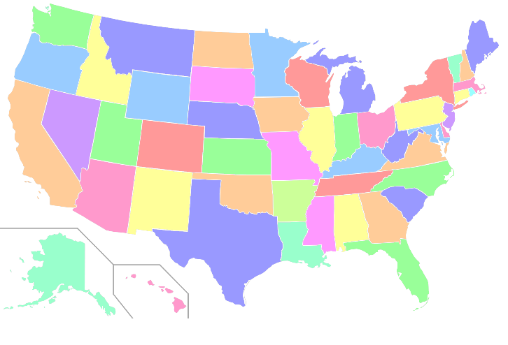
3 Ongoing Experiments
© Ravi Sandhu
World-Leading Research with Real-World Impact!
6

Slide 7
Questions
Is big data the biggest threat to privacy?
It is a big threat
What are the most promising technological solutions for protecting privacy?
Technology alone is not sufficient
Is privacy really dead in the Big Data era?
No
Is privacy preserving machine learning realistic?
No comment
© Ravi Sandhu
World-Leading Research with Real-World Impact!
7

