Slide 1
Cyber Security Trends and Challenges
Ravi Sandhu
Executive Director Professor of Computer Science Lutcher Brown Chair in Cyber Security
Financial Executives International San Antonio Chapter
March 19, 2019
ravi.sandhu@utsa.edu www.profsandhu.com www.ics.utsa.edu

Slide 2
ICS Mission and History
MISSION
Sustained excellence in leading edge research
2007-2012
Founded by start-up funding from State of Texas
2012-2017
Graduated to a self-sustaining operation
2017-2022
Major expansion by winning NSF C-SPECC grant
Established world class laboratories for: Secure cloud computing & Malware research
In collaboration with:
College of Engineering
College of Business
College of Education
Open Cloud Institute
Cyber Center for Security & Analytics
National Security Collaboration Center
Partnership with 4 NISD High Schools:
Harlan, Woodson, Taft, Business Careers

Slide 3
Cyber Security Perspective

Slide 4

Cyber Security in a Nutshell
“My dear, here we must run as fast as we can, just to stay in place. And if you wish to go anywhere you must run twice as fast as that.”
― Lewis Carroll, Alice in Wonderland

Slide 5
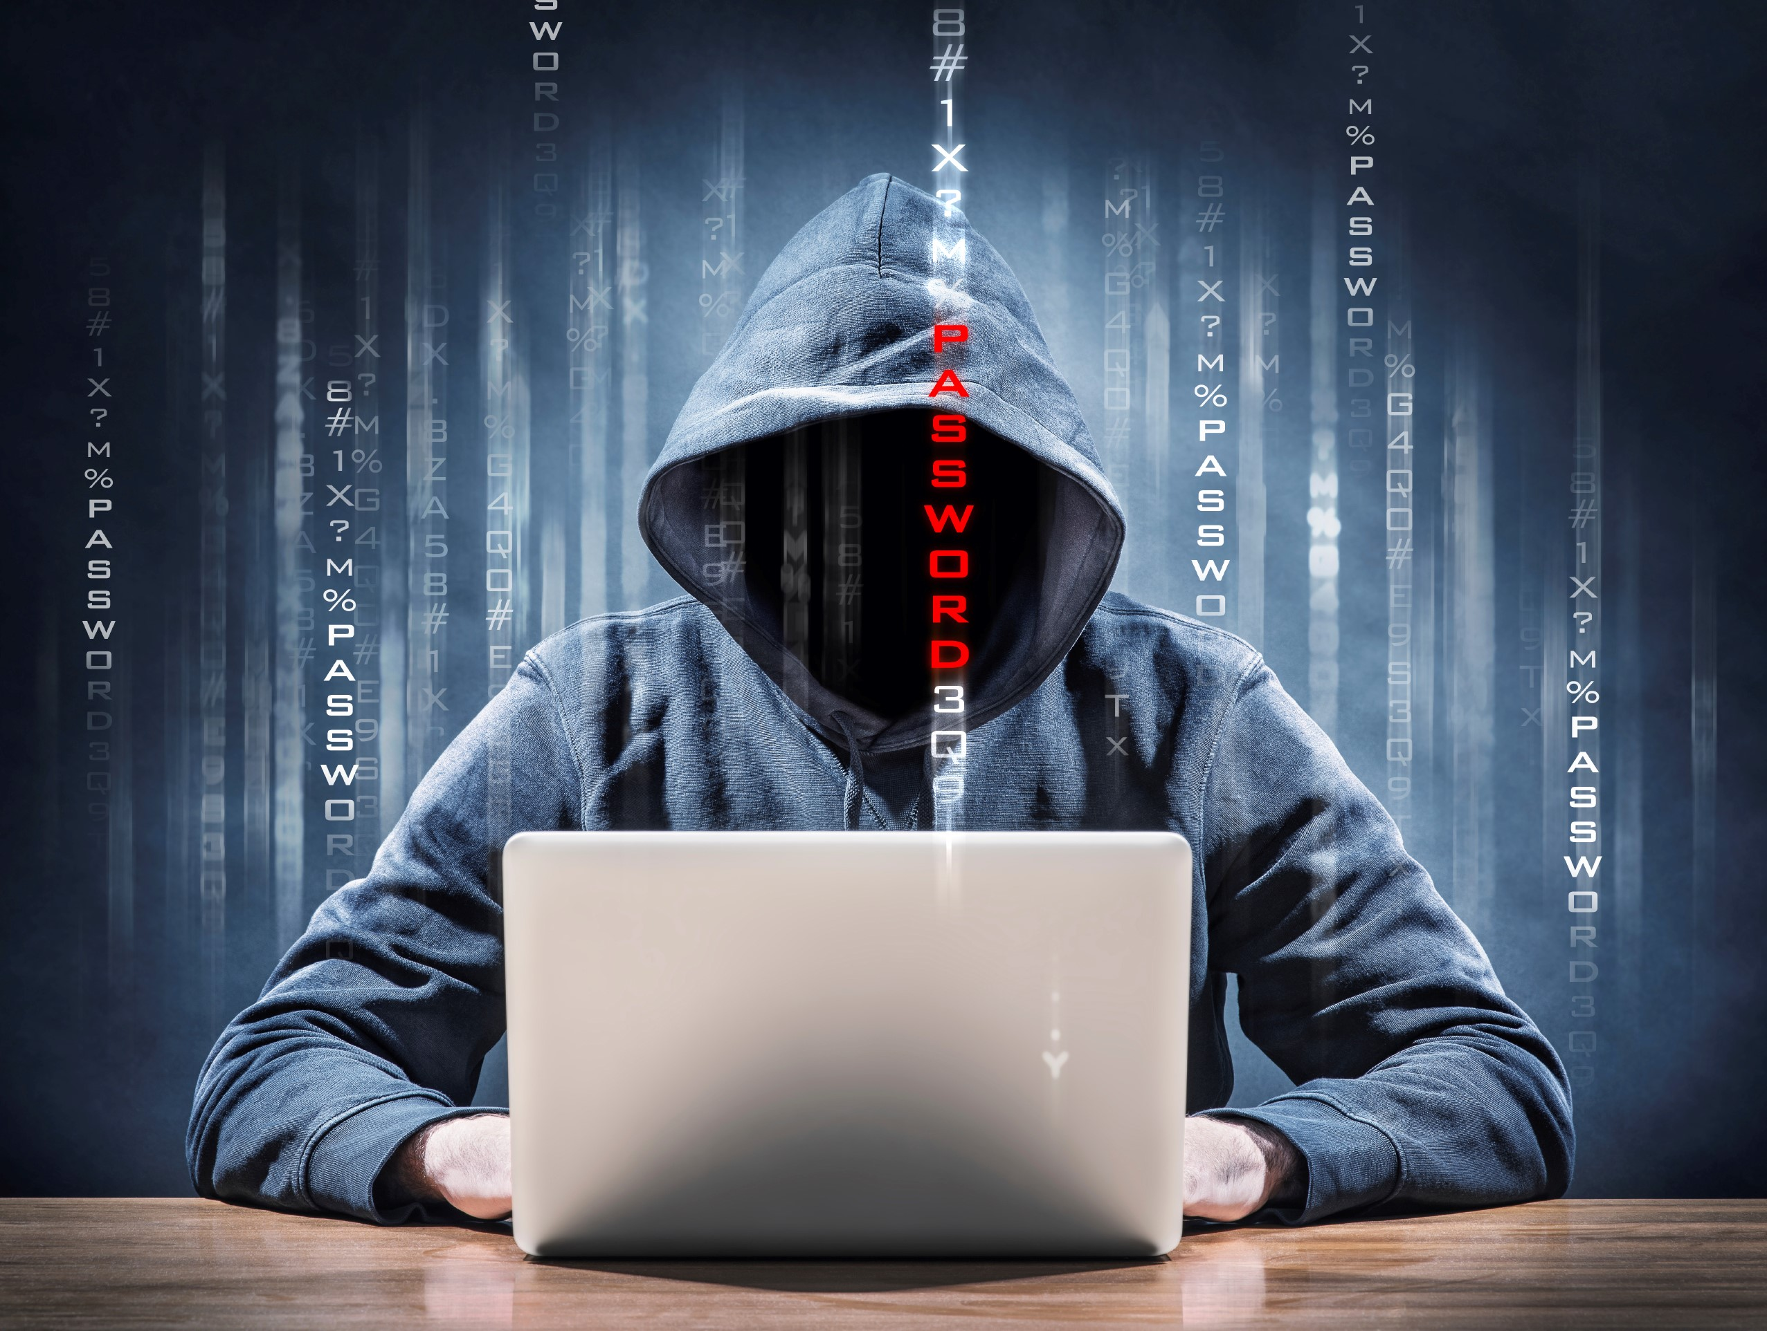
Cyber Security in a Nutshell
“My dear, here we must run as fast as we can, just to stay in place. And if you wish to go anywhere you must run twice as fast as that.”
― Lewis Carroll, Alice in Wonderland

Slide 6
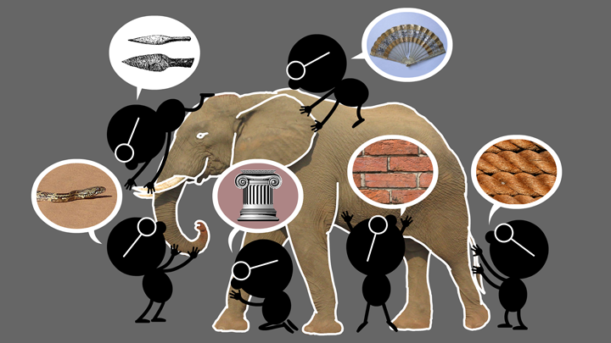
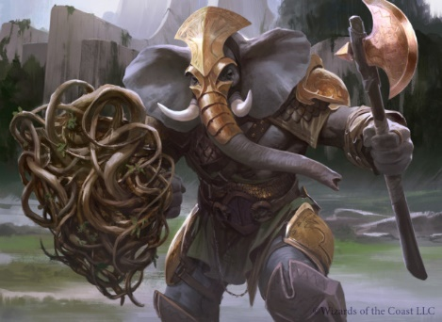
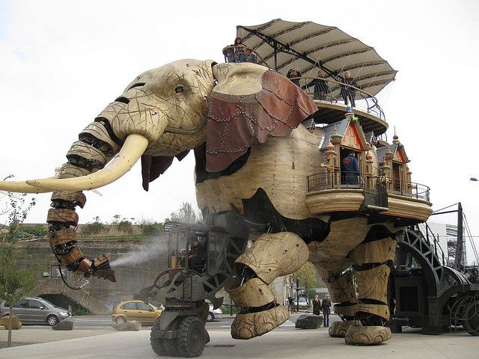
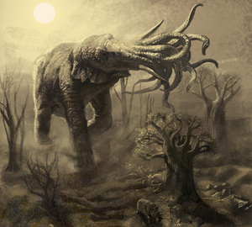
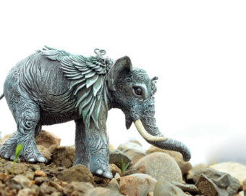
Natural vs Cyber Science
Elephant Problem
Cyber-Elephant Problem
Applied vs Foundational Science: Cyber-elephants require applied and foundational combined
Present vs Future Focus: Rapidly evolving cyber-elephants require future focus

Slide 7
Success Stories
The ATM (Automatic Teller Machine) system is
secure enough
global in scope
US President’s nuclear football

Slide 8
Security Objectives
INTEGRITY
modification
AVAILABILITY
access
CONFIDENTIALITY
disclosure

Slide 9
Security Objectives
USAGE
purpose
Covers privacy and intellectual property protection
INTEGRITY
modification
AVAILABILITY
access
CONFIDENTIALITY
disclosure

Slide 10
What can Security Technologists learn from the History of the Internet?

Slide 11
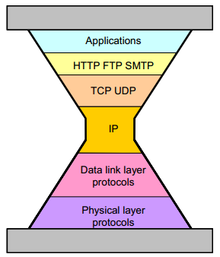
Internet Protocols
TCP RFC 793
Sept. 1981
IPv4 RFC 791
Sept. 1981

Slide 12
The TCP/IP Lesson
Agility trumps perfection
Not quite the same as
Good enough trumps perfect
Agility =
Good enough for now
+
Future-proof for uncertain future

Slide 13
IP Spoofing Story
ALLOW GOOD GUYS IN
KEEP BAD GUYS OUT
IP Spoofing predicted in Bell Labs report ≈ 1985
Unencrypted Telnet with passwords in clear
1st Generation firewalls deployed ≈ 1992
IP Spoofing attacks proliferate in the wild ≈ 1993
Virtual Private Networks emerge ≈ late 1990’s
Vulnerability shifts to the client PC
Network Admission Control ≈ 2000’s
Persists as a Distributed Denial of Service mechanism
Most of these fixes have not changed or extended IPv4

Slide 14
Laws and Principles of Cyber Security

Slide 15
Laws of Attackers
Attackers exist
You will be attacked
Attackers have sharply escalating incentive
Money, terrorism, war, espionage, sabotage, …
Attackers are lazy (follow path of least resistance)
Attacks will escalate BUT no faster than necessary
Attackers are innovative (and stealthy)
Eventually all feasible attacks will manifest
Attackers are copycats
Known attacks will proliferate widely
Attackers have asymmetrical advantage
Need one point of failure

Slide 16
Principles of Defense
Prepare for tomorrow’s attacks, not just yesterday’s
Good defenders strive to stay ahead of the curve, bad defenders forever lag
Take care of tomorrow’s attacks before next year’s attacks
Researchers will and should pursue defense against attacks that will manifest far in the future BUT these solutions will deploy only as attacks catch up
Use future-proof barriers
Defenders need a roadmap and need to make adjustments
It’s all about trade-offs
Security, Convenience, Cost
Beware of “silver bullets”

