Slide 1
Institute for Cyber Security (ICS) & Center for Security and Privacy Enhanced Cloud Computing (C-SPECC)
Ravi Sandhu Executive Director Professor of Computer Science Lutcher Brown Chair in Cyber Security
UTSA-NSA Briefing, UTSA Campus September 28, 2017
ravi.sandhu@utsa.edu www.ics.utsa.edu www.profsandhu.com

Slide 2
ICS Mission and History
MISSION
Sustained excellence in graduate-level sponsored research
2007-2012
Founded by start-up funding from State of Texas
2012-2017
Graduated to a self-sustaining operation
2017-2022
Major expansion by winning NSF C-SPECC grant
In collaboration with:
College of Science
College of Engineering
College of Business
College of Education and
Human Development
Open Cloud Institute
Cyber Center for Security & Analytics

Slide 3
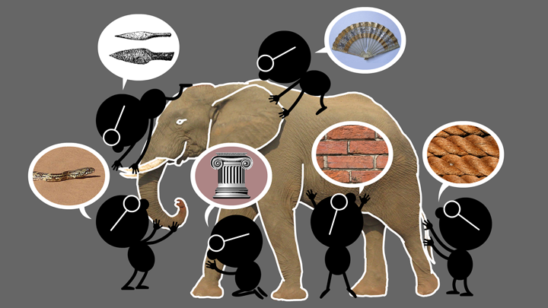
Natural Science
The Elephant Problem

Slide 4
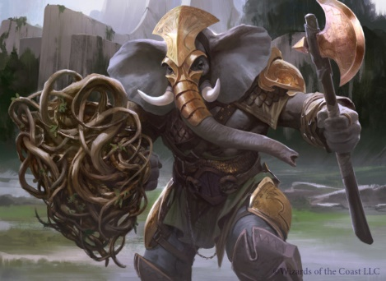
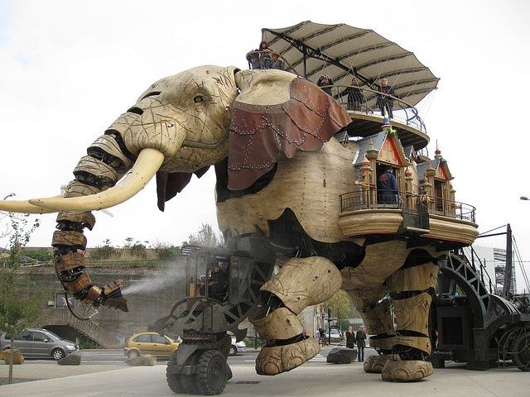
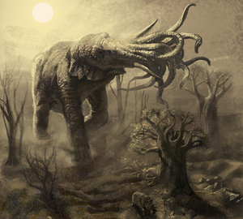
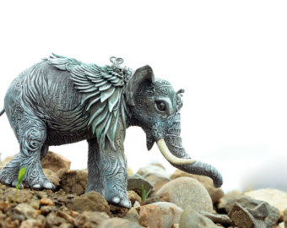
Cyber Science
The Cyber-Elephant Problem

Slide 5
ICS Research Philosophy
Applied and Basic Research Combined (ABC)
Software: Waterfall -> Agile and DevOps
Security: Waterfall -> ???
Tech transfer: Technology Readiness Levels (TRLs) -> ???
* The New ABCs of Research
by Ben Schneiderman, 2016

Slide 6
Major Research Areas
TECHNOLOGIES
Access Control
Policy
Malware
Security Dynamics
APPLICATION DOMAINS
Cloud Computing
Internet of Things (IoT)
Social Networks
Enterprise

Slide 7
Access Control Evolution
Discretionary Access Control (DAC), 1970
Mandatory Access Control (MAC), 1970
Role Based Access Control (RBAC), 1995
Attribute Based Access Control (ABAC), ????
Born 1990s

Slide 8
Access Control Evolution
Discretionary Access Control (DAC), 1970
Mandatory Access Control (MAC), 1970
Relationship Based
Access Control (ReBAC) ????
Role Based Access Control (RBAC), 1995
Provenance Based
Access Control (PBAC)
????
Born mid
2000s
Born late
2000s
Attribute Based Access Control (ABAC), ????
Born 1990s

Slide 9
ABAC Research Landscape
7. ABAC Design, Engineering and Applications
3. Administrative
ABAC Models
4. Extended
ABAC Models
5. ABAC Policy
Architectures and Languages
6. ABAC Enforcement Architectures
2. Core ABAC Models
1. Foundational Principles and Theory

Slide 10
Major Research Areas
TECHNOLOGIES
Access Control
Policy
Malware
Security Dynamics
APPLICATION DOMAINS
Cloud Computing
Internet of Things (IoT)
Social Networks
Enterprise
ICS and UTSA can dig a lot DEEPER and BROADER

