Slide 1
Institute for Cyber Security
ICS Research Projects
Ravi Sandhu
Institute for Cyber Security
University of Texas at San Antonio
August 30, 2012
IIIT Delhi
World-Leading Research with Real-World Impact!
1

Slide 2
ICS Philosophy
Foundations
Applications
Technologies
© Ravi Sandhu
World-Leading Research with Real-World Impact!

Slide 3
ICS Projects
Secure information sharing
Social network security
Secure data provenance
Attribute based access control
Botnet and malware analysis
Smart grid security
Hardware security
Future internet
© Ravi Sandhu
World-Leading Research with Real-World Impact!

Slide 4
ICS Projects
Secure information sharing
Social network security
Secure data provenance
Attribute based access control
Botnet and malware analysis
Smart grid security
Hardware security
Future internet
© Ravi Sandhu
World-Leading Research with Real-World Impact!

Slide 5
Secure Information Sharing (SIS)
Goal: Share but protect
Containment challenge
Client containment
Ultimate assurance infeasible (e.g., the analog hole)
Appropriate assurance achievable
Server containment
Will typically have higher assurance than client containment
Policy challenge
How to construct meaningful, usable, agile SIS policy
How to develop an intertwined information and security model
© Ravi Sandhu
World-Leading Research with Real-World Impact!

Slide 6
SIS Policy Construction
Dissemination Centric (d-SIS)
Sticky policies that follow an object along a dissemination chain (possibly modified at each step)
Group Centric (g-SIS)
Bring users and information together to share existing information and create new information
Metaphors: Secure meeting room, Subscription service
Benefits: analogous to RBAC over DAC
© Ravi Sandhu
World-Leading Research with Real-World Impact!

Slide 7
Community Cyber Security
Filtered RW
Administered Membership
Core Group
Incident Group
Conditional Membership
Automatic Membership
Administered Membership
Administered Membership
Open Group
Filtered RW
Domain
Experts
© Ravi Sandhu
World-Leading Research with Real-World Impact!

Slide 8
Community Cyber Security
Incident Groups
Conditional Membership
g1
Administered Membership
Core Group
Read Subordination
Domain Experts
Automatic Membership
Conditional Membership
Administered Membership
Open Group
g2
Conditional Membership
Write Subordination
Administered Membership
g3
© Ravi Sandhu
World-Leading Research with Real-World Impact!

Slide 9
ICS Projects
Secure information sharing
Social network security
Secure data provenance
Attribute based access control
Botnet and malware analysis
Smart grid security
Hardware security
Future internet
© Ravi Sandhu
World-Leading Research with Real-World Impact!

Slide 10

Relationship-based Access Control
Users in Online Social Networks (OSNs) are connected with social relationships
Owner of the resource can control its release based on such relationships between the access requester and the owner
© Ravi Sandhu
World-Leading Research with Real-World Impact!

Slide 11
Solution Approach
Using regular expression-based path pattern for arbitrary combination of relationship types
Given relationship path pattern and hopcount limit, graph traversal algorithm checks the social graph to determine access
© Ravi Sandhu
World-Leading Research with Real-World Impact!

Slide 12
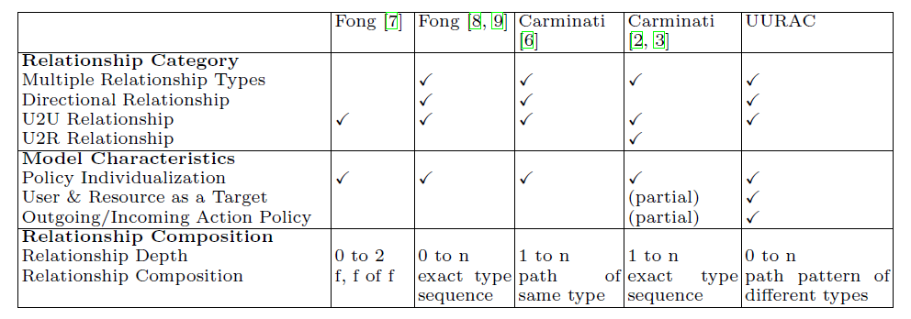
Related Works
The advantages of this approach:
Passive form of action allows outgoing and incoming action policy
Path pattern of different relationship types make policy specification more expressive
© Ravi Sandhu
World-Leading Research with Real-World Impact!

Slide 13
ICS Projects
Secure information sharing
Social network security
Secure data provenance
Attribute based access control
Botnet and malware analysis
Smart grid security
Hardware security
Future internet
© Ravi Sandhu
World-Leading Research with Real-World Impact!

Slide 14
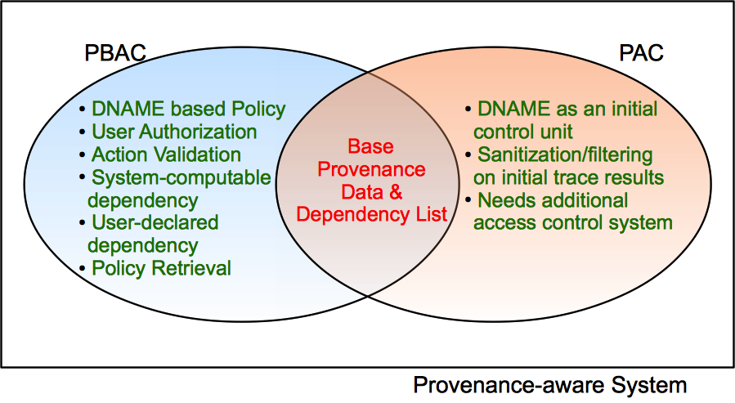
Provenance Based Access Control (PBAC) vs Provenance Access Control (PAC)
© Ravi Sandhu
World-Leading Research with Real-World Impact!

Slide 15
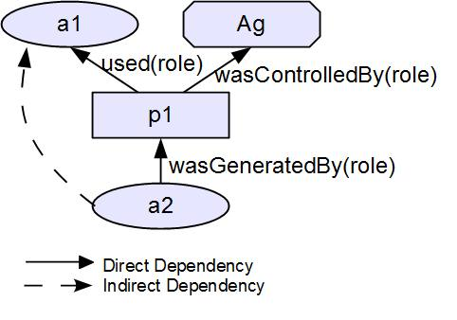
OPEN PROVENANCE MODEL (OPM)
© Ravi Sandhu
World-Leading Research with Real-World Impact!

Slide 16
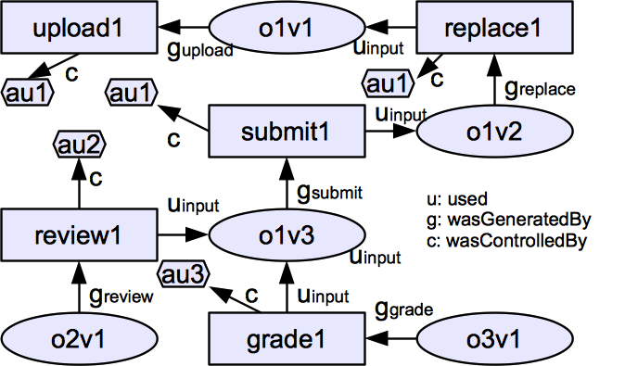
Sample Base Provenance Data
© Ravi Sandhu
World-Leading Research with Real-World Impact!

Slide 17
Sample Base Provenance Data
wasReviewedOby
wasReplacedVof
wasSubmittedVof
wasSubmittedVof
wasGradedOof
wasReviewedOof
wasGradedOof
© Ravi Sandhu
wasReviewedOof
World-Leading Research with Real-World Impact!

Slide 18
ICS Projects
Secure information sharing
Social network security
Secure data provenance
Attribute based access control
Botnet and malware analysis
Smart grid security
Hardware security
Future internet
© Ravi Sandhu
World-Leading Research with Real-World Impact!

Slide 19
Access Control Models
Discretionary Access Control (DAC), 1970
Owner controls access
But only to the original, not to copies
Grounded in pre-computer policies of researchers
Mandatory Access Control (MAC), 1970
Synonymous to Lattice-Based Access Control (LBAC)
Access based on security labels
Labels propagate to copies
Grounded in pre-computer military and national security policies
Role-Based Access Control (RBAC), 1995
Access based on roles
Can be configured to do DAC or MAC
Grounded in pre-computer enterprise policies
Numerous other models but only 3 successes: SO FAR
© Ravi Sandhu
World-Leading Research with Real-World Impact!
19

Slide 20
RBAC Shortcomings
Role granularity is not adequate leading to role explosion
Researchers have suggested several extensions such as parameterized privileges, role templates, parameterized roles (1997-)
Role design and engineering is difficult and expensive
Substantial research on role engineering top down or bottom up (1996-), and on role mining (2003-)
Assignment of users/permissions to roles is cumbersome
Researchers have investigated decentralized administration (1997-), attribute-based implicit user-role assignment (2002-), role-delegation (2000-), role-based trust management (2003-), attribute-based implicit permission-role assignment (2012-)
Adjustment based on local/global situational factors is difficult
Temporal (2001-) and spatial (2005-) extensions to RBAC proposed
RBAC does not offer an extension framework
Every shortcoming seems to need a custom extension
Can ABAC unify these extensions in a common open-ended framework?
© Ravi Sandhu
World-Leading Research with Real-World Impact!
20

Slide 21
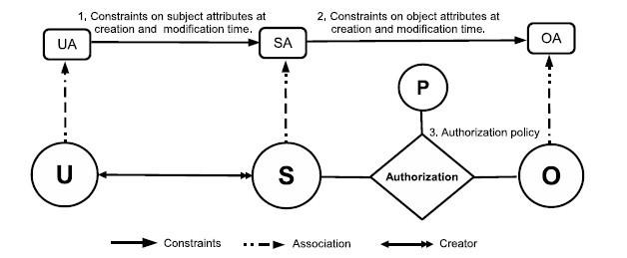
ABACα Model Structure
Policy Configuration Points
© Ravi Sandhu
World-Leading Research with Real-World Impact!
21

Slide 22
ICS Projects
Secure information sharing
Social network security
Secure data provenance
Attribute based access control
Botnet and malware analysis
Smart grid security
Hardware security
Future internet
© Ravi Sandhu
World-Leading Research with Real-World Impact!

