Slide 1


Secure Cyber Incident Information Sharing
UTSA Team Leads
Dr. Ram Krishnan, Assistant Professor, ECE
Dr. Ravi Sandhu, Executive Director, ICS
April 30, 2014

Slide 2









LMI Research Institute (LRI): Academic Partnership Program
Through formal working relationships with universities across the country, LMI bridges the gap between academia and industry to create innovative solutions and explore new research topics
The partnership program exposes students to real-world challenges faced by the federal government through structured, funded research projects

Slide 3
Cyber Incident Response
Secure information sharing amongst a set of entities/organizations
Often ad hoc
What are the effective ways to facilitate information sharing in such circumstances?
Information sharing models
Infrastructure, technologies, platforms

Slide 4
Agile Incident Response
Org A
Personnel Join/Leave
County Threat Emergency Response
Long-Term
Members
Org B
Team 1
Personnel+Resources
Personnel+Resources
Local Police
Org C
Resources Add/Remove
Within a team:
Controlled access
Flexible and fine-grained access control
Team should function unaffected by membership dynamics
Org D
Team 2

Slide 5
Cyber Incident Information Sharing Scenarios
Community
Cyber incidents across critical infrastructure providers in a community
Emergency response, healthcare, banks, utility
Electric grid
Cyber incidents in electric power provider orgs
Local utilities, ISOs, ERCOT, NERC

Slide 6
Key Requirements
Cyber infrastructure sharing to support data and compute
Need a community information sharing platform
Controlled access
Light-weight and agile
Rapid deployment and configuration
Secure environment

Slide 7
Cloud Infrastructure as a Service
Virtualized IT infrastructure (servers, storage, networks, OS, etc.)
Delivered as a service over a network, on demand, dynamic scaling, etc.
Prominent examples
Amazon AWS
OpenStack

Slide 8

Enforcement in Cloud IaaS
Community Cloud
Add/Remove Data
Add/Remove Data
Secure Isolated Domain (SID)
View #1: Participant C
View #2: SID
View #1: Participant A
View #2: SID
Participant C
Participant A
Join/Leave Users
Join/Leave Users
Add/Remove Data
Join/Leave Users
Participant B
View #1: Participant B
View #2: SID

Slide 9
Next Steps
UTSA to incorporate INL input
Develop prototype in OpenStack
Share research results with INL
August/September

Slide 10
Thanks
Comments, Q&A

Slide 11
Backup

Slide 12
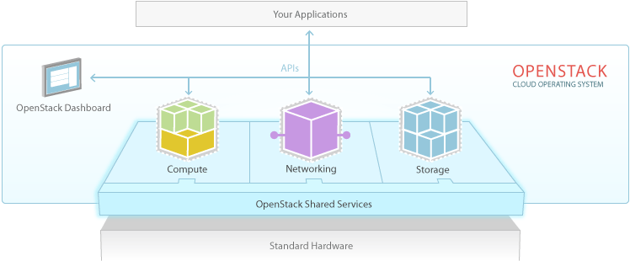
OpenStack
> 200 companies
~14000 developers
>130 countries
OpenStack
Dominant open source cloud IaaS platform

Slide 13
Project Goal
Tenant #3
Tasks:
Manage Virtual Infrastructure
Create and Manage Tenants (e.g. create tenant super-user)
Inter-Tenant Sharing
CSP Personnel
Tenant #2
CSP’s OpenStack
Servers
Storage
Network
Tasks:
Architect Attributes of Org’s Users + Cloud Resources
Create and Manage Admin Users
Manage Attributes of Admin Users
Tasks:
Day-to-Day Operations
Add/Remove Capacity
Manage N/W
Backup, Snapshot, etc.
Tasks:
Create and Manage Org’s Regular Users
Manage Attributes of Regular Users
Manage Attributes of Org’s Resources
Tenant #1 Regular IT Users
Tenant #1
IT Super-Users (Architects)
Tenant #1 Administrative IT Users
Utilize
Utilize
Utilize
ABAC Administrative Models
ABAC Operational Models

Slide 14
Closed Network Scenario
Unusual activity in Air Force, Navy & Army networks
A physically secure and air-gapped meeting room with members from AFCYBER, ARCYBER and FLTCYBER
Members bring data for analysis and collaboration
Maps, a VM configured with software tools, a VM image with a virus/worm, log files, etc.
Strict control on data import/export

Slide 15
Data Exfiltration Scenario
Unusual file transfers from IP addresses within an org to an external IP address
Similar activities observed in partner orgs
Need to find if these events are connected
Any correlation between those files?
Members bring data for analysis+collaboration

