Slide 1
Institute for Cyber Security
Group-Centric Models for
Secure Information Sharing
Prof. Ravi Sandhu
Executive Director and Endowed Chair
March 30, 2012
ravi.sandhu@utsa.edu
www.profsandhu.com
www.ics.utsa.edu
Joint work with ICS colleagues:
Ram Krishnan, Jianwei Niu and Will Winsborough
© Ravi Sandhu
World-Leading Research with Real-World Impact!

Slide 2
Goal: 4th Element
3 succesful access control models in 40+ years
  Discretionary Access Control (DAC)
  Mandatory Access Control (MAC)
  Role-base Access Control (RBAC)
Crucial ingredients for success
  Strong mathematical foundations
  Strong intuitive foundations
  Significant real-world deployment
© Ravi Sandhu
World-Leading Research with Real-World Impact!

Slide 3
What is the 4th Element?
DAC – owner control
MAC – information flow in a lattice
RBAC – organizational/social alignment
Dynamics/agility
  DAC: too loose, too fine-grained
  MAC: too rigid, static lattice
  RBAC: too enterprise centric
  Group-centric conceived to fill this gap
© Ravi Sandhu
World-Leading Research with Real-World Impact!

Slide 4
Historical Aside on Dynamics/Agility
Harrison, Russo and Ullman 1976: HRU
  dynamics leads to undecidable safety
Jones, Lipton, Snyder 1978: Take-Grant
  simple models can be efficiently decidable
Sandhu, 1988, 1992: SPM, TAM
  sophisticated models can be efficiently decidable
© Ravi Sandhu
World-Leading Research with Real-World Impact!

Slide 5
Secure Information Sharing (SIS)
Goal: Share but protect
Containment challenge
  Client containment
    Ultimate assurance infeasible (e.g., the analog hole)
    Appropriate assurance achievable
  Server containment
    Will typically have higher assurance than client containment
Policy challenge
  How to construct meaningful, usable, agile SIS policy
  How to develop an intertwined information and security model
© Ravi Sandhu
World-Leading Research with Real-World Impact!

Slide 6
SIS Policy Construction
Dissemination Centric (d-SIS)
  Sticky policies that follow an object along a dissemination chain (possibly modified at each step)
Group Centric (g-SIS)
  Bring users and information together to share existing information and create new information
  Metaphors: Secure meeting room, Subscription service
  Benefits: analogous to RBAC over DAC
© Ravi Sandhu
World-Leading Research with Real-World Impact!

Slide 7
Community Cyber Security
Filtered RW
Administered Membership
Core Group
Incident Group
Conditional Membership
Automatic Membership
Administered Membership
Administered Membership
Open Group
Filtered RW
Domain
Experts
© Ravi Sandhu
World-Leading Research with Real-World Impact!

Slide 8
Community Cyber Security
Incident Groups
Conditional Membership
g1
Administered Membership
Core Group
Read Subordination
Domain Experts
Automatic Membership
Conditional Membership
Administered Membership
Open Group
g2
Conditional Membership
Write Subordination
Administered Membership
g3
© Ravi Sandhu
World-Leading Research with Real-World Impact!

Slide 9
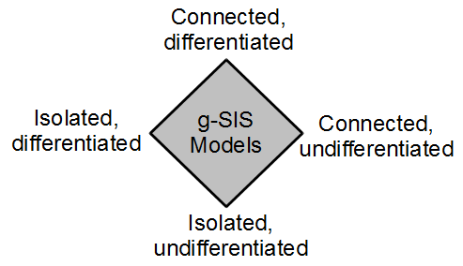
A Family of g-SIS Models
© Ravi Sandhu
World-Leading Research with Real-World Impact!

Slide 10
Isolated, Undifferentiated g-SIS Models
Users
Join
Leave
GROUP
Authz(U,O,R)?
GROUP
Authz(U,O,R)?
Add
Remove
Objects
© Ravi Sandhu
World-Leading Research with Real-World Impact!

Slide 11
Isolated, Undifferentiated g-SIS Models
Strict Join
Users
Strict Leave
Liberal
Join
GROUP
Authz(U,O,R)?
LiberalLeave
GROUP
Authz(U,O,R)?
Strict
Add
Strict
Remove
Liberal Add
Liberal Remove
Objects
© Ravi Sandhu
World-Leading Research with Real-World Impact!

Slide 12
Group Operation Semantics
Strict Vs Liberal operations
  User operations (SJ, LJ, SL, LL)
  Object operations (SA, LA, SR, LR)
u not authorized to access objects added prior to join time
Users joining after add time not authorized to access o
SJ (u)
SA (o)
Users authorized to access o at remove time retain access
u retains access to objects authorized at leave time
LL (u)
LR (o)
© Ravi Sandhu
World-Leading Research with Real-World Impact!

Slide 13
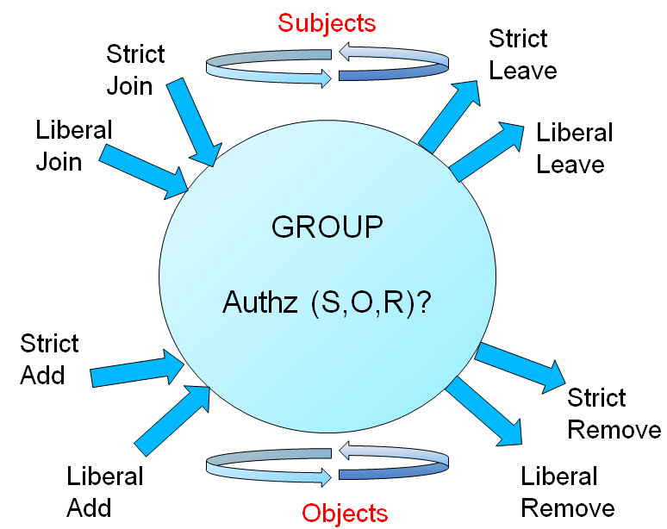
The π-System g-SIS Specification
π-system g-SIS Specification:
Add after Join
Add before Join
Well-formedness constraints rule out invalid traces
Examples:
1. user joining and leaving in the same state
2. leaving before joining
© Ravi Sandhu
World-Leading Research with Real-World Impact!

Slide 14
Stateful Specification
Consists of three modules
state₀
interval₀
state₁
phase₁
phase₂
2.1
2.2
Capture action+authz requests
(Module 1)
Process authz requests
(Module 3)
Process action requests
(Module 2)
Module 2 maintains and manages data structures
  Keeps track of historical joins and leaves and adds and removes for users and objects
Module 3 consults with that data structure
© Ravi Sandhu
World-Leading Research with Real-World Impact!

Slide 15
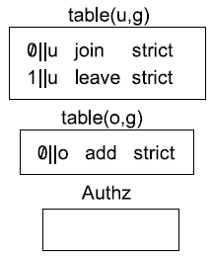
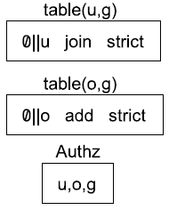
Stateless and Stateful Equivalence
state₀
state₁
SJ(u,g)
SA(o,g)
Authz(u,o,g)
SL(u,g)
¬ Authz(u,o,g)
A sample stateless trace
α-mapping
Corresponding stateful trace below
β-mapping
phase₁
phase₂
state₀
phase₁
phase₂
state₁
SJReq(u,g)
SAReq(o,g)
isAuthz(u,o,g)
SLReq(u,g)
isAuthz(u,o,g)
1. Process user & object events & update data structure
2. Check for authz
1. Process user & object events & update data structure
2. Check for authz
© Ravi Sandhu
World-Leading Research with Real-World Impact!

Slide 16
Formal Models Development
Formal stateless behavioral model
Provable security properties
Formal stateful enforceable model
Proof of equivalence
Formal stateful enforceable model with latencies, disconnected operations etc
Proof of safe equivalence
© Ravi Sandhu
World-Leading Research with Real-World Impact!

Slide 17
Why not ABAC (Attribute-Based Access Control)?
gSIS
Security and system goals
(objectives/policy)
Necessarily informal
P
E
I
M
O
D
E
L
S
Specified using users, subjects, objects, admins, labels, roles, groups, etc. in an ideal setting.
Security analysis (objectives, properties, etc.).
Policy models
Approximated policy realized using system architecture with trusted servers, protocols, etc.
Enforcement level security analysis (e.g. stale information due to network latency, protocol proofs, etc.).
Enforcement models
Implementation models
Technologies such as Cloud Computing, Trusted Computing, etc.
Implementation level security analysis (e.g. vulnerability analysis, penetration testing, etc.)
ABAC
Concrete System
Software and Hardware
© Ravi Sandhu
World-Leading Research with Real-World Impact!

