Slide 1
Institute for Cyber Security
Prof. Ravi Sandhu
Executive Director and Endowed Chair
February 4, 2015
ravi.sandhu@utsa.edu
www.profsandhu.com
www.ics.utsa.edu
© Ravi Sandhu
World-Leading Research with Real-World Impact!

Slide 2
UTSA Cyber Security Programs
Computer Science
College of Sciences
Hallmarks
Diversity
Maturity
Excellence
Institute for
Cyber Security
Information Systems
College of Business
Computer Engineering
College of Engineering
© Ravi Sandhu
World-Leading Research with Real-World Impact!
2

Slide 3
UTSA Cyber Security Programs
Diversity
3 Departments across 3 Colleges
Core security faculty plus numerous collaborators
World class labs: FlexCloud, FlexFarm
Research, Education, Workforce development, Cyber competitions
Hispanic minority serving institution
Maturity
Major and sustained push in cyber security since 2000
Established degrees and concentrations
NSA CAE for Education and for Research
Excellence
Rated number 1 in the country by a HP sponsored study in 2013
Creating first BS degree in Cyber Security in USA to be offered by a research intensive CS Department
Effectively a dual major in CS and Cyber Security
Excellent placement record for students at all levels
© Ravi Sandhu
World-Leading Research with Real-World Impact!
3

Slide 4
ICS Philosophy
Systems
Applications
Technologies
Foundations
© Ravi Sandhu
World-Leading Research with Real-World Impact!

Slide 5
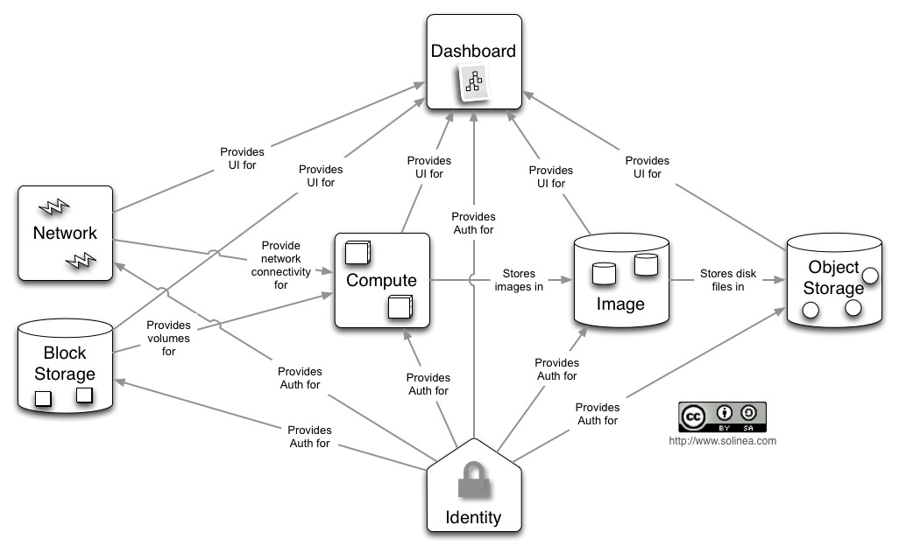
OpenStack Cloud Platform
Developers at 100’s of companies world wide
Very few Universities
© Ravi Sandhu
World-Leading Research with Real-World Impact!

Slide 6
Access Control
Human
Driven
Discretionary Access Control (DAC), 1970
Mandatory Access Control (MAC), 1970
Role Based Access Control (RBAC), 1995
Attribute Based Access Control (ABAC), ????
Automated
Adaptive
© Ravi Sandhu
World-Leading Research with Real-World Impact!
6

Slide 7
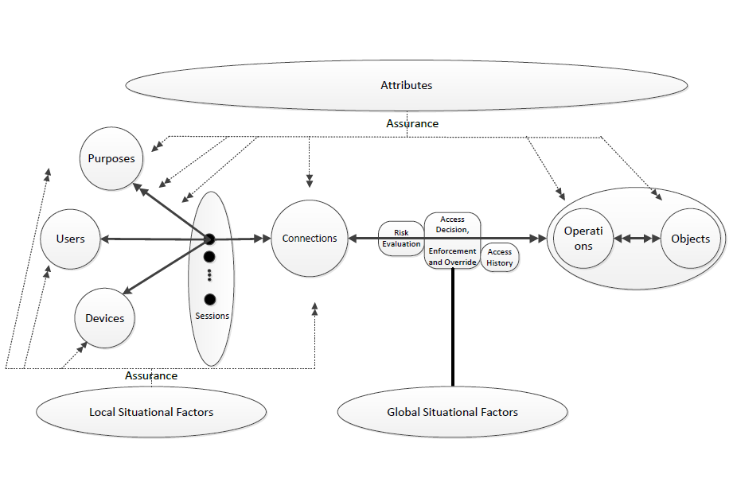
Risk Adaptive Access Control (RAdAC)
© Ravi Sandhu
World-Leading Research with Real-World Impact!
7

Slide 8









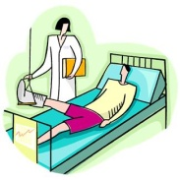





Provenance Aware Systems
Access and Usage Control
of Data and its Provenance
Data Trustworthiness
(e.g., sensor networks)
Data
Data Forensics
(e.g., SIM tools)
Provenance
Data Privacy
(e.g., track hospital records)
etcetera
© Ravi Sandhu
World-Leading Research with Real-World Impact!

Slide 9
Group Centric Information/Resouce Sharing
Administrative Model
Collaboration Group
Operational Model
Establish/Disband
Join User
Join User
Create RO/RW Subject
Kill Subject
Create Object
Read/Update Version
Suspend/Resume
Version
Leave User
Create RO/RW Subject
Kill Subject
Create Object
Read/Update Version
Suspend/Resume
Version
Leave User
ORG A
Add Version
Add Version
ORG B
Remove Version
Remove Version
Merge Version
Merge Version
Substitute User
Substitute User
Import Version
© Ravi Sandhu
World-Leading Research with Real-World Impact!

Slide 10
Other Research Areas
Social network and social computing security
Integrated models for access control, compliance and forensics
Smart grid security
Malware models and analysis
Botnet detection and mitigation
…………….
© Ravi Sandhu
World-Leading Research with Real-World Impact!
10

