Slide 1
Identity and Access Control in the
Physical and Virtual Internet of Things
Prof. Ravi Sandhu
Executive Director and Endowed Chair
Project Status Briefing
July 7, 2016
ravi.sandhu@utsa.edu
www.profsandhu.com
www.ics.utsa.edu
© Ravi Sandhu
World-Leading Research with Real-World Impact!

Slide 2
Motivating Premises
© Ravi Sandhu
World-Leading Research with Real-World Impact!
2
Security and privacy will be adopted in IoT to the extent these
  Provide added value
  Are achievable at reasonable cost
Academic research can contribute by developing identity and access control models that resonate with industry innovators.
  Simple to understand and deploy
  Can accommodate complex policies when appropriate

Slide 3
Project Goals
© Ravi Sandhu
World-Leading Research with Real-World Impact!
3
Develop an initial set of identity and access control models for IoT within a robust framework, which can
Support further maturation and elaboration of this initial set.

Slide 4
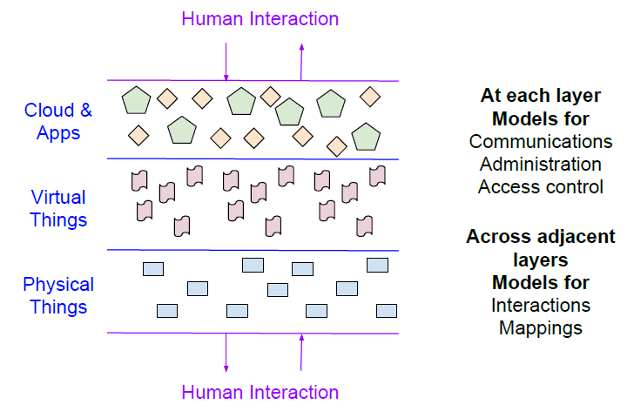
Core Technical Premises
© Ravi Sandhu
World-Leading Research with Real-World Impact!
4

Slide 5
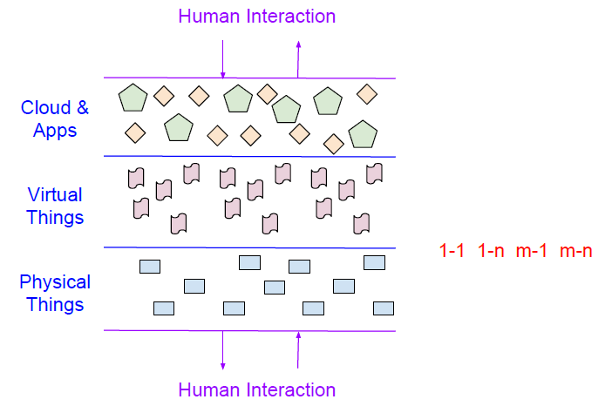
Core Technical Premises
© Ravi Sandhu
World-Leading Research with Real-World Impact!
5

Slide 6
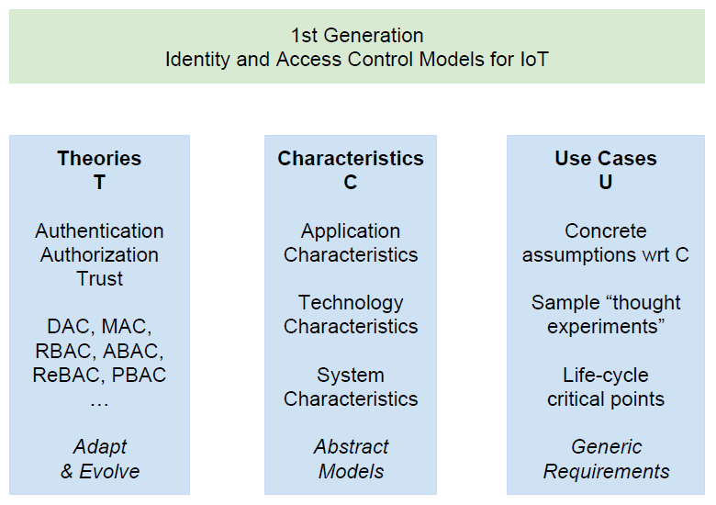
Technical Approach
© Ravi Sandhu
World-Leading Research with Real-World Impact!
6

Slide 7
Project Deliverables
An initial set of identity and access control models for the IoT domain encompassing physical and virtual layers
An articulation of the three pillars of T, C and U, which underlie these models
A statement of future R&D efforts required to take the initial set of models to maturity and deployment in practice.
© Ravi Sandhu
World-Leading Research with Real-World Impact!
7

