Slide 1
What can Technologists learn from
the History of the Internet?
Prof. Ravi Sandhu
Executive Director and Endowed Chair
Department of Computer Science
University of Texas at San Antonio
Munich Center for Internet Research
September 22, 2016
ravi.sandhu@utsa.edu
www.profsandhu.com
www.ics.utsa.edu
© Ravi Sandhu
World-Leading Research with Real-World Impact!

Slide 2
What can Security Technologists learn from
the History of the Internet?
Prof. Ravi Sandhu
Executive Director and Endowed Chair
Department of Computer Science
University of Texas at San Antonio
Munich Center for Internet Research
September 22, 2016
ravi.sandhu@utsa.edu
www.profsandhu.com
www.ics.utsa.edu
© Ravi Sandhu
World-Leading Research with Real-World Impact!

Slide 3
Cyberspace/Cybersecurity Ecosystem
Science
Engineering
Business/Societal
Cyberspace Characteristics
Entirely human-made
Evolves rapidly and unpredictably
Subject to physical, mathematical and technological laws/heuristics
© Ravi Sandhu
World-Leading Research with Real-World Impact!
3

Slide 4
Cyberspace/Cybersecurity Ecosystem
Science
Traditional science explains the cause of observed phenomenon
Cyber science facilitates the construction of future systems
Engineering
Business/Societal
Cyberspace Characteristics
Entirely human-made
Evolves rapidly and unpredictably
Subject to physical, mathematical and technological laws/heuristics
© Ravi Sandhu
World-Leading Research with Real-World Impact!
4

Slide 5
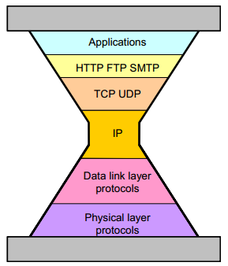
Internet Hourglass Model TCP/IP
© Ravi Sandhu
World-Leading Research with Real-World Impact!

Slide 6
Internet Hourglass Model TCP/IP
TCP RFC 793
Sept. 1981
IPv4 RFC 791
Sept. 1981
© Ravi Sandhu
World-Leading Research with Real-World Impact!

Slide 7
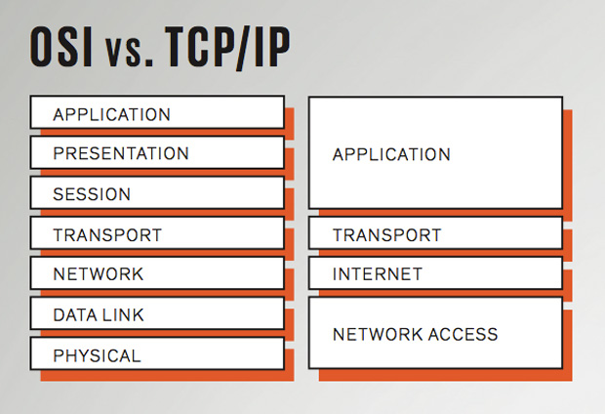
The TCP/IP Story
A TCP/IP based Internet was not inevitable.
The Internet was supposed to be OSI based.
© Ravi Sandhu
World-Leading Research with Real-World Impact!

Slide 8
The TCP/IP Story
TCP and IP have several well known deficiencies but are unlikely to disappear soon IPv6 not withstanding
© Ravi Sandhu
World-Leading Research with Real-World Impact!

Slide 9
The TCP/IP Lesson
Agility trumps perfection
© Ravi Sandhu
World-Leading Research with Real-World Impact!
9

Slide 10
The TCP/IP Lesson
Agility trumps perfection
Not quite the same as
Good enough trumps perfect
© Ravi Sandhu
World-Leading Research with Real-World Impact!
10

Slide 11
The TCP/IP Lesson
Agility =
Good enough for now
+
Future-proof for uncertain future
© Ravi Sandhu
World-Leading Research with Real-World Impact!
11

Slide 12
IP Spoofing Story
ALLOW GOOD GUYS IN
KEEP BAD GUYS OUT
IP Spoofing predicted in Bell Labs report ≈ 1985
Unencrypted Telnet with passwords in clear
1st Generation firewalls deployed ≈ 1992
IP Spoofing attacks proliferate in the wild ≈ 1993
Virtual Private Networks emerge ≈ late 1990’s
Vulnerability shifts to the client PC
Network Admission Control ≈ 2000’s
Persists as a Distributed Denial of Service mechanism
Most of these fixes have not changed or extended IPv4
© Ravi Sandhu
World-Leading Research with Real-World Impact!
12

Slide 13
Internet Security Protocols
SSL/TLS
Dozens of other security protocols
IPSEC
© Ravi Sandhu
World-Leading Research with Real-World Impact!

Slide 14
Internet Security Protocols
Half successful
SSL/TLS
Dozens of other security protocols
IPSEC
Largely failed
Some successes
Many failures
© Ravi Sandhu
World-Leading Research with Real-World Impact!

Slide 15
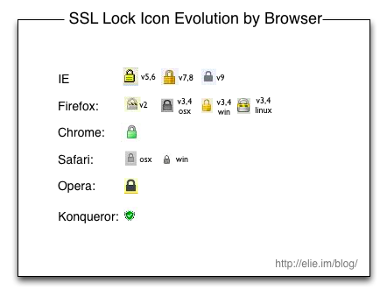
SSL (Secure Sockets Layer)
© Ravi Sandhu
World-Leading Research with Real-World Impact!

Slide 16

1-way vs 2-way SSL
Client
(Browser)
1-way SSL
Server
Client
(Browser)
2-way SSL
Server
© Ravi Sandhu
World-Leading Research with Real-World Impact!

Slide 17
1-way vs 2-way SSL
Client
(Browser)
1-way SSL
Server
INSECURE
Phishing
Man-in-the-middle
Client
(Browser)
2-way SSL
Server
SECURE
Phishing
Man-in-the-middle
© Ravi Sandhu
World-Leading Research with Real-World Impact!

Slide 18
1-way vs 2-way SSL
Client
(Browser)
1-way SSL
Server
INSECURE
Phishing
Man-in-the-middle
MASS DEPLOYMENT
Client
(Browser)
2-way SSL
Server
SECURE
Phishing
Man-in-the-middle
MINIMAL DEPLOYMENT
© Ravi Sandhu
World-Leading Research with Real-World Impact!

Slide 19
The SSL Lesson
Client-less trumps client-full
Start-ups (SSL) trump committees (IPSEC)
© Ravi Sandhu
World-Leading Research with Real-World Impact!
19

Slide 20
Summary
Agility trumps perfection
Client-less trumps client-full
Start-ups trump committees
© Ravi Sandhu
World-Leading Research with Real-World Impact!
20

