Slide 1
Institute for Cyber Security
Prof. Ravi Sandhu
Executive Director and Endowed Chair
Private Briefing
June 18, 2013
ravi.sandhu@utsa.edu
www.profsandhu.com
www.ics.utsa.edu
© Ravi Sandhu
World-Leading Research with Real-World Impact!

Slide 2
Access Control
Human
Driven
Discretionary Access Control (DAC), 1970
Mandatory Access Control (MAC), 1970
Role Based Access Control (RBAC), 1995
Attribute Based Access Control (ABAC), ????
Automated
Adaptive
© Ravi Sandhu
World-Leading Research with Real-World Impact!
2

Slide 3
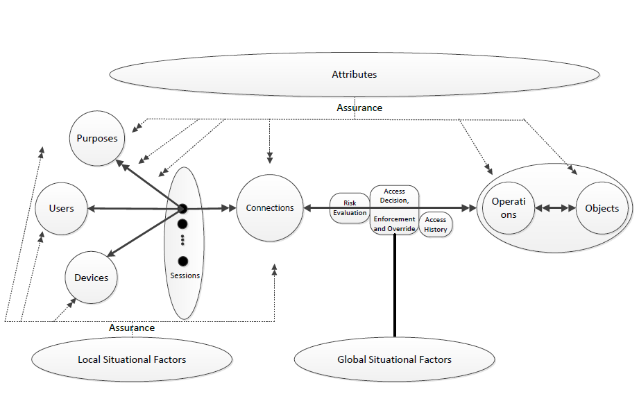
Risk Adaptive Access Control (RAdAC)
© Ravi Sandhu
World-Leading Research with Real-World Impact!
3

Slide 4









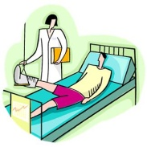





Provenance Aware Systems
Access and Usage Control
of Data and its Provenance
Data Trustworthiness
(e.g., sensor networks)
Data
Data Forensics
(e.g., SIM tools)
Provenance
Data Privacy
(e.g., track hospital records)
etcetera
© Ravi Sandhu
World-Leading Research with Real-World Impact!

