Slide 1
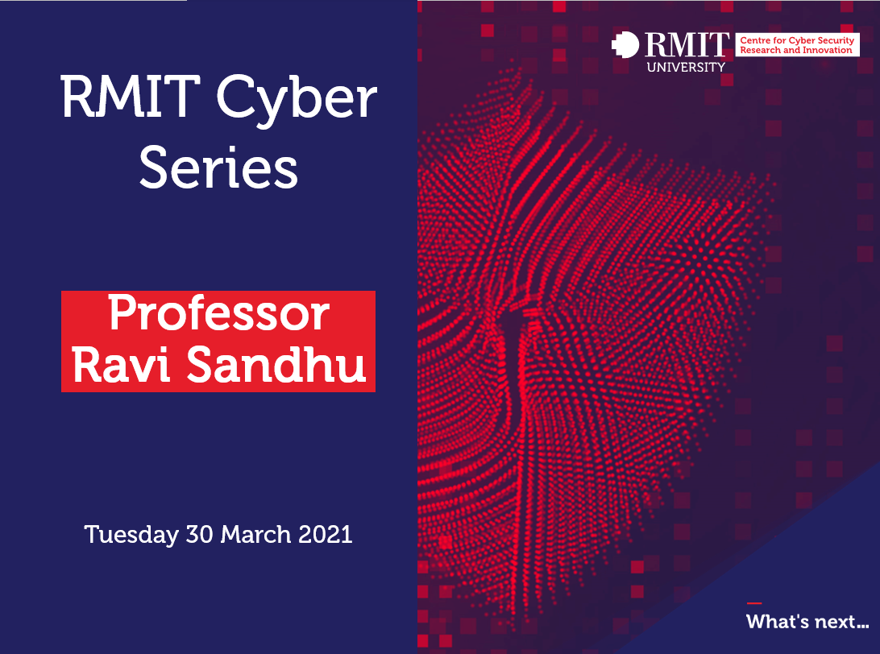

Slide 2


Slide 3
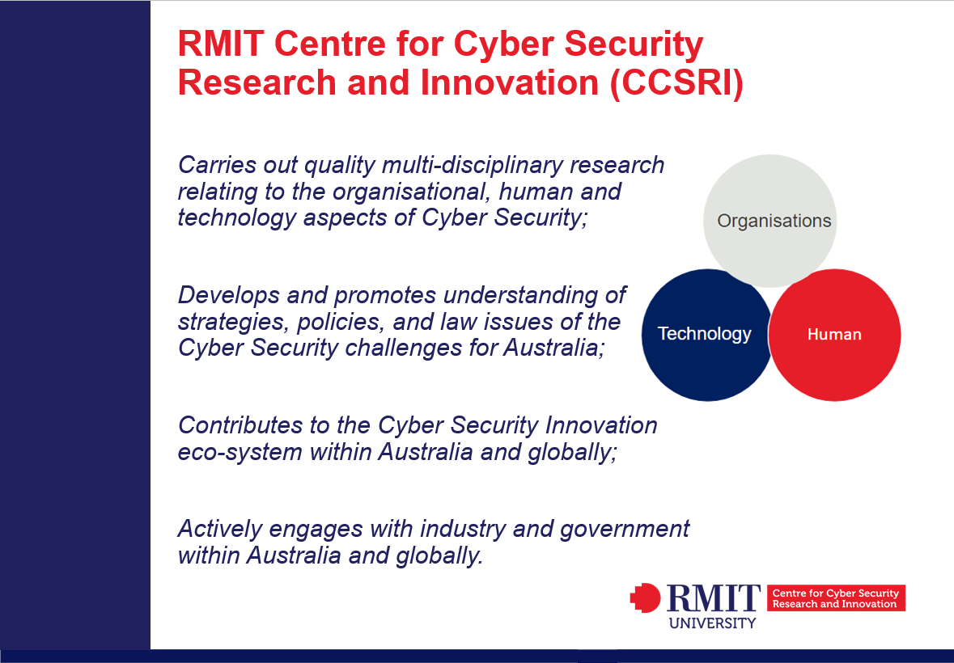

Slide 4
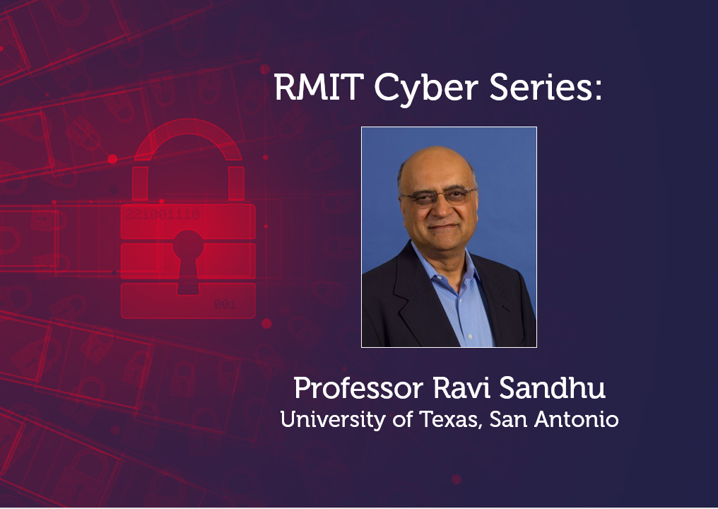

Slide 5
What Technologists Should Learn from the History of Cyber Security
Ravi Sandhu
Professor of Computer Science
Lutcher Brown Chair in Cyber Security
Executive Director, Institute for Cyber Security
RMIT University Centre for Cyber Security Research and Innovation
Seminar Series
March 29, 2021
ravi.sandhu@utsa.edu
www.profsandhu.com

Slide 6
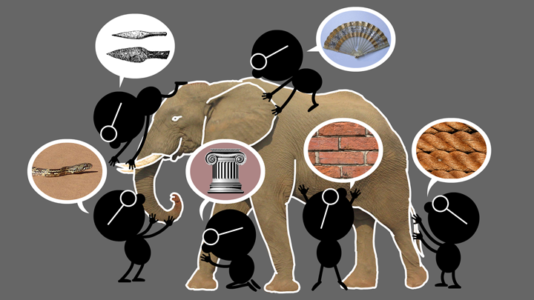
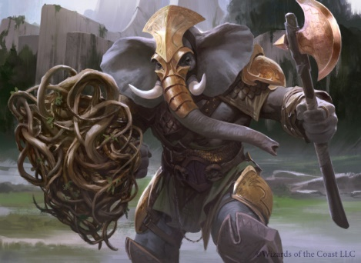
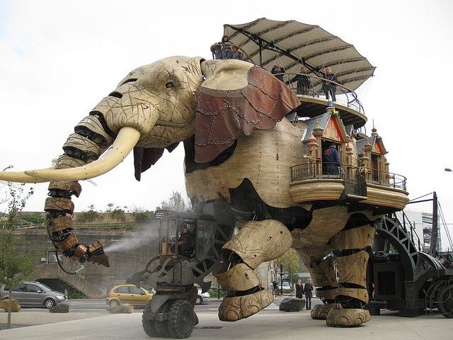

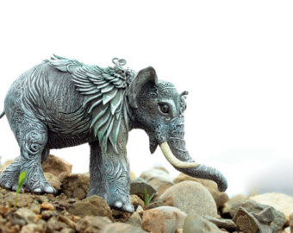
Natural vs Cyber Science
Elephant Problem
Cyber-Elephant Problem
Applied vs Foundational Science: Cyber-elephants require applied and foundational combined
Present vs Future Focus: Rapidly evolving cyber-elephants require future focus

Slide 7
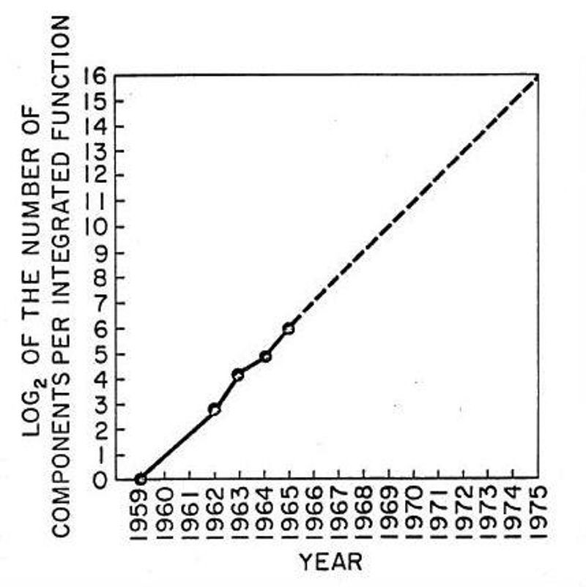
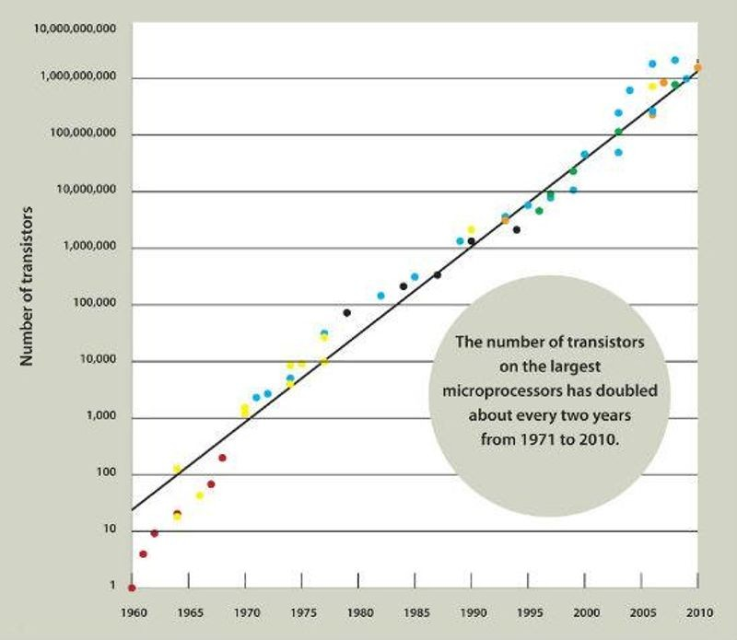
Moore’s Law & Future Focus

Slide 8

History Rhymes

Slide 9
Cyber Security Success is Possible
The ATM (Automatic Teller Machine) system is
  secure enough
  global in scope
US President’s nuclear football
Consumer Grade Assurance
Military Grade Assurance

Slide 10
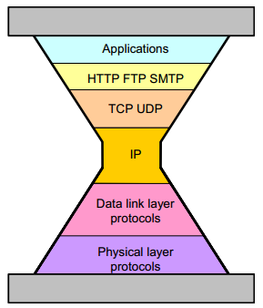
Internet Protocols
TCP RFC 793
Sept. 1981
IPv4 RFC 791
Sept. 1981

Slide 11
IP Spoofing Story
ALLOW GOOD GUYS IN
KEEP BAD GUYS OUT
IP Spoofing predicted in Bell Labs report ≈ 1985
Unencrypted Telnet with passwords in clear
1st Generation firewalls deployed ≈ 1992
IP Spoofing attacks proliferate in the wild ≈ 1993
Virtual Private Networks emerge ≈ late 1990’s
Vulnerability shifts to the client PC
Network Admission Control ≈ 2000’s
Persists as a Distributed Denial of Service mechanism
Most of these fixes have not changed or extended IPv4

Slide 12
World Wide Web Protocols
http versions
1989 onwards
TCP RFC 793
Sept. 1981
https
http over SSL
1994 onwards
IPv4 RFC 791
Sept. 1981

Slide 13

SSL: 2-Way
Client
(Browser)
Server
https
Client
certificate
Server
certificate
Authenticated

Slide 14
SSL: 1-Way
Client
(Browser)
Server
https
X
X
Client
certificate
Server
certificate
Authenticated
X

Slide 15
SSL: 1-Way
Man-in-the-Middle (MITM)
Known since at least 1998
Client
(Browser)
MITM
Server
https
https
fake server
certificate
server
certificate
Authenticated
Authenticated

Slide 16
Laws of Attackers
  Attackers exist
    You will be attacked
  Attackers have sharply escalating incentive
    Money, terrorism, war, espionage, sabotage, …
  Attackers are lazy (follow path of least resistance)
    Attacks will escalate BUT no faster than necessary
  Attackers are innovative (and stealthy)
    Eventually all feasible attacks will manifest
  Attackers are copycats
    Known attacks will proliferate widely
  Attackers have asymmetrical advantage
    Need one point of failure

Slide 17
Principles of Defense
  Prepare for tomorrow’s attacks, not just yesterday’s
    Good defenders strive to stay ahead of the curve, bad defenders forever lag
  Take care of tomorrow’s attacks before next year’s attacks
    Researchers will and should pursue defense against attacks that will manifest far in the future BUT these solutions will deploy only as attacks catch up
  Use future-proof barriers
    Defenders need a roadmap and need to make adjustments
  It’s all about trade-offs
    Security, Convenience, Cost
Beware of “silver bullets”

Slide 18
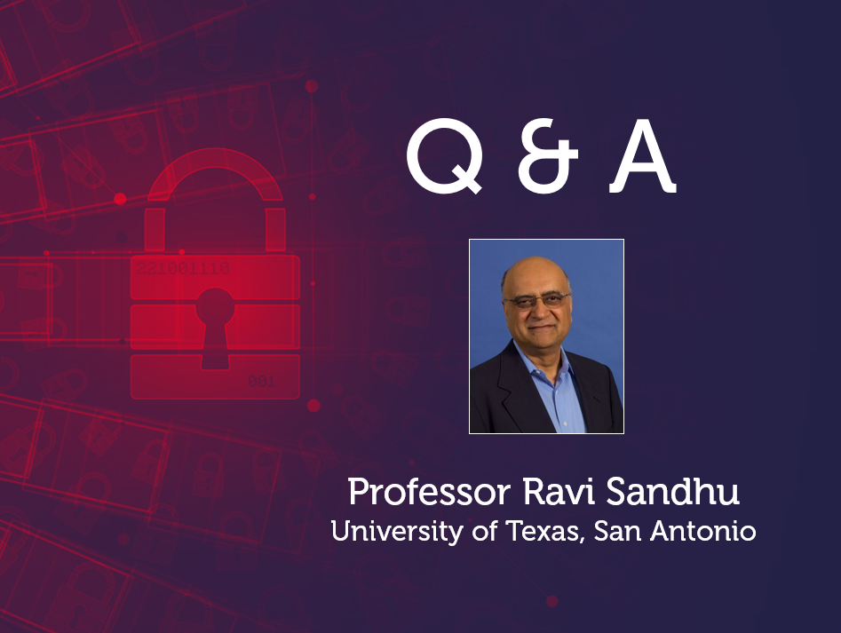

Slide 19


