Slide 1
On the Value of Access Control Models
Ravi Sandhu
Executive Director and Chief Scientist
Professor of Computer Science
Lutcher Brown Chair in Cyber Security
SACMAT Panel, June 14, 2018
www.profsandhu.com

Slide 2
Attributes? Roles? Relationships? or no model at all?
Model base vs Learnt Policies:
Finding balance between expressible and usable policies
Ravi Sandhu
Executive Director and Chief Scientist
Professor of Computer Science
Lutcher Brown Chair in Cyber Security
SACMAT Panel, June 14, 2018
www.profsandhu.com

Slide 3
Value of a “Good” Model
NIST-ANSI
Standard Adopted
NIST-ANSI
Standard Proposed
RBAC96
model
Ludwig Fuchs, Gunther Pernul and Ravi Sandhu, Roles in Information Security-A Survey and Classification of the Research Area, Computers & Security, Volume 30, Number 8, Nov. 2011, pages 748-76

Slide 4
ABAC Status
NIST-ANSI
Standard Adopted
NIST-ANSI
Standard Proposed
RBAC96
model
1990?
2018
ABAC still in pre/early phase

Slide 5
Risk of “Bad” Models for ABAC Adoption
  Good model is missing
  Incomplete model:
    ABAC = XACML
  Enforcement model:
    ABAC = ABE
X
X

Slide 6
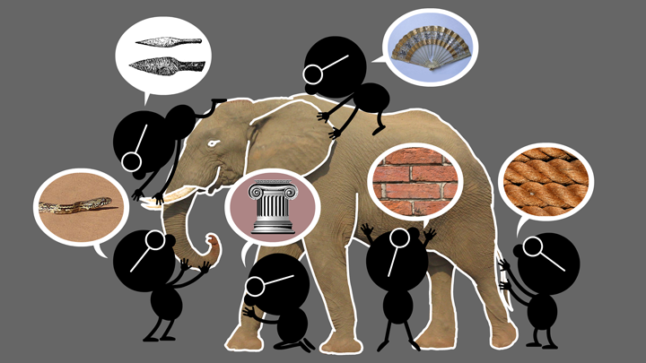

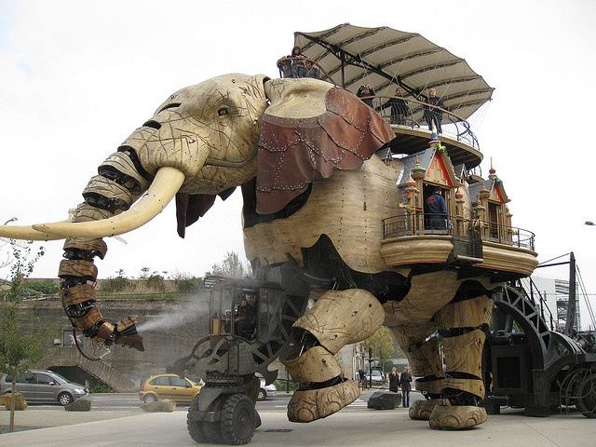


Cyber Challenge: Evaluation of Models
Elephant Problem
Cyber-Elephant Problem
Natural vs
Cyber Science

