Slide 1
Privacy and Access Control:
How are These Two Concepts Related?
Prof. Ravi Sandhu
Executive Director and Endowed Chair
SACMAT Panel
June 3, 2015
ravi.sandhu@utsa.edu
www.profsandhu.com
www.ics.utsa.edu
© Ravi Sandhu
World-Leading Research with Real-World Impact!

Slide 2
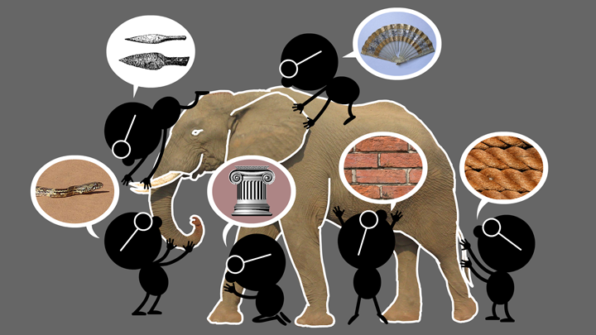
Elephant Problem
© Ravi Sandhu
World-Leading Research with Real-World Impact!
2

Slide 3
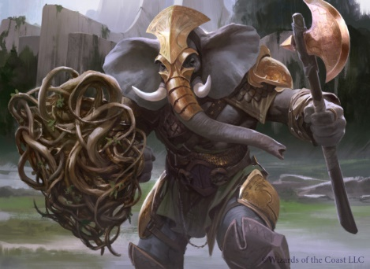
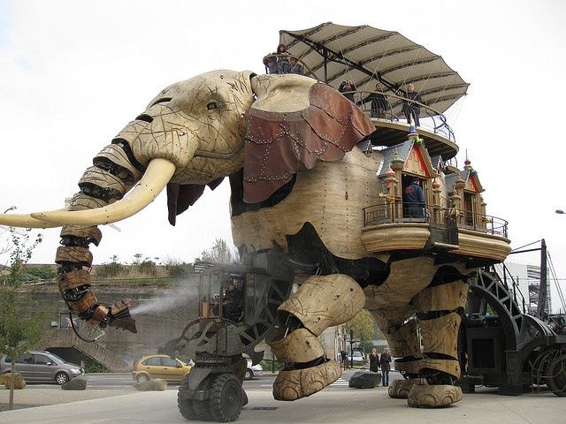

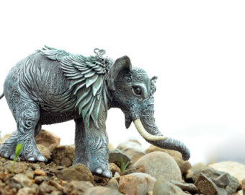
Cyber-Elephant Problem
© Ravi Sandhu
World-Leading Research with Real-World Impact!
3

Slide 4
Access Control
Privacy-Inspired Extensions
Pre-Access
Post-Access
© Ravi Sandhu
World-Leading Research with Real-World Impact!
4

Slide 5
Access Control
Privacy-Inspired Extensions
Pre-Access
Post-Access
Impose
agreements
Impose
limits
Declare
purpose
Trust
negotiation
Attribute-Based
Encryption
© Ravi Sandhu
World-Leading Research with Real-World Impact!
5

Slide 6
Access Control
Privacy-Inspired Extensions
Pre-Access
Post-Access
Enforce
Audit
Trust
© Ravi Sandhu
World-Leading Research with Real-World Impact!
6

Slide 7
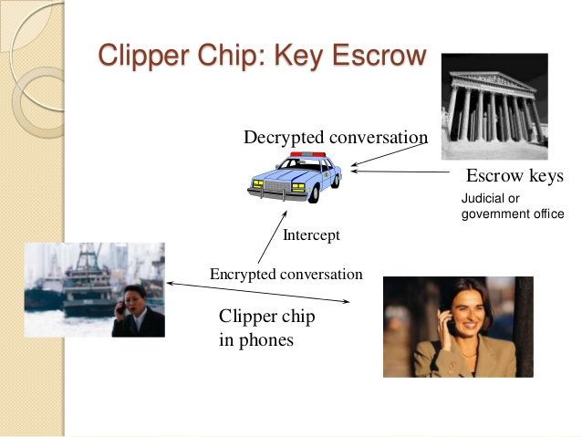
Clipper Chip 1993
© Ravi Sandhu
World-Leading Research with Real-World Impact!
7

Slide 8
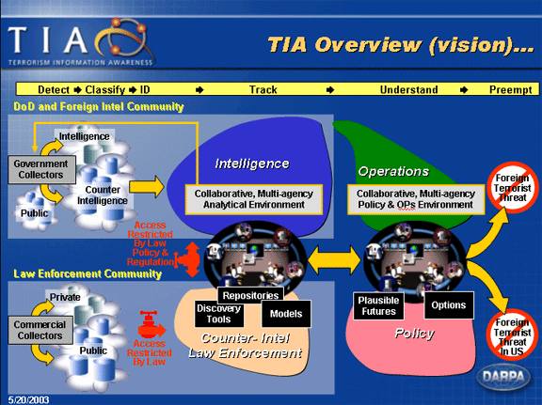
Total Information Awareness 2003
© Ravi Sandhu
World-Leading Research with Real-World Impact!
8

Slide 9
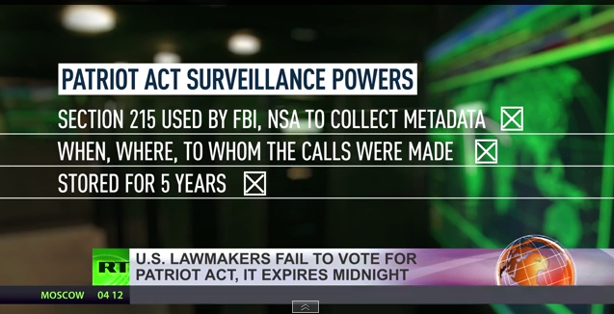
Patriot Act Reauthorization 2015
© Ravi Sandhu
World-Leading Research with Real-World Impact!
9

