Slide 1
Institute for Cyber Security
Attribute-Based Access Control Models
and Beyond
Prof. Ravi Sandhu
Executive Director, Institute for Cyber Security
Lutcher Brown Endowed Chair in Cyber Security
University of Texas at San Antonio
Singapore Management University
Singapore
April 10, 2015
ravi.sandhu@utsa.edu, www.profsandhu.com, www.ics.utsa.edu
© Ravi Sandhu
World-Leading Research with Real-World Impact!

Slide 2
Cyber Security Technologies
AUTHENTICATION
RISK
ANALYSIS
ASSURANCE
CRYPTOGRAPHY
ACCESS
CONTROL
INTRUSION/MALWARE
DETECTION
AND AUDIT
SECURITY ENGINEERING
& MANAGEMENT
© Ravi Sandhu
World-Leading Research with Real-World Impact!
2

Slide 3
Security Limitations
Analog Hole
Inference
Covert Channels
Side Channels
Phishing
Social Engineering
Attack Asymmetry
Privacy vs Security
Base-rate Fallacy
….
Can manage Cannot eliminate
© Ravi Sandhu
World-Leading Research with Real-World Impact!
3

Slide 4
Access Control
Discretionary Access Control (DAC), 1970
Mandatory Access Control (MAC), 1970
Role Based Access Control (RBAC), 1995
Attribute Based Access Control (ABAC), ????
© Ravi Sandhu
World-Leading Research with Real-World Impact!
4

Slide 5
Access Control
Fixed
policy
Discretionary Access Control (DAC), 1970
Mandatory Access Control (MAC), 1970
Role Based Access Control (RBAC), 1995
Attribute Based Access Control (ABAC), ????
Flexible
policy
© Ravi Sandhu
World-Leading Research with Real-World Impact!
5

Slide 6
Access Control
Administration
Driven
Discretionary Access Control (DAC), 1970
Mandatory Access Control (MAC), 1970
Role Based Access Control (RBAC), 1995
Attribute Based Access Control (ABAC), ????
Automated
Adaptive
© Ravi Sandhu
World-Leading Research with Real-World Impact!
6

Slide 7
Access Control
Enterprise
Oriented
Discretionary Access Control (DAC), 1970
Mandatory Access Control (MAC), 1970
Role Based Access Control (RBAC), 1995
Attribute Based Access Control (ABAC), ????
Beyond
Enterprise
© Ravi Sandhu
World-Leading Research with Real-World Impact!
7

Slide 8
Access Control
Discretionary Access Control (DAC), 1970
Mandatory Access Control (MAC), 1970
Role Based Access Control (RBAC), 1995
Messy or Chaotic?
Attribute Based Access Control (ABAC), ????
© Ravi Sandhu
World-Leading Research with Real-World Impact!
8

Slide 9
Access Control Models
Discretionary Access Control (DAC), 1970
Owner controls access
But only to the original, not to copies
Grounded in pre-computer policies of researchers
Mandatory Access Control (MAC), 1970
Synonymous to Lattice-Based Access Control (LBAC)
Access based on security labels
Labels propagate to copies
Grounded in pre-computer military and national security policies
Role-Based Access Control (RBAC), 1995
Access based on roles
Can be configured to do DAC or MAC
Grounded in pre-computer enterprise policies
Numerous other models but only 3 successes: SO FAR
© Ravi Sandhu
World-Leading Research with Real-World Impact!
9

Slide 10
Access Control Models
Policy
Specification
Policy
Enforcement
RBAC, ABAC
Initial focus
Policy
Reality
MAC, DAC
Main focus
RBAC, ABAC
Next step focus
Policy
Administration
MAC, DAC
Easy (relatively)
© Ravi Sandhu
World-Leading Research with Real-World Impact!
10

Slide 11
The RBAC Story
NIST-ANSI
Standard
Adopted
NIST-ANSI
Standard Proposed
RBAC96
model
Ludwig Fuchs, Gunther Pernul and Ravi Sandhu, Roles in Information Security-A Survey and Classification of the Research Area, Computers & Security, Volume 30, Number 8, Nov. 2011, pages 748-76
© Ravi Sandhu
World-Leading Research with Real-World Impact!
11

Slide 12
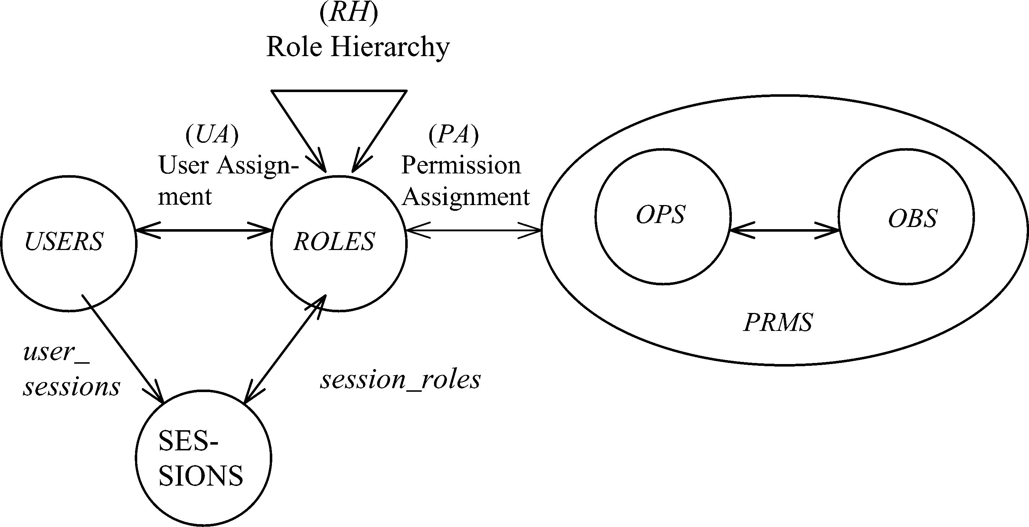
RBAC96 Model
Constraints
© Ravi Sandhu
World-Leading Research with Real-World Impact!
12

Slide 13
RBAC Policy Configuration Points
Security Architect
Security
Administrator
Security
Administrator
Security
Architect
User
Security Architect
Constraints
Security Architect
© Ravi Sandhu
World-Leading Research with Real-World Impact!
13

Slide 14
Fundamental Theorem of RBAC
RBAC can be configured to do MAC
RBAC can be configured to do DAC
RBAC is policy neutral
RBAC is neither MAC nor DAC!
© Ravi Sandhu
World-Leading Research with Real-World Impact!
14

Slide 15
RBAC Shortcomings
Role granularity is not adequate leading to role explosion
Researchers have suggested several extensions such as parameterized privileges, role templates, parameterized roles (1997-)
Role design and engineering is difficult and expensive
Substantial research on role engineering top down or bottom up (1996-), and on role mining (2003-)
Assignment of users/permissions to roles is cumbersome
Researchers have investigated decentralized administration (1997-), attribute-based implicit user-role assignment (2002-), role-delegation (2000-), role-based trust management (2003-), attribute-based implicit permission-role assignment (2012-)
Adjustment based on local/global situational factors is difficult
Temporal (2001-) and spatial (2005-) extensions to RBAC proposed
RBAC does not offer an extension framework
Every shortcoming seems to need a custom extension
Can ABAC unify these extensions in a common open-ended framework?
© Ravi Sandhu
World-Leading Research with Real-World Impact!
15

Slide 16
RBAC Shortcomings
Hard Enough
Impossible
Constraints
© Ravi Sandhu
World-Leading Research with Real-World Impact!
16

Slide 17
ABAC is not New
User (Identity)
Attributes
Public-keys +
Secured secrets
© Ravi Sandhu
World-Leading Research with Real-World Impact!

Slide 18
ABAC is not New
User (Identity)
X.500
Directory
X.509
Identity Certificates
Attributes
Public-keys +
Secured secrets
Pre Internet, early 1990s
© Ravi Sandhu
World-Leading Research with Real-World Impact!

Slide 19
ABAC is not New
User (Identity)
X.509
Attribute
Certificates
X.509
Identity Certificates
Attributes
Public-keys +
Secured secrets
Post Internet, late 1990s
© Ravi Sandhu
World-Leading Research with Real-World Impact!

Slide 20
ABAC is not New
User (Identity)
Attributes
SPKI Certificates
Public-keys +
Secured secrets
Post Internet, late 1990s
© Ravi Sandhu
World-Leading Research with Real-World Impact!

Slide 21
ABAC is not New
User (Identity)
Attributes
Anonymous
Credentials
Public-keys +
Secured secrets
Mature Internet, 2000s
© Ravi Sandhu
World-Leading Research with Real-World Impact!

Slide 22
ABAC is not New
Attributes
Action
Authorization Decision
User
Subject
Yes/No
Object
Context
Policy
© Ravi Sandhu
World-Leading Research with Real-World Impact!

Slide 23
ABAC is not New
Attributes
Action
Authorization Decision
User
Subject
Yes/No
Object
Context
Usage Control
XACML
Attribute-Based Encryption
Policy
Mature Internet, 2000s
© Ravi Sandhu
World-Leading Research with Real-World Impact!

Slide 24
ABAC Status
Standard
Adopted
Proposed
Standard
RBAC96
paper
1990?
2014
ABAC still in pre/early phase
© Ravi Sandhu
World-Leading Research with Real-World Impact!
24

Slide 25
Attribute-Based Access Control (ABAC)
Attributes are name:value pairs
possibly chained
values can be complex data structures
Associated with
actions
users
subjects
objects
contexts
policies
Converted by policies into rights just in time
policies specified by security architects
attributes maintained by security administrators
but also possibly by users OR reputation and trust mechanisms
Inherently extensible
© Ravi Sandhu
World-Leading Research with Real-World Impact!
25

Slide 26
ABACα Hypothesis (DBSEC 2012)
An ABAC model requires
identification of policy configuration points (PCPs)
languages and formalisms for each PCP
A core set of PCPs can be discovered by building the ABACα model to unify simple forms of DAC, MAC and RBAC
Additional ABAC models can then be developed by
increasing the sophistication of the ABACα PCPs
discovering additional PCPs driven by requirements beyond DAC, MAC and RBAC
A small but crucial first step
© Ravi Sandhu
World-Leading Research with Real-World Impact!
26

Slide 27
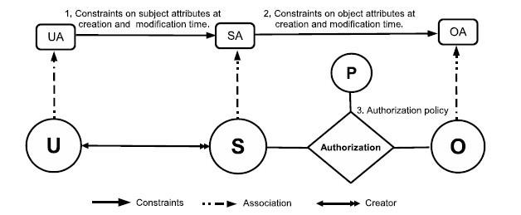
ABACα Model Structure
Policy Configuration Points
© Ravi Sandhu
World-Leading Research with Real-World Impact!
27

Slide 28
ABACα Model Structure
Policy Configuration Points
Can be configured to do DAC, MAC, RBAC
© Ravi Sandhu
World-Leading Research with Real-World Impact!
28

Slide 29
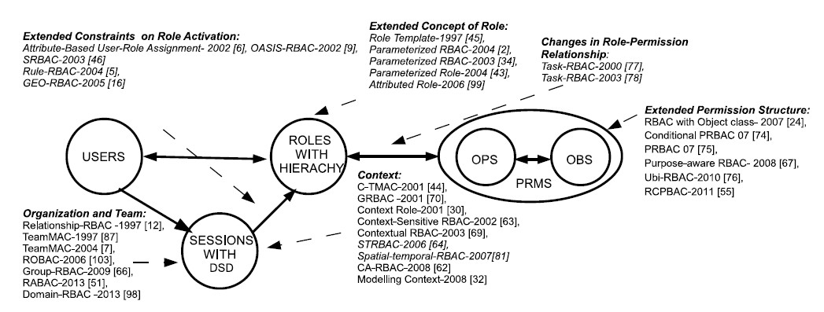
ABAC_{β} Scope
1,4
1, 2, 4, 5
1, 4, 5
4, 5
1, 2, 3, 4, 5
4
1, 4, 5
1. Context Attributes
2. Subject attribute constraints policy are different at creation and modification time.
4. Policy Language
5. Meta-Attributes
3. Subject attributes constrained by attributes of subjects created by the same user.
World-Leading Research with Real-World Impact!
29
Notes:
Give examples about what is excluded

Slide 30
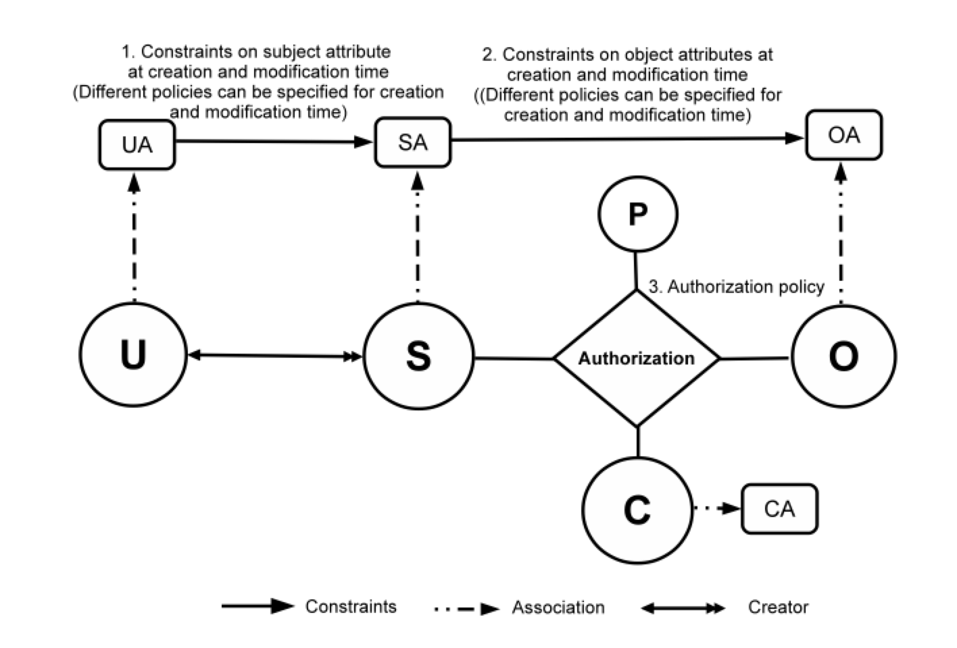
ABAC_{β} Model
30
Notes:
Show abac-alpha
Then for each type of extension, highlight the extensions to ABAC
23 and 24 integrated

Slide 31
Beyond ABAC
Attributes
Security
Access Control
Trust
Risk
Relationships
Provenance
© Ravi Sandhu
World-Leading Research with Real-World Impact!

Slide 32
ABAC Research at ICS
GURA model for user-attribute assignment
Safety analysis of ABAC_{α} and ABAC_{β}
Undecidable safety for ABAC models
Decidable safety for ABAC with finite fixed attributes
Constraints in ABAC
ABAC Cloud IaaS implementations (OpenStack)
Attribute Engineering
Attribute Mining
Unification of Attributes, Relationships and Provenance
© Ravi Sandhu
World-Leading Research with Real-World Impact!
32

