Slide 1
Cyber Security and Privacy:
An Optimist’s Perspective
Prof. Ravi Sandhu
Executive Director, Institute for Cyber Security
Lutcher Brown Endowed Chair in Cyber Security
Trinity University Computer Science Colloquium
No-Boundary Thinking
March 22, 2016
ravi.sandhu@utsa.edu
www.profsandhu.com
www.ics.utsa.edu
© Ravi Sandhu
World-Leading Research with Real-World Impact!

Slide 2
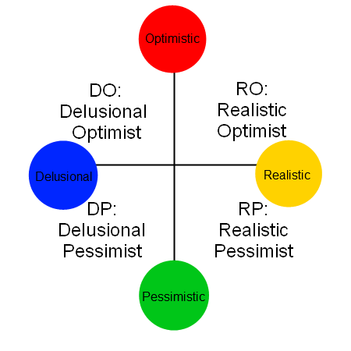
Pragmatic Optimist
© Ravi Sandhu
World-Leading Research with Real-World Impact!
2

Slide 3
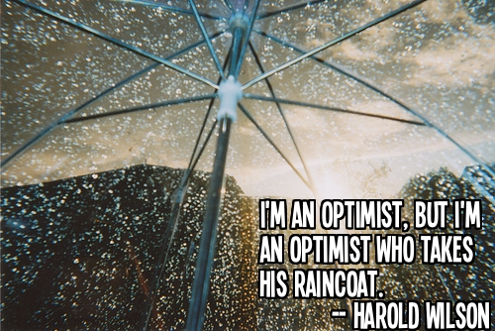
Pragmatic Optimist
© Ravi Sandhu
World-Leading Research with Real-World Impact!
3

Slide 4
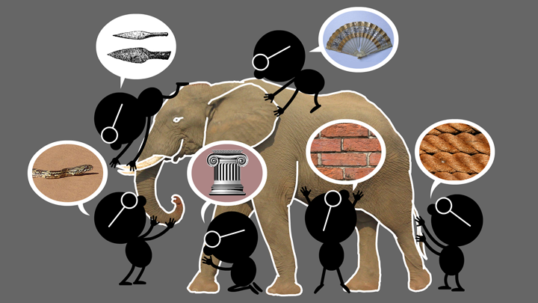
Elephant Problem
© Ravi Sandhu
World-Leading Research with Real-World Impact!
4

Slide 5
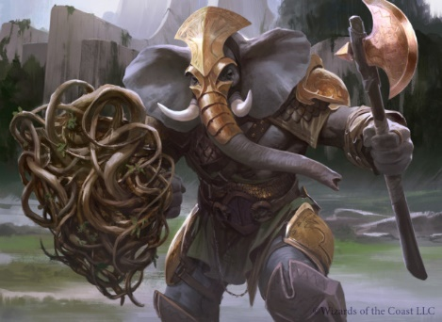
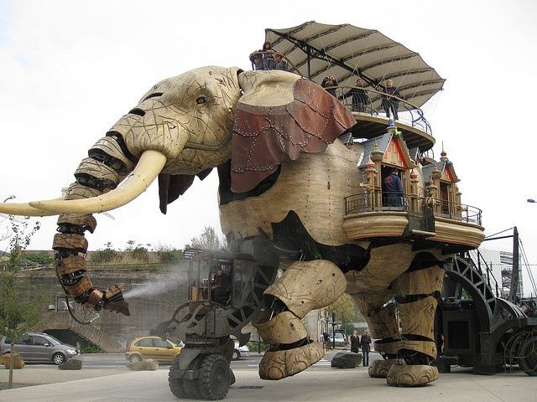

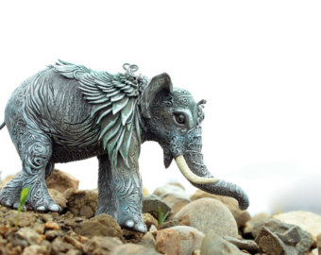
Cyber-Elephant Problem
© Ravi Sandhu
World-Leading Research with Real-World Impact!
5

Slide 6
What is Cyber?
Pre-Network
Age
Computer
Security
Communications
Security
Network
Age
Information
Security
Internet
Age
Cyber
Security
© Ravi Sandhu
World-Leading Research with Real-World Impact!
6

Slide 7
Security vis a vis Privacy
Security
Privacy
© Ravi Sandhu
World-Leading Research with Real-World Impact!
7

Slide 8
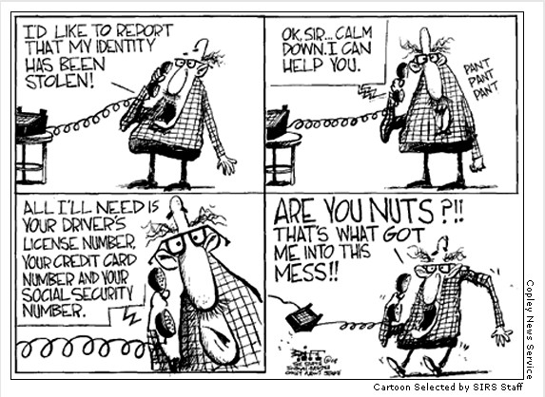
Security vis a vis Privacy
© Ravi Sandhu
World-Leading Research with Real-World Impact!
8

Slide 9
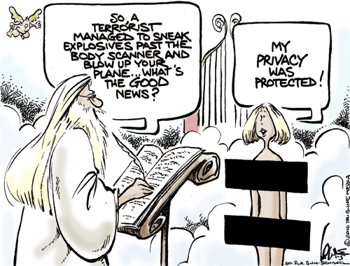
Security vis a vis Privacy
© Ravi Sandhu
World-Leading Research with Real-World Impact!
9

Slide 10
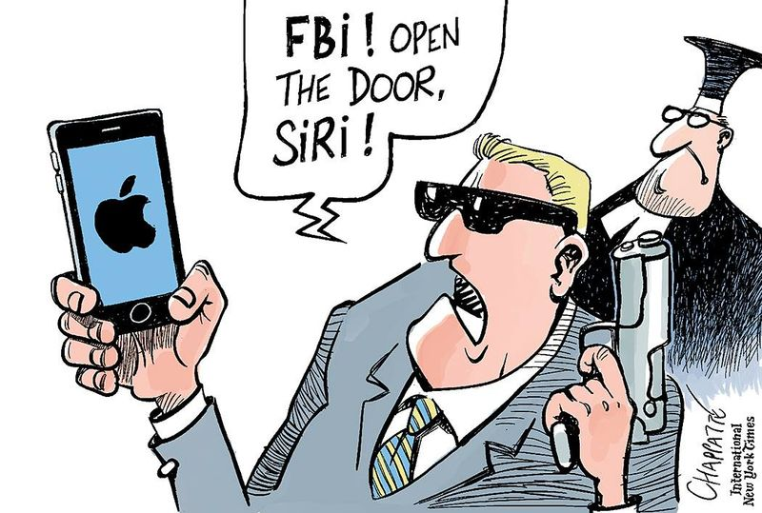
Security vis a vis Privacy
© Ravi Sandhu
World-Leading Research with Real-World Impact!
10

Slide 11
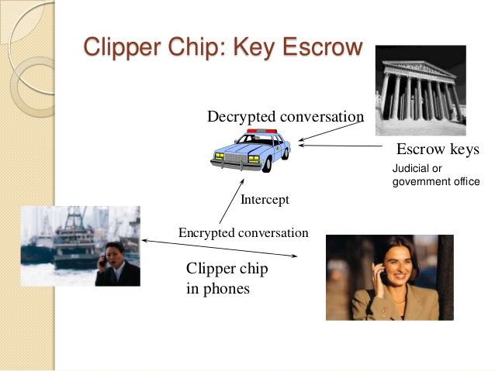
Clipper Chip 1993
© Ravi Sandhu
World-Leading Research with Real-World Impact!
11

Slide 12
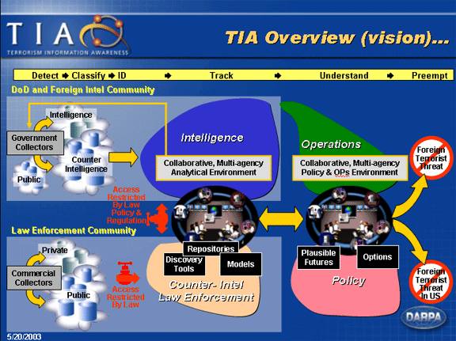
Total Information Awareness 2003
© Ravi Sandhu
World-Leading Research with Real-World Impact!
12

Slide 13
Security vis a vis Privacy
Security
Privacy
How can there be conflict from such a simple picture?
© Ravi Sandhu
World-Leading Research with Real-World Impact!
13

Slide 14
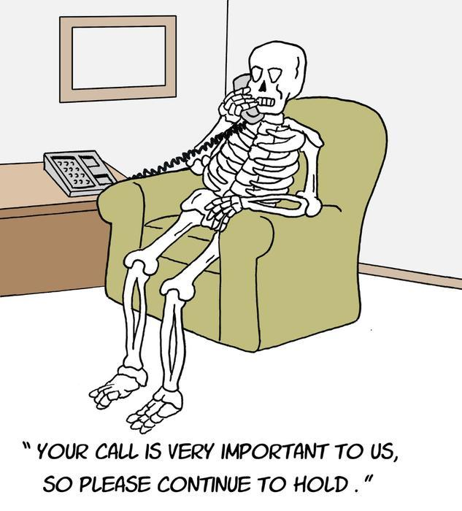

The Virtuous Cycle
© Ravi Sandhu
World-Leading Research with Real-World Impact!
14

Slide 15

The Virtuous Cycle
© Ravi Sandhu
World-Leading Research with Real-World Impact!
15

Slide 16
The Virtuous Cycle
Personal info
Delightful service
Aggregated
Analyzed
Modeled
© Ravi Sandhu
World-Leading Research with Real-World Impact!
16

Slide 17
The Virtuous Cycle
Personal info
Delightful service
Aggregated
Analyzed
Modeled
Misused?
Malicious
Negligent
Coerced
© Ravi Sandhu
World-Leading Research with Real-World Impact!
17

Slide 18
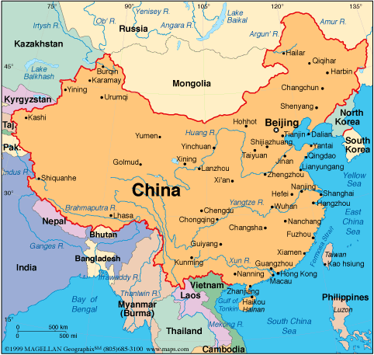
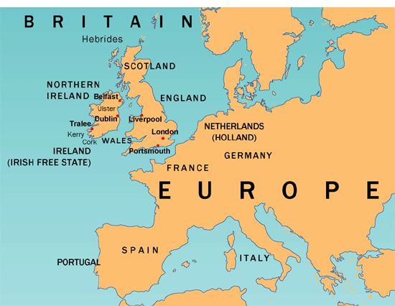
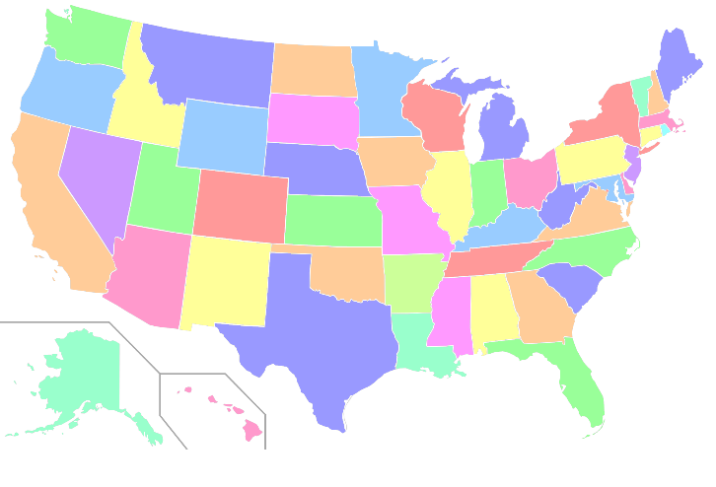
3 Ongoing Experiments
© Ravi Sandhu
World-Leading Research with Real-World Impact!
18

Slide 19
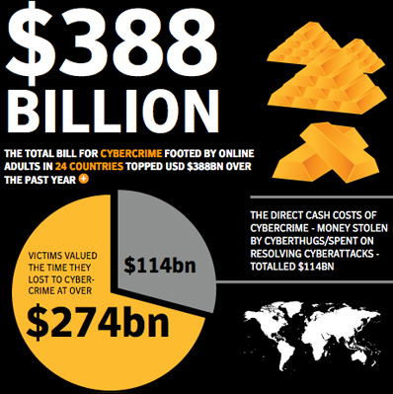
Money is the Easier Problem
© Ravi Sandhu
World-Leading Research with Real-World Impact!
19

Slide 20
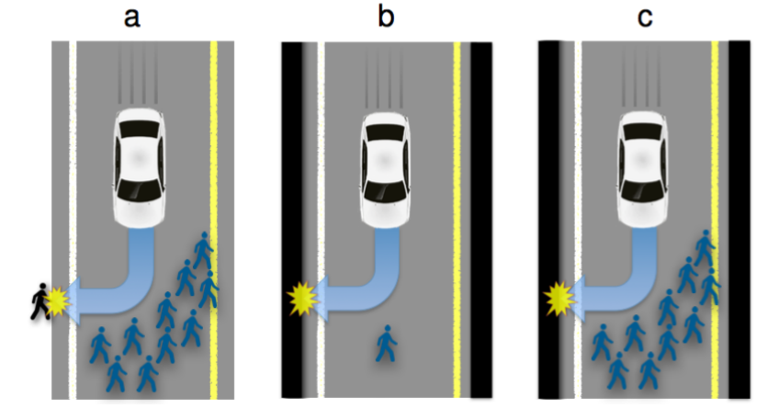
Machine Ethics
© Ravi Sandhu
World-Leading Research with Real-World Impact!
20

Slide 21
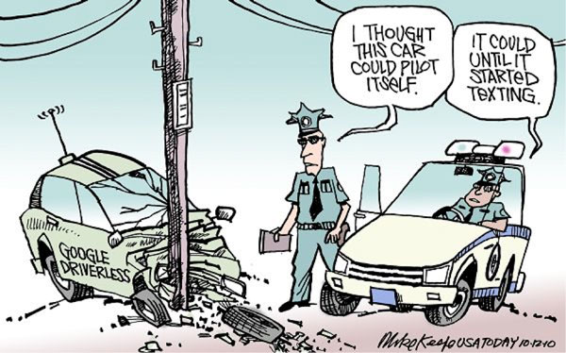
On a Lighter Note
© Ravi Sandhu
World-Leading Research with Real-World Impact!
21

