Slide 1
Authorization and Trust in the Cloud
Prof. Ravi Sandhu
Executive Director and Endowed Chair
USECSW
May 29, 2013
ravi.sandhu@utsa.edu
www.profsandhu.com
www.ics.utsa.edu
Joint work with
Bo Tang and Qi Li

Slide 2
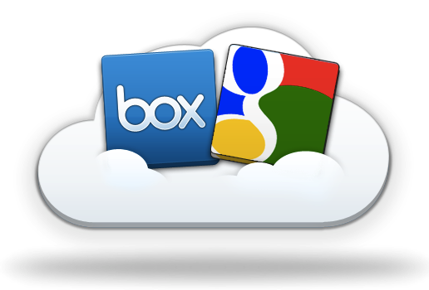
Cloud Computing
Shared infrastructure
  [$$$] -----> [$|$|$]
Multi-Tenancy
  Virtually dedicated resources
Drawbacks:
  Data Locked-in
    Collaborations can only be achieved through desktop.
    E.g.: open files in Box with GoogleDoc.
  How to collaborate?
Source: http://blog.box.com/2011/06/box-and-google-docs-accelerating-the-cloud-workforce/
Notes:
This kind of collaboration is not necessarily among parties. It could be among applications.
Subleasing an apartment for 2 rooms. A living room and a bedroom. Direct access in between.
E.g.: subleasing two rooms in an apartment.
One for storage, the other for living.
Direct accessible in between.

Slide 3
Collaborative Access Control
Centralized Facility
  Chance for centralized models in distributed systems
Agility
  Collaboration and collaborators are temporary
Homogeneity
  Handful of popular brands
Out-Sourcing Trust
  Built-in collaboration spirit
Notes:
This kind of collaboration is not necessarily among parties. It could be among applications.
Subleasing an apartment for 2 rooms. A living room and a bedroom. Direct access in between.
E.g.: subleasing two rooms in an apartment.
One for storage, the other for living.
Direct accessible in between.

Slide 4
Market Place
Microsoft and IBM: Fine-grained data sharing in SaaS using DB schema
  Only feasible in DB
NASA: RBAC + OpenStack
  Lacks ability to support collaborations
Salesforce (Force.com): SSO + SAML
  Focus on authentication
  Heavy management of certificates
Source: http://msdn.microsoft.com/en-us/library/aa479086.aspx
http://nebula.nasa.gov/blog/2010/06/03/nebulas-implementation-role-based-access-control-rbac/
http://wiki.developerforce.com/page/Single_Sign-On_with_SAML_on_Force.com

Slide 5
Literature
Problem:
semantic mismatch
RBAC
  CBAC, GB-RBAC, ROBAC
  Require central authority managing collaborations
Delegation Models
  dRBAC and PBDM
  Lacks agility (which the cloud requires)
Grids
  CAS, VOMS, PERMIS
  Absence of centralized facility and homogeneous architecture (which the cloud has)

Slide 6
Literature (Contd.)
  Role-based Trust
  RT, Traust, RMTN AND RAMARS_TM
  Calero et al: towards a multi-tenant authorization system for cloud services
    Implementation layer PoC
    Open for extensions in trust models
  Suits the cloud (out-sourcing trust)
Challenge:
trust relation

Slide 7









Multi-Tenant Authorization as a Service (MT-AaaS)
MT-AaaS
Multi-Tenant
Access Control
Cross-Tenant
Access

Slide 8
MTAS Trust Model
If A trusts B then B (resource owner) can assign
  B’s permissions to A’s roles; and
  B’s roles as junior roles to A’s roles.
Tenant A
Tenant B
If No trust
Resources
AuthStmts
Resources
AuthStmts
If A trust B
Resources
AuthStmts
Resources
AuthStmts
User
Notes:
Non-animation version

Slide 9
MTAS

Slide 10
MT-RBAC Trust Model
If B (resource owner) trusts A then A can assign
  B’s permissions to A’s roles; and
  B’s roles as junior roles to A’s roles.
Tenant A
Tenant B
If No trust
Resources
AuthStmts
Resources
AuthStmts
If B trust A
Resources
AuthStmts
Resources
AuthStmts
User
Notes:
Non-animation version

Slide 11
MT-RBAC

Slide 12
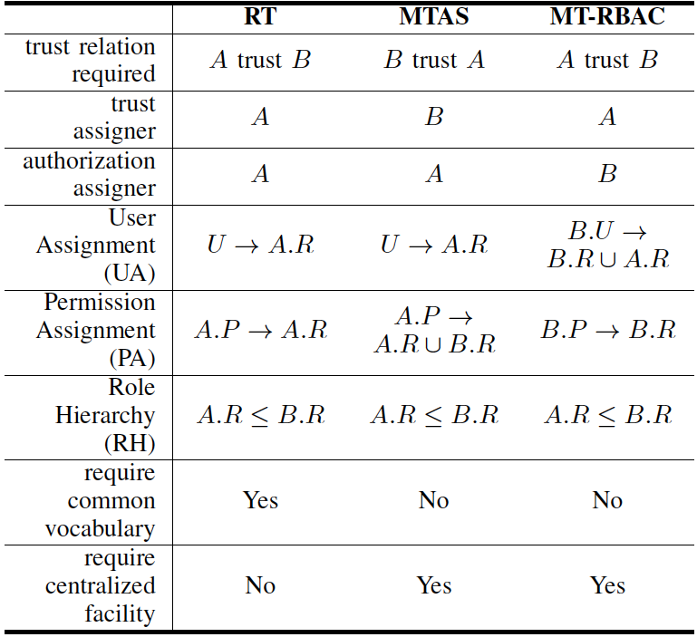
Trust Model Comparison
A: resource owner
B: resource requester

Slide 13
Finer-grained Trust Models

Slide 14
Constraints
Role Cycles: lead to implicit role upgrades in the role hierarchy.
SoD: conflict of duties
  Tenant-level
    E.g.: SOX compliance companies may not hire same the same company for both consulting and auditing.
  Role-level
    Across tenants
Chinese Wall: conflict of interests among tenants.

Slide 15
Collaboration Admin.
Decentralized management
  Trusters maintain the trust relation
Immediately effective when trust changes
  Automatic revocation of cross-tenant accesses
  Agility in cloud environments

Slide 16
PROTOTYPE AND EVALUATION
Cloud Service
  CloudStorage: an open source web based cloud storage and sharing system.
Authorization Service
  Centralized PDP
  Distributed PEP

Slide 17
Evaluation: Performance
MT-RBAC vs RBAC
  More policy references incur more decision time
MT-RBAC₂ introduces 6.82% overhead in average.
Performance comparison at PDP
File retrieval delay ratio introduced

Slide 18
Evaluation: Scalability
Scalable by either
  Enhancing PDP capability; or
  Increasing PEP amount.
Different Flavors of PDP
Different Numbers of PEP

Slide 19
Summary
Collaboration needs in the cloud eco-system
Novel service model: MT-AaaS
Proposed formal models
  MTAS
  MT-RBAC
  Constraints and administration
Prototype and evaluation
  Performance overhead ≤ 6.82%
  Scalable in the cloud
Trust Model Comparison

Slide 20
Future Work
OpenStack Keystone extensions
Integrate trust into ABAC: MT-ABAC
Unified trust framework for the cloud

Slide 21
Q & A
Bo Tang, Ravi Sandhu and Qi Li. Multi-Tenancy Authorization Models for
Collaborative Cloud Services. CTS, 2013.
Bo Tang, Qi Li and Ravi Sandhu. A Multi-Tenant RBAC Model for Collaborative
Cloud Services. PST 2013.

