Slide 1
Doctoral Research in Cyber Security:
A Personal Perspective
Ravi Sandhu
Professor of Computer Science
Lutcher Brown Chair in Cyber Security
Executive Director, ICS
Lead PI, NSF C-SPECC Center
April 2022
ravi.sandhu@utsa.edu
www.ics.utsa.edu
www.profsandhu.com

Slide 2
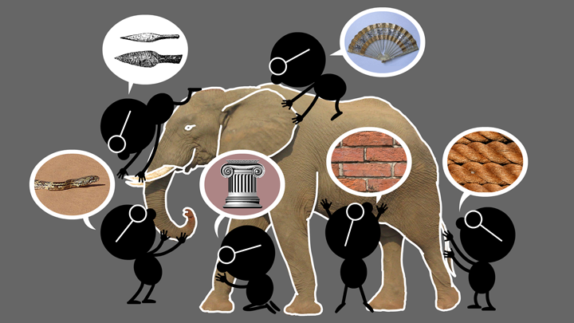

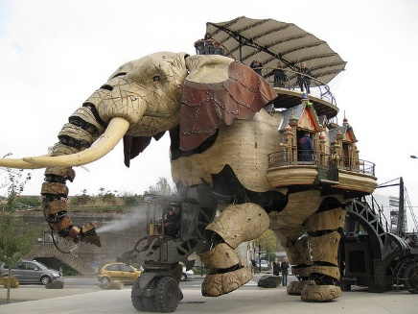


Natural vs Cyber Science
Elephant Problem
Cyber-Elephant Problem

Slide 3
Cyber Security Context
Science
Engineering
Business

Slide 4
Holistic Cyber Security Research
Objectives
POLICY
ATTACKS
Enable
What?
Why?
Respond
Enforce
Defend
PROTECT
How?
DETECT
Application
Context
Enterprise
Social
Cloud
IoT/CPS
Metaverse
…
Mechanisms
Complement

Slide 5
Access Control
Discretionary Access Control (DAC)
1970
Mandatory Access Control (MAC) 1970
Role Based Access Control (RBAC) 1995
Attribute Based Access Control (ABAC)
Relationship-Based Access Control (ReBAC)
Usage Control (UCON)
2020s (Hopefully)

Slide 6
Holistic Access Control Research
ABAC
ReBAC
RBAC
…
DAC
MAC
Convergent Access Control (CAC)
Application
Context
Enterprise
Social
Cloud
IoT/CPS
Metaverse
…
Access Control Policy Models
Access Control Enforcement Models

Slide 7
Cyber Security
Doctoral Research
Conceptual
Theory
Implementation

Slide 8
Cyber Security
Doctoral Research
Conceptual
OSI NW Stack
Theory
Implementation
P = NP?
RESTful API

Slide 9
Cyber Security
Dissertation Structure
Ch 1: Introduction/Problem Definition/Summary of Contributions
Thesis statement
Ch 2: Background/Related Work/Literature Survey
Ch 3:
Ch 4:
Ch 5:
Ch 6: Conclusion/Future Work
Appendices: if appropriate
original contributions
1-3 conference papers/chapter

